Slide 1

Presentation to
Travel Industry Trends & Best Practices
November 6, 2014

Slide 2


Slide 3
Tom McIntyre - President – Passageways division
Lisa Hoehn - Vice President national Corporate Sales
Kristina dunn - Director of corporate development
Introductions

Slide 4





Who We Are
Passageways Travel – Founded in 1980 by Tom McIntyre
ALTOUR Founded in 1991 by Alexandre Chemla
Combined forces in 2012
Over 1,200 Travel Professionals
Over $1.6 Billion Total Sales 2013
2013 – 13th Travel Weekly Power List of agencies nationwide
52 Offices in the US / UK / France– Global HDQ – New York City
Sister companies: ALTOUR AIR and ALTOUR Tech

Slide 5


Our Diverse Menu
Specializing in Corporate Travel Management

Slide 6

ALTOUR & American Express
ALTOUR is the largest member
of the American Express US Representative Travel Network.
Preferred hotel negotiated rates and car rental discount programs
Global travel consolidation and industry benchmarking data
Ability to book all American Express Card associated programs, Platinum, Centurion and Gold, to take advantage of promotions such as International 2 for 1 Air Program
“Pay with Points” - Members will be able to use points when booking through ALTOUR anytime, any place. Air – Cruise – Tour, etc. (No seat restrictions or blackout dates)
Card Members can earn points on American Express Vacation products
Through our affiliation with American Express, we are able to offer the “best of both worlds”:
the tools and programs of a “Mega Agency” and the reputable, excellent, individual service and customized program management of a privately, independently owned agency.

Slide 7


Slide 8



2014 Top Business Travel Trends

Slide 9
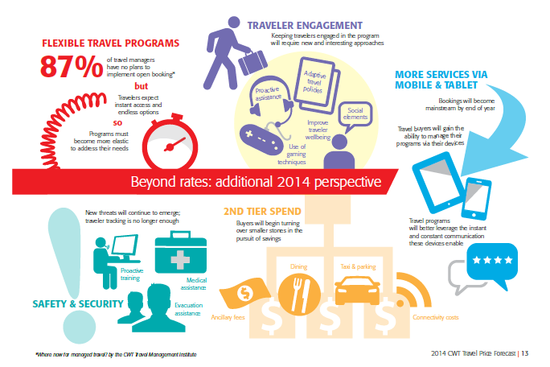
Beyond Rates: Additional 2014 perspective

Slide 10
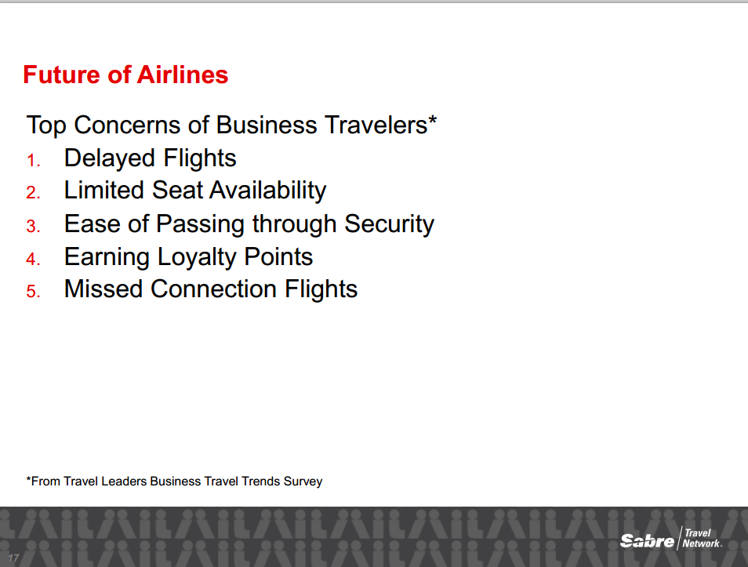

Slide 11
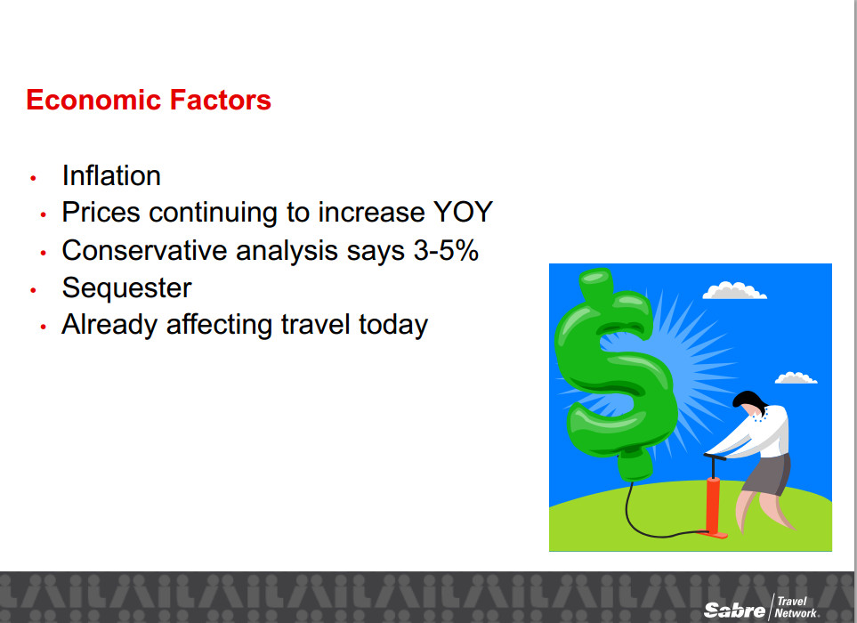

Slide 12
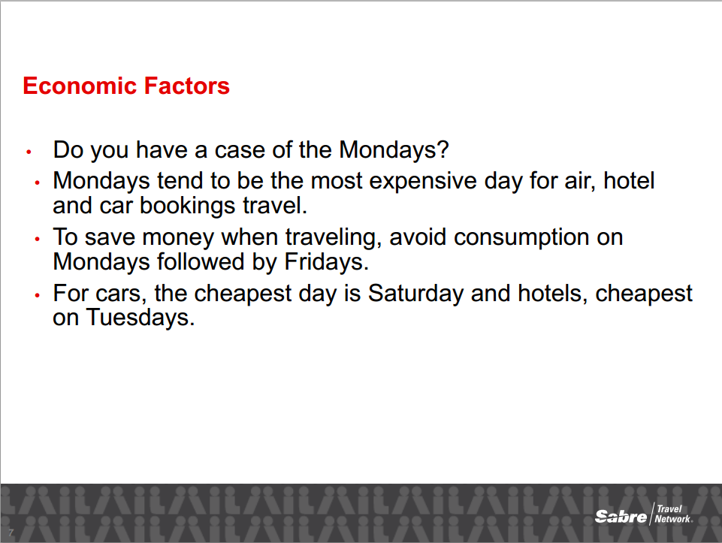

Slide 13


Slide 14


Slide 15
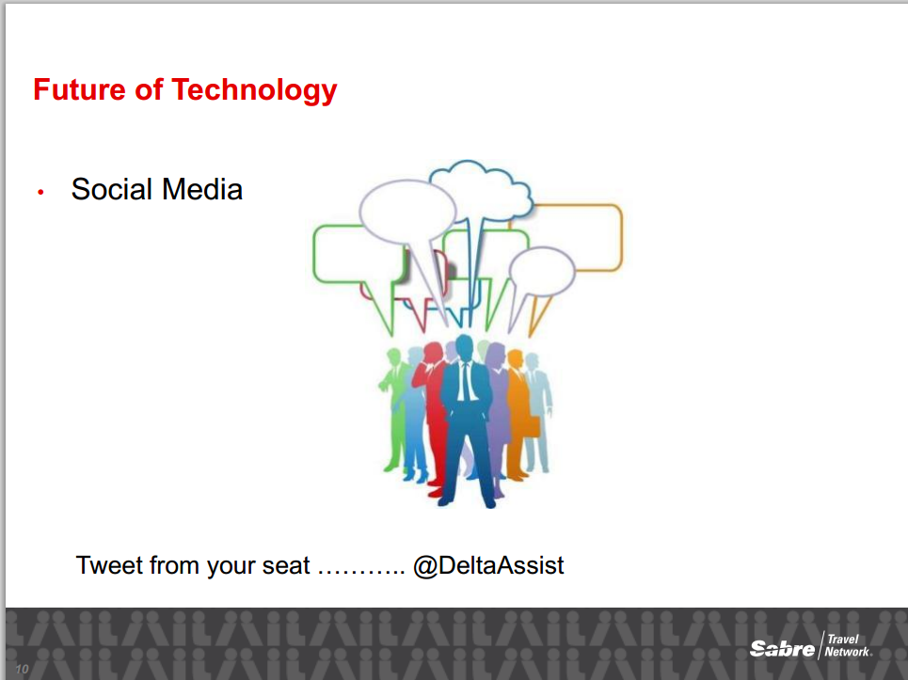

Slide 16
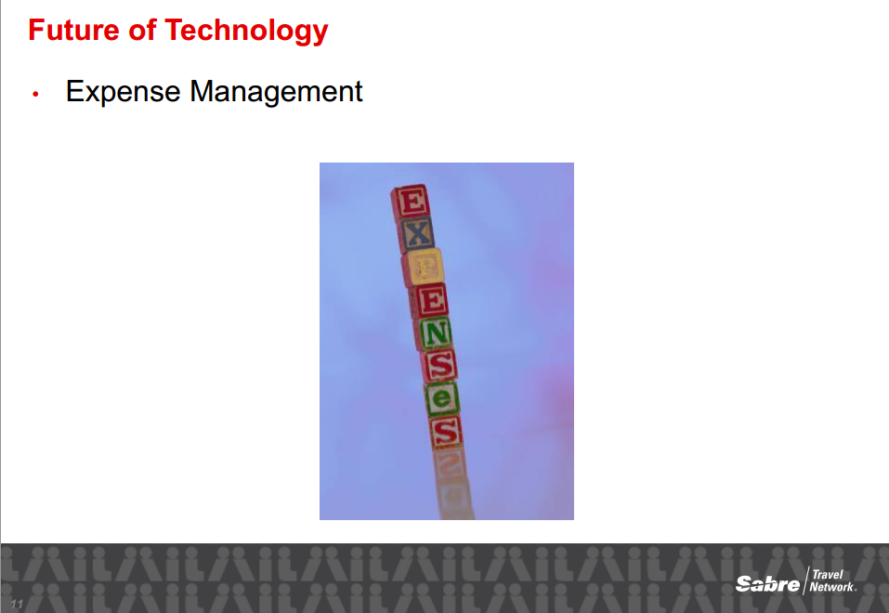

Slide 17
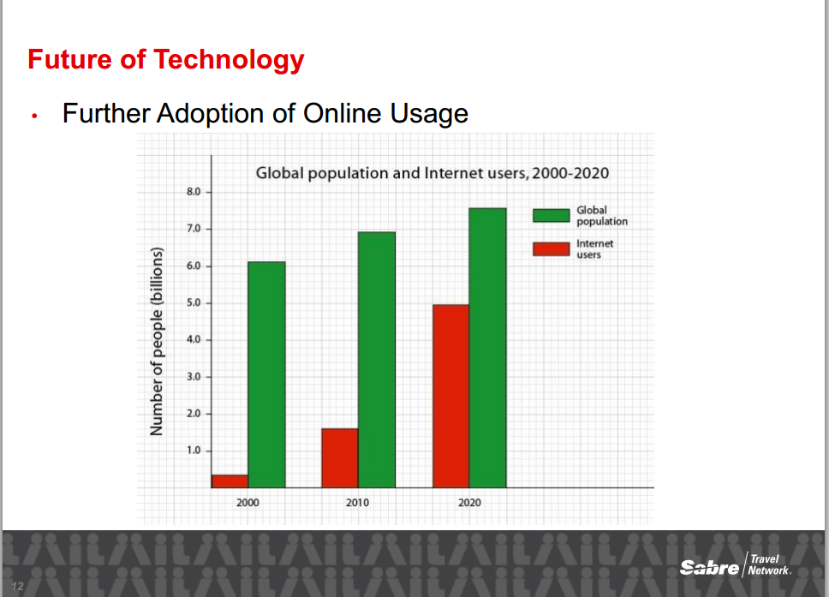

Slide 18
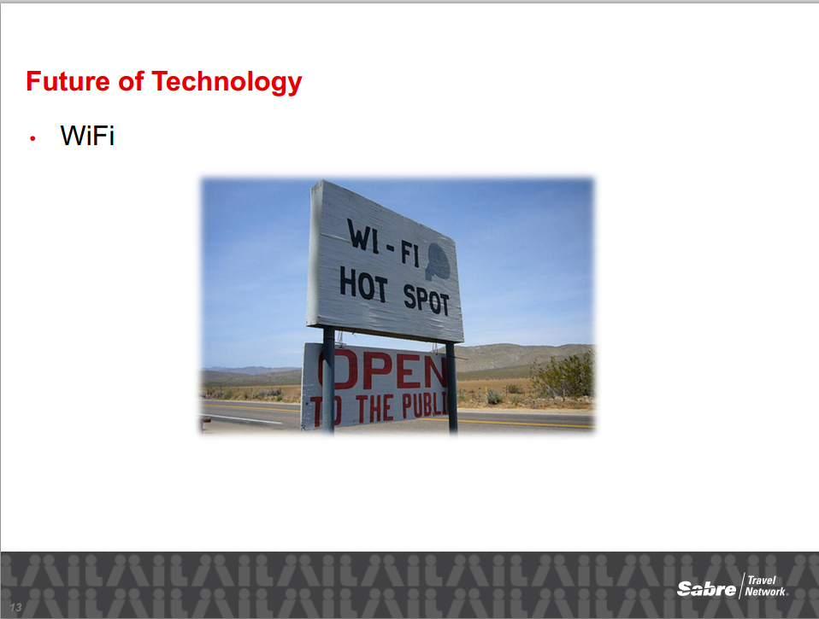

Slide 19
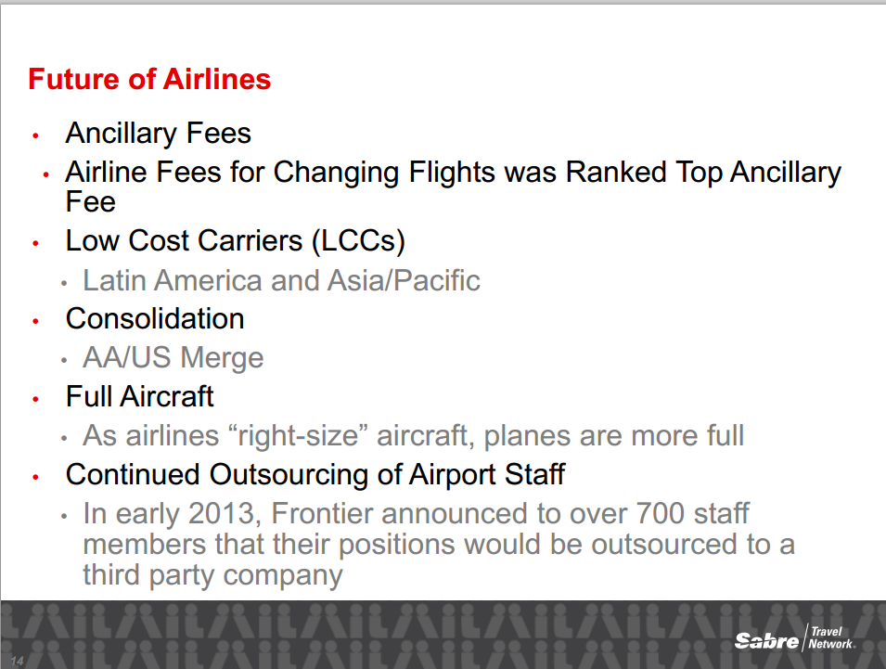

Slide 20
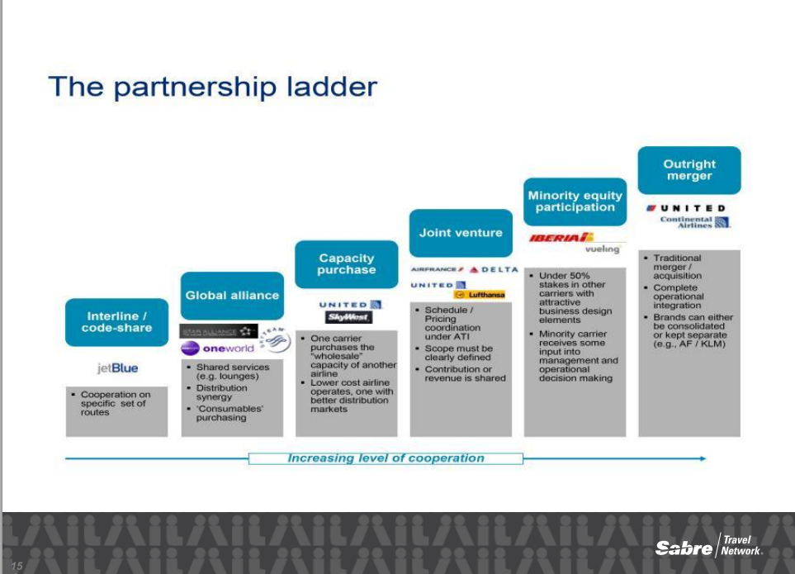

Slide 21
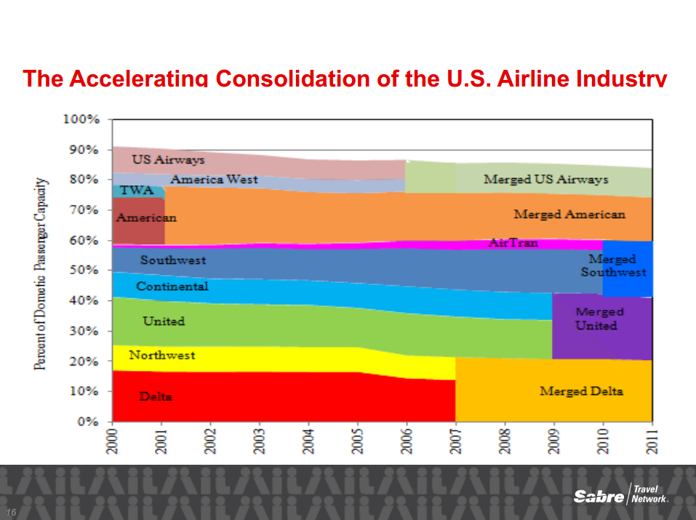
American Airlines Merged American
US Airways
2013

Slide 22
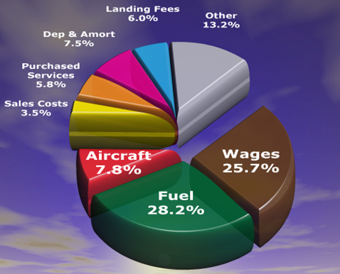
Airline Industry: Cost Drivers
Key Points
Top 3 Drivers Account For 64.3% of Total Airline Costs.
Cost Drivers
The top three cost drivers for ninety five percent of the world’s airlines, are: fuel, personnel and the cost of aircraft, which together account for an average of 64.3% of an airline’s total cost structure.
Dependence on oil production, labor agreements and a duopoly in aircraft manufacturing prevent airlines from having any substantive impact on these cost drivers.
With revenues fixed by competitive ticket pricing and the majority of their costs out of their control, airlines are challenged to maintain earnings and gain competitive advantage by controlling less than 35% of their cost structure.
Source: www.rajcoaviation.com

Slide 23
SAMPLE
Airline Industry: Baggage Fees
Baggage Fees by Airline 2013
Airlines ranked by 2013 baggage fee revenue, dollars in thousands (000)
Updated: May 5, 2014
Rank | Airline | 1Q | 2Q | 3Q | 4Q | 2013
1 | Delta | 191,986 | 217,072 | 226,243 | 197,882 | 833,183
2 | United | 143,252 | 158,012 | 170,186 | 153,371 | 624,821
3 | US Airways | 130,470 | 139,306 | 130,564 | 127,251 | 527,591
4 | American | 123,115 | 132,698 | 127,070 | 122,814 | 505,697
5 | Spirit | 47,741 | 53,499 | 57,488 | 53,233 | 211,961
6 | Southwest | 42,727 | 42,500 | 32,411 | 25,902 | 143,540
7 | Allegiant | 33,594 | 33,038 | 28,957 | 16,864 | 112,453
8 | Alaska | 20,671 | 24,249 | 28,580 | 22,533 | 96,033
9 | JetBlue | 17,893 | 17,863 | 19,622 | 18,938 | 74,316
10 | Hawaiian | 16,563 | 17,753 | 19,115 | 16,603 | 70,034
11 | Frontier | 14,212 | 14,186 | 18,659 | 22,169 | 69,226
12 | Virgin America | 12,205 | 15,557 | 16,149 | 14,614 | 58,525
13 | Sun Country | 4,926 | 3,592 | 3,825 | 3,238 | 15,581
14 | Mesa | 1,014 | 966 | 1,056 | 888 | 3,924
15 | Island Air Hawaii | 635 | 851 | 874 | 840 | 3,200
16 | American Eagle** | 0 | 0 | -13 | 0 | -13
 | All | 801,004 | 871,142 | 880,786 | 797,140 | 3,350,072
Source: Bureau of Transportation Statistics, Schedule P-1.2
* American Eagle's third-quarter 2013 report represents a baggage-handling expense and is subject to revision.
Source: www.bts.gov

Slide 24
SAMPLE
Airline Industry: Cancellation/Change Fees
Reservation Cancellation/Change Fees by Airline 2013
Airlines ranked by 2013 reservation cancellation/change fee revenue, dollars in thousands (000)
Updated: May 5, 2014
Rank | Airline | 1Q | 2Q | 3Q | 4Q | 2013
1 | Delta | 198,596 | 212,432 | 225,898 | 203,144 | 840,070
2 | United | 176,989 | 197,293 | 198,715 | 183,516 | 756,513
3 | American | 132,050 | 134,524 | 134,381 | 120,077 | 521,032
4 | US Airways | 83,584 | 84,352 | 81,602 | 77,791 | 327,329
5 | JetBlue | 36,727 | 34,733 | 36,306 | 38,668 | 146,434
6 | Alaska | 21,833 | 22,221 | 23,922 | 22,002 | 89,978
7 | Spirit | 7,962 | 7,816 | 8,165 | 8,602 | 32,545
8 | Virgin America | 7,723 | 8,280 | 8,302 | 7,918 | 32,223
9 | Southwest | 9,254 | 7,092 | 6,646 | 2,364 | 25,356
10 | Hawaiian | 4,672 | 4,293 | 4,596 | 4,370 | 17,931
11 | Frontier | 3,023 | 3,115 | 3,414 | 3,642 | 13,194
12 | Allegiant | 2,297 | 2,474 | 2,281 | 1,996 | 9,048
13 | Sun Country | 466 | 434 | 536 | 500 | 1,936
 | Island Air Hawaii | 128 | 123 | 107 | 122 | 480
 | All | 685,304 | 719,182 | 734,871 | 674,712 | 2,814,069
Source: Bureau of Transportation Statistics, Schedule P-1.2
Source: www.bts.gov

Slide 25
Airline Industry: Price of Air Travel versus Other Goods & Services
Price of Air Travel Versus Other Goods and Services
Product (Unit) | 1978* | 2000 | 2013 | 2013 vs. 1978 | 2013 vs. 2000
Walt Disney World (One Day Pass, Adult)⁰ | ​$6.50 | ​$46 | ​$95 | 1362% | 107%​
College Education: Public, Undergraduate (Year)¹ | $688 | $3,508 | $8,893 | 1193% | 154%​
College Education: Private, Undergraduate (Year)¹ | $2,958 | $16,072 | $30,094 | 917% | 87%​
National Football League Game (Ticket)⁹ | $9.67 | $48.97 | $81.54 | 743% | 67%​
Prescription Drugs (BLS Index)² | 61.6 | 285.4 | 442.58 | 618% | 55%​
Major League Baseball Game (Ticket)¹⁰ | $3.98 | $16.22 | $27.48 | 590% | 69%​
Gasoline (Gallon, Unleaded)⁴ | $0.67 | $1.51 | $3.53 | 426% | 134%​
​Vehicle (New)¹² | ​$6,470 | ​$24,923 | ​$31,762 | ​391% | 27%​
Single-Family Home (New)⁵ | $55,700 | $169,000 | $265,900 | 377% | 57%​
Consumer Price Index (CPI-U)2 | 65.2 | 172.2 | 232.957 | 257% | 35%​
Movie Ticket⁶ | $2.34 | $5.39 | $8.13 | 247% | 51%​
​Food & Beverage (BLS Index) | ​72.183 | ​168.35 | 237.0​ | 228%​ | 41%​
Postage Stamp (First-Class)⁷ | $0.15 | $0.33 | $0.46 | 207% | 39%​
Whole Milk (Index)² | 81 | 156.9 | 214.68 | 165% | 37%​
​Air Travel (R/T Domestic Fare + Ancillary)⁸ | ​$187 | $316.96 | $385.32​ | 106%​ | 22%​
Air Travel (R/T Domestic Fare Only)⁸ | $186 | $314.46 | $362.85 | 95% | 15%​
Apparel: Clothing/Footwear/Jewelry (BLS Index)² | 81.3 | 129.6 | 127.41 | 57% | -2%​
Television (BLS Index)² | 101.8 | 49.9 | 4.58 | -96% | -91%​
Cable TV (Monthly)¹¹ | ​N/A | ​$31.22 | ​$65.07 | ​N/A
AllEars.net – based on June of each year
1. The College Board – based on beginning of academic year
2. U.S. Bureau of Labor Statistics – includes hedonic “quality-change” adjustments
3. National Automobile Dealers Association – average retail selling price
4. U.S. Department of Energy – Monthly Energy Review, Table 9.4
5. U.S. Census Bureau – median sales price of new homes sold in the United States, including the land
6. National Association of Theatre Owners
7. U.S. Postal Service – Publication 100
8. A4A via U.S. Bureau of Transportation Statistics – shown on a round-trip basis; first column reflects 1979 (1978 data not available)
9. Team Marketing Report Fan Cost Index, average nonpremium ticket
10. Team Marketing Report Fan Cost Index, average nonpremium ticket​​​
11. Federal Communications Commission – 2013 estimated based on growth rate from 2009-2012
12. NADA DATA 2014
* Domestic fare data commences in 1979; international fare data commences in 1990
Sources: Airlines for America: www.airlines.org

Slide 26
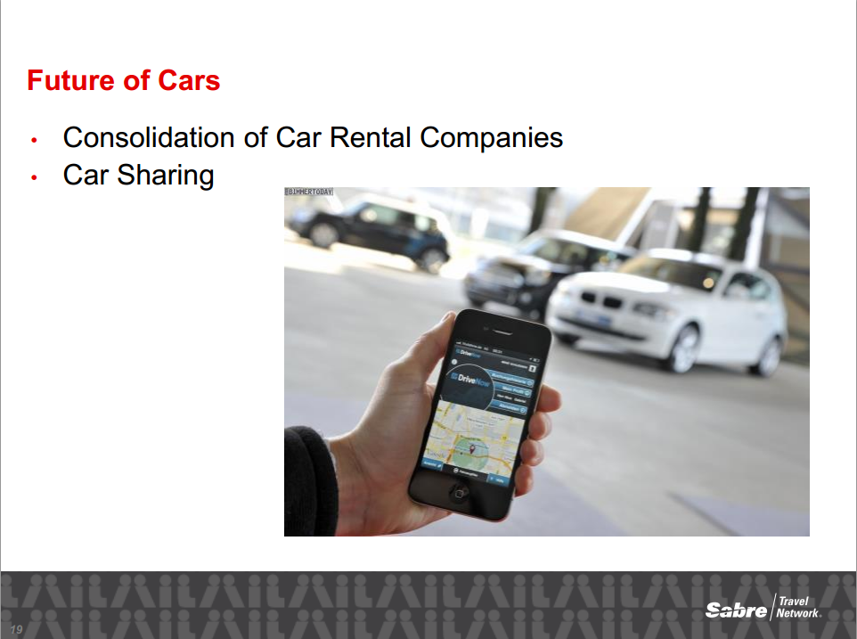

Slide 27
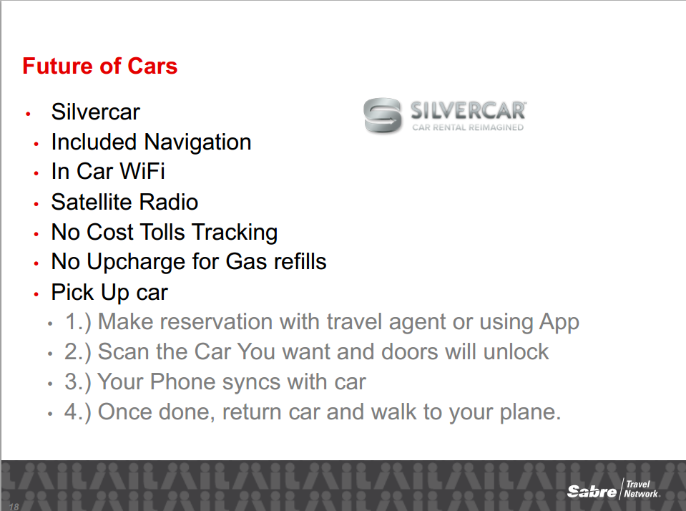

Slide 28
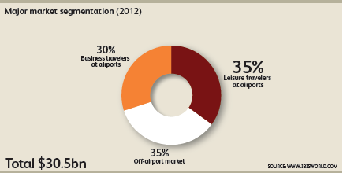
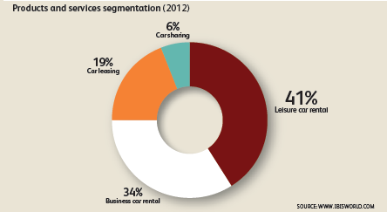
Car Rental Industry: Overview
SAMPLE
Key Points
Global industry spend is $30.5 Billion of which 34% is business travel
The industry is segmented by business travelers, leisure travelers, car leasing and car sharing
Leisure market has grown larger than corporate business market
Industry revenue is forecasted to increase 2% for the next 5 years
High fuel cost is impacting industry as customers, especially leisure travelers, are finding other alternatives (public transportation)
Hertz and Avis expanding off-airport locations to compete with Enterprise
Car rental industry adjusted to global recession better than other travel industry categories. They can “right” size fleet to meet demand by disposing vehicles quickly and reduce costs.
Source: IBISWORLD, Auto Rental News, Business Travel News

Slide 29
The PPI for passenger car rentals has gone up 22% from 2005 to 2008 indicating increased fleet and fuel cost. In 2008 and 2009, prices have slightly increased and since 2011 prices are still dropping significantly.
Rental Car Industry: PPI
– Passenger Car Rental
NAICS 532111 All indexes are subject to revision four months after original publication.
Source: http://www.bls.gov/ppi/

Slide 30
Car Rental Industry: Market Share
The U.S. car rental market is highly consolidated among a small
number of major players and is getting smaller.
Top 4 Car Rental Companies By Revenue
Key Points
After Hertz’s purchase of Dollar Thrifty, the top three rental car companies will make up 95% of the total on-airport US car rental industry revenues
Suppliers offer different brands that focus on specialized markets:
  Corporate Traveler – On-airport convenience – Hertz, Avis and National
  Leisure Market – On/Off-airport Budget, Dollar Thrifty, and Enterprise
Additional Non-US regional players include:
  Europcar (Europe and Asia Pacific)
  Sixt (Germany and EMEA)
In high risk countries such as India, China, Thailand, Latin America, etc. the business model is to rent a car with driver. Cost is less than a chauffer / limo as a typical rental vehicle is used
Car rental companies have implemented a variety of new ancillary fees to help preserve some of the lost revenue in recent times, such as tacking on fees to extend a reservation, eliminating 60 minute grace period, or increasing the cost of a two-day rental
“Virtual rental technology” – enables customers to reserve, rent, access and return cars just about anywhere. ZipCar, WeCar, Connect.
It is forecasted that that base rates will increase on average between 0% to 2% for business travel rental cars in the U.S. next year. This is big news since US suppliers haven’t been able to increase rates, even slightly. This is due to increasing fleet costs for car rental providers, as their used vehicles sell for less than in recent years as consumers shift toward buying more new and fewer used vehicles. Even so, the highly consolidated market will retain strong competition among suppliers in 2014.
Source: www.autorentalnews.com, Business Travel News Corporate Travel Index 2012

Slide 31
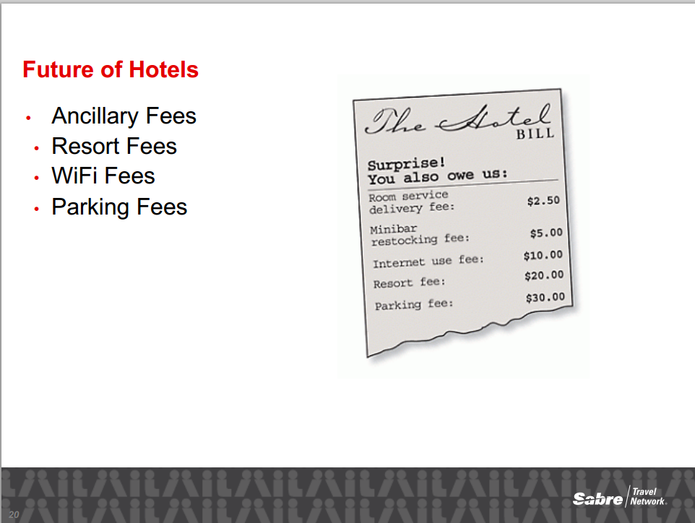

Slide 32
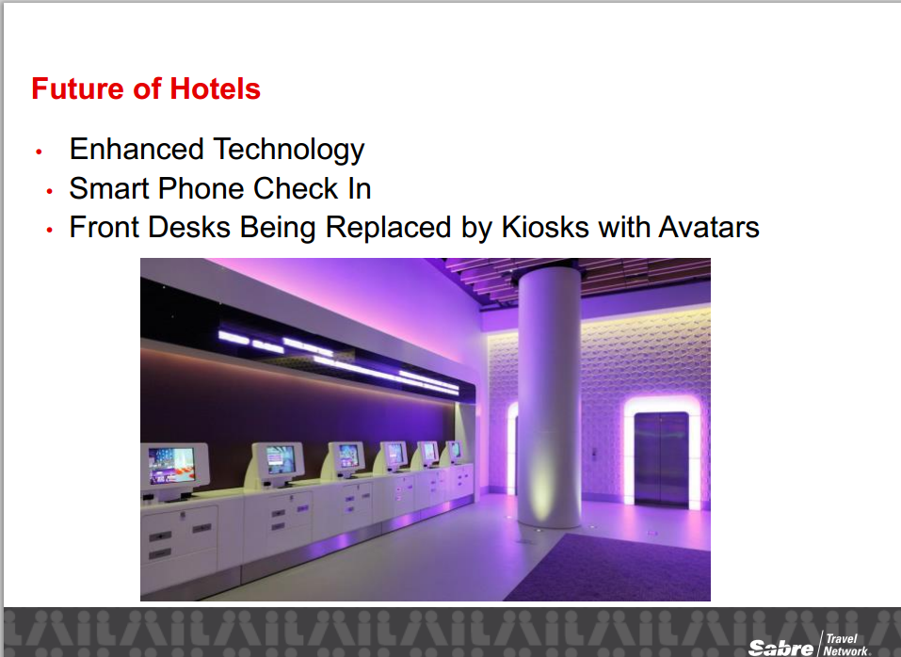

Slide 33
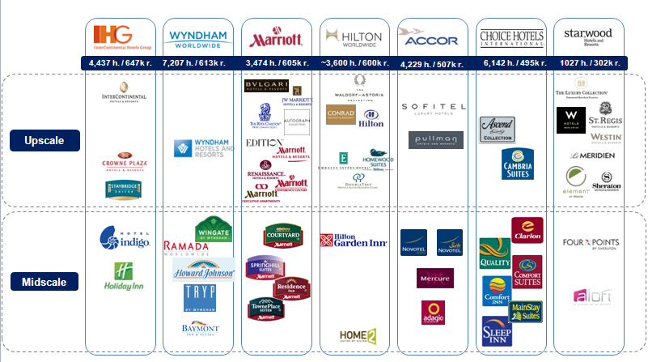
Hotel Industry: Chains / Brands
The majority of the global branded properties and revenue are mostly located in North America,
Key Points
The majority of the global branded properties and revenue are mostly located in North American
Major revenue for global chains (such as Marriott, Hilton, etc.) is from franchise and management fees.
Business travelers, including executives, are shifting from luxury hotels to more moderate mid-priced hotels
Hotel taxes, usually a combination of sales and occupancy taxes along with the occasional flat fee, range from 10% to more than 18%.
Hotel costs represent the single largest component of non-air expenses, about 43% of the travel dollar
Brands by Service Level
Source: PWC Hospitality Directions, Smith Travel Research, CWT Hotel Solutions, Business Travel News, IBISWorld
SAMPLE

Slide 34
The PPI for hotel rooms have fluctuated during 2012 due to pressures from both buyers and sellers. The 2013 average is 134.7, indicating rates are continuing to rise.
Hotel Industry: PPI –
Hotels & Motels, Room Rentals
NAICS 721110.1 All indexes are subject to revision four months after original publication.
Source: http://www.bls.gov/ppi/

Slide 35
Case for Managed Travel Programs

Slide 36
Travel Industry: Overview
The Top 50 travel management companies represent over $160 billion in sale revenue
Key Points
2013 Top 5 (over $1B in revenue) Travel Management Co’s By Revenues
The top 50 travel management companies represent over $160 billion in sales revenue in 2013.
Five companies registered more than $20 billion in sales, including a snowballing Priceline, which showed significant increases each year.
There were 16 listees with sales of more than $1 billion, up from 14 last year.
Expedia, Priceline, AAA Travel, and Travelong receive 90% or more sales revenue from the leisure market.
Many of the listees registered surges in year-over-year sales, a couple by acquisitions but most by generating additional revenue from existing clients or winning new clients.
Expedia regained top slot over Priceline, Carlson & American Express 2013.
Source: www.travelweekly.com Travel Weekly Power List 2012, www.bts.gov

Slide 37

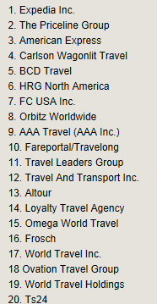
Overview of Company
2014 Power List

Slide 38
Industry Profile - Objective & Key Questions
  Objective
  Develop an understanding of the current business travel environment as well as the forces shaping future travel services. The results of this profile will shape the your Travel Sourcing Strategy.
  Key Questions
    What is the average spend for your peers?
    Who are the leaders?
    realistic objectives based on best practices?
    What are the key cost drivers?
    Are peers in a state of growth or decline?
    What are the current travel pricing trends?

Slide 39
10 Best Practices for a Managed Travel Program
Select an appropriate travel management company
Develop a travel policy
Provide training to your travelers
Identify vendors who may offer savings
Collect travel data and reports
Determine level of “Travel Mandate”
Understand your Duty of Care requirements
Determine a payment program
Plan travel oversight
Reevaluate your plan at least every two years

Slide 40
Strategy Considerations
Examine current travel policies. Enforcement of on-line booking tool, advance booking, preferred hotels and other travel guidelines will result in significant savings.
Evaluate your air spend and determine if there are opportunities to negotiate for airline savings – including airline programs designed for small business.
Re-examine preferred hotel program opportunities and consolidate markets and room nights to leverage buying power where appropriate
Leverage hotel spend for meetings/events in negotiating hotel rates for transient travel
Preferred car rental utilization is “best in class”, therefore consider a competitive bid to leverage utilization
Consider utilizing teleconferencing as an alternative to reduce overall travel usage

Slide 41
High Level Travel Project Plan
Travel Workplan Review
April
May
June
July
August
September
Determine process for program implementation
Profile Objectives Internally & Externally
Develop Procurement Strategy
Screen Suppliers & Selection Factors
Select TMC or Issue RFP
Negotiate & Develop Sourcing Recommendation
Implement Agreement
Notes:
Tony

Slide 42
Concur Travel & Expense:
A Best Practice Travel Management and Expense Tool

Slide 43
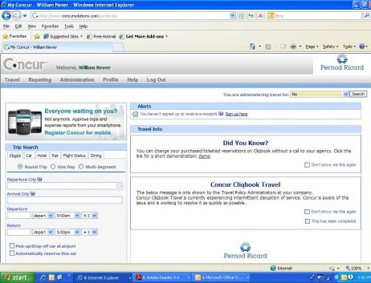

Concur Online Booking
Fully Customized
Preferred Vendors
Corporate Policies
Expense Report Management
Contract Rates
Quality Assurance
Web Connect Fares
Training & support
Key benefits of Concur tool
Multiple travelers on one reservation
Unused ticket tracking
Southwest reservations
Hold feature
Change feature
Taxi, ground transportation, and long term parking
GoGo In-flight internet passes for discounted rate
Electronic receipts for cars and hotels
Mobile applications
Additional discounts for cars and hotels
Many policy and approval capabilities

Slide 44
Thank you!
Closing – q&A

