Slide 2
Health Care Reform Update:
Where we have been and Where we are going
Justin W. Spewock, LIC, CGBM, CEO
Ballard Benefit Works, Inc.

Slide 3
The materials and information have been prepared for informational purposes only.
This is not legal advice, nor intended to create or constitute a lawyer-client relationship.
Before acting on the basis of any information or material, readers who have specific questions or problems should consult their lawyer.

Slide 4
Agenda
What is the legal status of the law?
Which plans must comply?
Reforms currently in place
2013 compliance deadlines
Future compliance deadlines
Questions

Slide 5
Legal Status of Health Care Reform Law

Slide 6
Health Care Reform
Affordable Care Act enacted in March 2010
Patient Protection and Affordable Care Act (March 23)
Health Care and Education Reconciliation Act (March 30)
Makes significant changes to health care system and coverage rules over several years
Provisions for:
Health insurance issuers
Employers
Health plan sponsors

Slide 7
What Will Be Next?
Implementation of health care reform law continues as scheduled for now
Supreme Court upheld law as constitutional in June 2012
November 2012 elections maintained political status quo
Changes to law may come from Congress
Some changes already made
Democrats will oppose any major changes, and President Obama has promised to veto
Courts will address other aspects of the law
For example, courts have ruled on the law’s contraceptive coverage mandate, with mixed results on whether employers must comply

Slide 8
Which Plans Must Comply?

Slide 9
Plans Subject to Health Care Reform
Health care reform’s health plan rules generally apply to group health plan coverage
Exceptions
Excepted benefits
Retiree-only plans
Group health plans covering fewer than 2 employees
Excepted Benefits
Accident or disability income coverage
Separate dental and vision plans
Liability insurance
Some FSAs

Slide 10
Grandfathered Plans
Grandfathered plan: group health plan or health insurance coverage in which an individual was enrolled on March 23, 2010
Certain health care reform provisions don’t apply to grandfathered plans, even if coverage is later renewed
A plan can lose grandfathered status by making too many changes to benefits or costs
Plans will have to analyze status and changes at each renewal

Slide 11
Which Rules Don’t Apply to Grandfathered Plans?
Patient protections
Nondiscrimination rules for fully-insured plans
Preventive care coverage
New appeals process
Quality of care reporting
Insurance premium restrictions
Guaranteed issue and renewal of coverage
Nondiscrimination based on health status/in health care
Comprehensive health insurance coverage
Limits on cost-sharing
Coverage for clinical trials

Slide 12
Reforms Currently in Place

Slide 13
Provisions Effective before 2013
Small employer tax credit
Dependent coverage up to age 26
No lifetime limits/restrictions on annual limits
No rescissions
No pre-existing condition exclusions for children
No cost-sharing for preventive care services (non-GF plans)
Appeals process changes (non-GF plans)
No reimbursement for OTC medicine or drugs (without a prescription)
Medical loss ratio rules
Form W-2 reporting

Slide 14
Provisions Effective in 2013
Uniform Summary of Benefits and Coverage (SBC) requirement
No cost-sharing for preventive care services for women
Increased Medicare tax
Health FSA contribution limits
Whistleblower protections
Patient-Centered Outcomes Research Institute Fees (PCORI) Fees
Notice of Exchange

Slide 15
2013 Compliance Deadlines

Slide 16
Summary of Benefits and Coverage
Simple & concise explanation of benefits and costs
Template provided
Can provide in paper or electronic form
Applies to:
Issuers and health plans (plan sponsors)
GF and non-GF plans
No duplication required: if issuer provides to enrollees, plan doesn’t have to
Providing to participants and beneficiaries
1st day of 1st open enrollment period on/after Sept. 23, 2012
1st day of 1st plan year on/after Sept. 23, 2012 (for other enrollment)
Must provide at various points thereafter

Slide 17
SBC Standards
Appearance
Cannot be longer than 4 double-sided pages
12-point or larger font
May be color or black and white
Paper or electronic form
Template available
Language:
Easily understood language
“Culturally and linguistically appropriate manner” – interpretive services and written translations upon request
Translations are available

Slide 18
SBC Content
Uniform definitions of standard terms
Description of plan’s coverage
Exceptions and limitations
Cost-sharing provisions
Renewability and continuation
Coverage examples
Required statements and contact information
Internet address for obtaining the uniform glossary of terms

Slide 19
60-Day Notice Rule
Effective once SBC rule is effective for a plan
Material modifications not in connection with renewal must be described in a summary of material modifications (SMM) or an updated SBC
Must be provided at least 60 days BEFORE modification becomes effective
Material modification:
Enhancement of covered benefits or services
Material reduction in covered benefits or services
More stringent requirements for receipt of benefits

Slide 20
Preventive Care for Women
New guidelines for preventive care for women on Aug. 1, 2011
Must provide coverage for women’s preventive health services without any cost-sharing
Applies to non-GF plans
No deductible, copayment or coinsurance
Effective for plan years beginning on or after Aug. 1, 2012

Slide 21
Covered Health Services
Well-women visits
Gestational diabetes screening
HPV DNA testing
Sexually transmitted infection counseling
HIV screening and counseling
Breastfeeding support, supplies and counseling
Domestic violence screening and counseling
Contraceptives and contraceptive counseling (certain exceptions apply to religious employers)

Slide 22
Increased Medicare Tax
Medicare tax rate to increase for high-earners for 2013 tax year
0.9 percent increase (from 1.45 percent to 2.35 percent)
High-earner threshold
Single: $200,000
Married : $250,000
Individual liability for tax depends on filing status and household income
Employer responsibilities
Withhold additional amounts from wages in excess of $200,000
No requirement to match additional tax
No requirement to notify employees

Slide 23
Health FSA Limits
Before health care reform
No limit on salary reductions
Many employers imposed limit
Beginning with 2013 plan year, limit is $2500/year
Limit is indexed for inflation for later years
Per FSA limit
Does not apply to dependent care FSAs

Slide 24
Whistleblower Protections
OSHA final rule clarifies protections for employees under ACA
Employers may not retaliate against employees for:
Providing information or filing a complaint regarding ACA violations
Objecting to or refusing to participate in violations of the ACA
Receiving a premium credit or subsidy for coverage though an Exchange
Employees can file complaints with OSHA if they experience retaliation
Discharge, demotion, discipline, etc.

Slide 25
PCORI Fees
Apply to plan years ending on or after Oct. 1, 2012
End with the 2018 plan year – do not apply for plan years ending on or after Oct. 1, 2019
Paid annually on Form 720 by July 31 each year
Amount of fees
2012 plan year: $1 x average number of covered lives
2013 plan year: $2 x average number of covered lives
2014 and beyond: increase based on National Health Expenditures
Who pays?
Insurance carriers and self-funded plan sponsors
Special rule for HRAs

Slide 26
Notice of Exchange
Employers subject to the FLSA must notify new and current employees of Exchange information
New employees beginning Oct. 1, 2013 (within 2 weeks)
Current employees no later than Oct. 1, 2013
Notice must include information about:
Existence of health benefit Exchange and services provided
Potential eligibility for subsidy under Exchange
Risk of losing employer contribution if employee buys coverage through an Exchange
Model notice available (will need some customization)
Notice can be provided by mail or electronically (if DOL requirements met)

Slide 27
Federal Income Poverty Levels (48 Contiguous States)
Household Size | 100% | 133% | 150% | 200% | 300% | 400%
1 | $11,490 | $15,282 | $17,235 | $22,980 | $34,470 | $45,960
2 | 15,510 | 20,628 | 23,265 | 31,020 | 46,530 | 62,040
3 | 19,530 | 25,975 | 29,295 | 39,060 | 58,590 | 78,120
4 | 23,550 | 31,322 | 35,325 | 47,100 | 70,650 | 94,200
5 | 27,570 | 36,668 | 41,355 | 55,140 | 82,710 | 110,280
6 | 31,590 | 42,015 | 47,385 | 63,180 | 94,770 | 126,360
7 | 35,610 | 47,361 | 53,415 | 71,220 | 106,830 | 142,440
8 | 39,630 | 52,708 | 59,445 | 79,260 | 118,890 | 158,520
For each additional person, add | $4,020 | $5,347 | $6,030 | $8,040 | $12,060 | $16,080

Slide 28
2014 Compliance Deadlines

Slide 29
Individual Mandate
Effective Jan. 1, 2014: Individuals must enroll in health coverage or pay a penalty
Penalty amount: Greater of a flat dollar amount or a percent of income
2014 = $95 or 1%
2015 = $325 or 2%
2016 = $695 or 2.5%
Family penalty capped at 300% of the adult flat dollar penalty or “bronze” level Exchange premium
Some exceptions apply

Slide 30
Health Insurance Exchanges
Health insurance Exchanges will be established in each state (by the state or the federal government)
State action:
17 (and D.C.) declared state-based Exchange
7 planning Partnership Exchange
26 default to federal Exchange
Deadlines:
Open enrollment: 10/1/13
Fully operational: 1/1/14
Model Notice: http://www.dol.gov/ebsa/pdf/FLSAwithplans.pdf

Slide 31
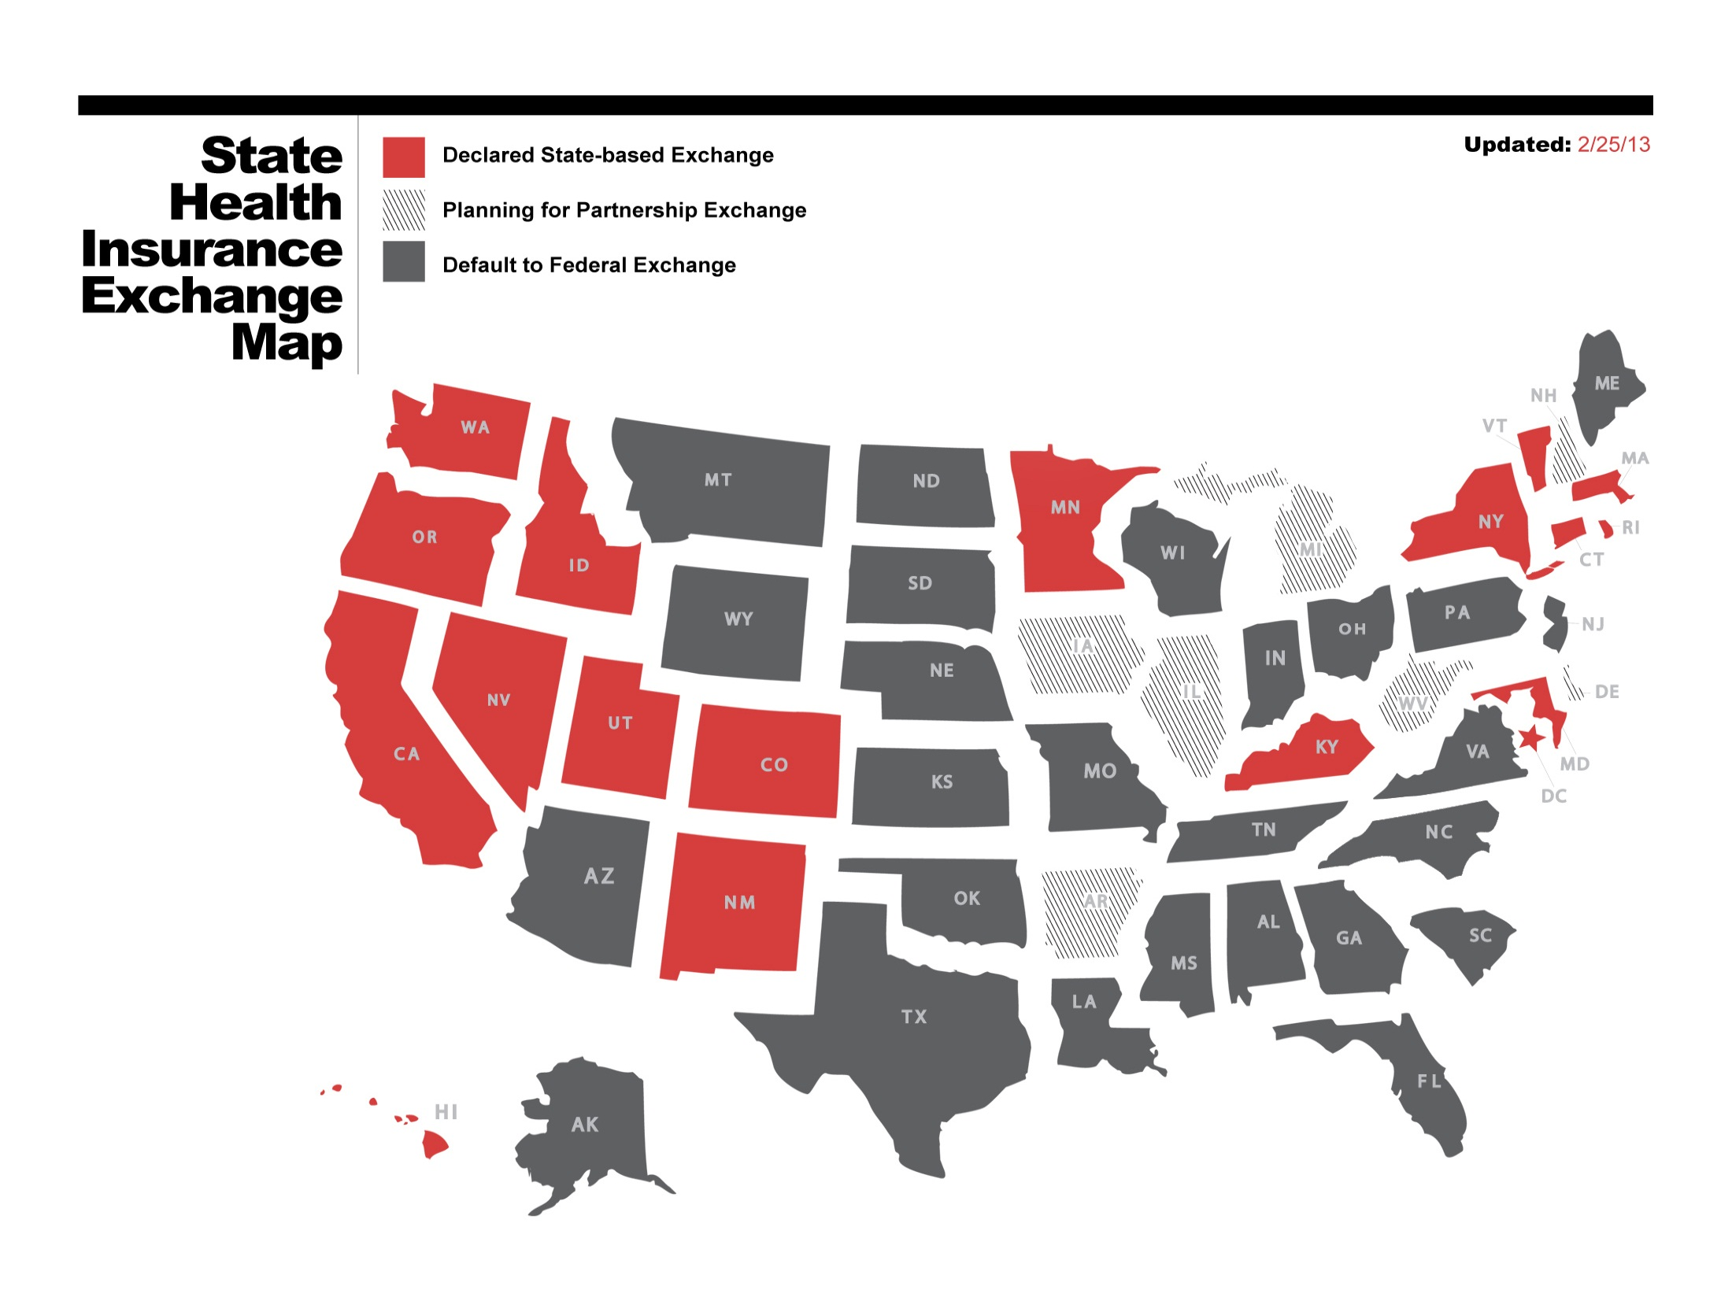

Slide 32
Health Insurance Exchanges
Individuals and small employers can purchase coverage through an Exchange
Small Business Health Option Program (SHOP)
Small employers = up to 100 employees
Before 2016, states can define small employers as having up to 50 employees
In 2017, states can allow employers of any size to purchase coverage through Exchange
Individuals can be eligible for tax credits
Limits on income and government program eligibility
Employer plan is unaffordable or not of minimum value

Slide 33
Employer Responsibility
Large employers subject to “Pay or Play” rules
Delayed for one year, until 2015 – these payments will not apply in 2014
Future guidance may impact the rules described in this document
Applies to employers with 50 or more full-time equivalent employees in prior calendar year
FT employee: employed for an average of at least 30 hours of service per week
Penalties may apply if the employer:
Fails to offer minimum essential coverage to all FT employees (and dependents) OR
Offers coverage that is not affordable or does not provide minimum value
Penalties triggered if any FT employee gets subsidized coverage through Exchange

Slide 34
Exchange Premium Assistance
Employee eligibility will trigger employer penalties
Employees who are not offered employer coverage
Not eligible for government programs (like Medicaid)
Meet income requirements (less than 400% of FPL)
Employees who are offered employer coverage
Not enrolled in employer’s plan
Not eligible for government programs (like Medicaid)
Meet income requirements (less than 400% of FPL)
Employer’s coverage is unaffordable (greater than 9.5% of income for single coverage) or not of minimum value (covers less than 60% of cost of benefits)

Slide 35
Employer Penalty Amounts
Employers that fail to offer coverage to all FT employees:
$2,000 per full-time employee (excludes first 30 employees)
Employers that offer coverage to substantially all FT employees (and dependents) but not all FT employees OR coverage is unaffordable or not minimum value:
$3,000 for each employee who receives subsidized coverage through an Exchange
Capped at $2,000 per FT employee (excluding first 30 employees)

Slide 36
Safe Harbors
Employer penalties: who is a full-time employee?
Ongoing employees
New full-time employees
New seasonal and variable hour employees
Affordability safe harbors
Three optional safe harbors for determining affordability – W-2 wages, rate of pay and federal poverty line
Waiting periods
Cannot exceed 90 days
No penalty for employees in waiting period
Options for determining minimum value (MV)
MV calculator, design-based safe harbor checklist, actuary certification or metal level (small group plans)
Employers can rely on safe harbors through 2014

Slide 37
Variable Hour/Seasonal Testing Methodology
Ongoing Employees
Initial Cycle
SMP 5/1/13-10/31/13
AP 11/1/13-12/31/13
SP 1/1/14-12/31/14
2013
2014
2015
Months
1 2 3 4 5 6 7 8 9 10 11 12 1 2 3 4 5 6 7 8 9 10 11 12 1 2 3 4 5 6 7 8 9 10 11 12
SMP 11/1/13-10/31/14
AP 11/1/14-12/31/13
SP 1/1/15-12/31/15
SMP – Standard Measurement Period AP – Administrative Period SP – Stability Period

Slide 38
Variable Hour/Seasonal Testing Methodology
For New Employees
Bob’s Hire Date 5/10/14
Initial Cycle
Initial MP 5/10/14-5/9/15
AP 5/10/15-6/30/15
ISP 7/1/15-6/30/16
2014
2015
2016
1 2 3 4 5 6 7 8 9 10 11 12 1 2 3 4 5 6 7 8 9 10 11 12 1 2 3 4 5 6 7 8 9 10 11 12
Employer’s Standard Cycle
SMP 11/1/14-10/31/15
AP 11/1/15-12/31/15
SP 1/1/16-12/31/16
Employer must also begin measuring Bob’s hours with its first standard measurement period occurring after his start date.

Slide 39
Employer Reporting
Employers will have to report certain information about health coverage to the government and individuals (6056)
Applies to:
“Applicable large employers” – generally, employers with at least 50 full-time equivalent employees
Delayed for one year, until 2015
Treasury plans to issue additional regulations over the summer

Slide 40
Information Required
Employer identifying information
Whether employer offers health coverage to FT employees and dependents
Number of FT employees for each month
Length of any waiting period
Monthly premium for lowest-cost option in each enrollment category
Employer’s share of cost of benefits
Names and contact info of employees and months covered by employer’s health plan

Slide 41
6056 Reporting – Required Information
Certification of MEC offered to FTEs and dependents
Number of FTEs for each month during the calendar year
Contact information for each FTE covered and months they were covered
For MEC:
Duration of any waiting periods
Months coverage was available
Cost of lowest-cost options
Employer’s share of total allowed costs

Slide 42
Reporting of Health Coverage for Issuers and Self-Insured Plans (6055)
Applies to:
Health insurance issuers
Self-insured plan sponsors
Government-sponsored health insurance programs
Any entity providing MEC
Requirements:
File an annual return with IRS with info for each covered individual
Provide a report to individuals
Purpose: to administer the individual mandate

Slide 43
6055 Reporting
Delayed until 2015 (returns due 2016)
Regulations expected later this summer
Required reporting information:
Contact information for covered individuals
Dates of coverage
Whether coverage is a QHP (if yes, any amount of premium tax credit or cost-sharing reduction)
Employer group health plans
EIN
Portion of premium paid by the employer

Slide 44
Limits on Out-of-Pocket Expenses and Cost-Sharing
Non-GF group health plans subject to limits on cost-sharing and out-of-pocket costs
Out-of-pocket expenses may not exceed HDHP limits
2013: $6,250/$12,500
2014: $6,350/$12,700
Apply to all non-GF group health plans
Deductibles may not exceed $2,000 (single coverage) or $4,000 (family coverage)
Apply only to insured small group non-GF plans
Limits indexed for inflation

Slide 45
Waiting Period Limitations
Waiting periods limited to 90 days beginning with 2014 plan year
Proposed rule issued on March 18, 2013 (may rely on proposed rule through 2014)
First of the month following 90 days not permissible
Other eligibility conditions are permissible (unless designed to avoid compliance with 90-day limit)
Cumulative hours of service requirement cannot exceed 1200 hours and must be one-time only (not each year)
Employers can use up to a 12-month measurement period to determine FT status for variable hour employees
Coverage must be effective by 13 months from start date (plus remaining days in the month)

Slide 46
Plan Changes
Annual limits eliminated
Prohibited on essential health benefits with 2014 plan year
Essential health benefits to be determined according to state benchmark plan
Preexisting condition exclusions prohibited
Currently prohibited for children under age 19
Prohibited for everyone beginning with 2014 plan year
Small group and individual policies (non-GF plans)
Must provide essential health benefits package
Premium rating restrictions apply

Slide 47
Wellness Program Changes
Current rules for wellness program rewards:
Reward must be no more than 20% of the cost of coverage
Program must be designed to promote health/prevent disease
Opportunity to qualify for those with health issues (and notice)
2014 health care reform changes:
Reward increased to 30%
Reward up to 50% for programs to reduce/prevent tobacco use
Small business grants to establish new wellness programs (on hold)

Slide 48
Reinsurance Fees
Transitional reinsurance program to operate 2014-2016
Fees imposed on health insurance issuers and self-funded plan sponsors of major medical plans (with some exceptions)
Fees based on annual national contribution rate
2014 proposed rate: $5.25/month ($63/year) x average number of covered lives
Payment of fees
Issuers and sponsors to submit annual enrollment count to HHS by Nov. 15
HHS to notify issuer or sponsor of amount due within 15 days or by Dec. 15
Payment due within 30 days of notification

Slide 49
Future Compliance Deadlines

Slide 50
2018 – Cadillac Plan Tax
40 percent excise tax on high-cost health plans
Based on value of employer-provided health coverage over certain limits
$10,200 for single coverage
$27,500 for family coverage
To be paid by coverage providers
Fully insured plans = health insurer
HSA/Archer MSA = employer
Self-insured plans/FSAs = plan administrator
More guidance expected

Slide 51
Nondiscrimination Rules Coming for Fully-Insured Plans
Will apply to non-grandfathered plans
Discriminating in favor of highly-compensated employees (HCEs) will be prohibited
Eligibility test
Benefits test
HCEs
5 highest paid officers
More than 10% shareholder
Highest paid 25% of all employees
Effective date delayed for regulations

Slide 52
Automatic Enrollment Rules
Will apply to large employers that offer health benefits
Applies to GF and non-GF plans
Large employer = more than 200 employees
Must automatically enroll new employees and re-enroll current participants
Adequate notice and opt-out option required
DOL:
Regulations will not be ready to take effect by 2014
Employers not required to comply until regulations issued and applicable

Slide 53
Thank you!

Slide 54
Questions?
Justin W. Spewock, LIC, CGBM, CEO
Phone – 517.204.0914
justins@ballardbenefitworks.com

