Slide 1
Commitment to
Servicing Higher Education
March 2013
Wendy Burleson, Account Executive
Notes:
Choose the appropriate cover for your audience. This one is targeted to large and global customers.

Slide 2
Today’s Agenda
Landscape: Education
Today’s Challenges: Costs PCI Compliance Hosted Solutions
About Chase Paymentech
Q & A
March 11, 2013 © 2012, Chase Paymentech Solutions, LLC. All rights reserved.
2
Notes:
Purpose: When a detailed meeting agenda is needed.

Slide 3
What is on your mind today?
SURCHARGING? REDUCE MY COSTS!
KEEPING UP WITH PCI COMPLIANCE
IMPROVING STUDENT
EXPERIENCE
PROCESSOR SERVICE
Notes:
Lowering the total cost of Card Acceptance
Understanding the Changes in Surcharging and Convenience fee regulations
Reducing the inflow and number of points of receipt for cash
Optimizing Operations
Keeping up with PCI Compliance
Mobile Payments
Improving Student Experience
What we do is fairly straight forward – enable these innovators to accept payments from their customer = mainly consumers.
But aside from the breakthrough innovators what clients of all sizes come to us with day in and day out are a typical set of problems they face as commercial entities – and as account executives you are likely to have heard these same problems.

Slide 4
Convenience Fees and Surcharging are different
The current Tax Payment Program has been renamed the Government and Higher Education Payment Program. Colleges may now charge a convenience fee on Visa Transactions to cover the cost of acceptance. Some of the requirements include:
Registrations with Visa and your merchant acquirer
Convenience fee transactions must be submitted and processed as two separate transactions.
The service fee must be disclosed to the cardholder as a fee assessed by the merchant or third party
The service must be clearly disclosed to the cardholder in advance of the payment.
The variable service fee applies to both card present and card not present environments
Only applicable to tuition and fees. (Not cafeteria, foundation etc)
Surcharging is different than Convenience fees. Numerous rules apply.
See www.visa.com/merchantsurcharging for more information

Slide 5
Pricing Methodologies
Discount with Bill Back
Tiered Pricing Structure
Interchange + Pass through
Notes:
Discount with Bill Back
Tiered Pricing Structures
Interchange + Pass through
Provides the most transparency
Allows for you to take advantage of regulated debit rates

Slide 6
PCI Compliance
Chase Paymentech is fully PCI Compliant
Hosted Solutions
Certified Third Parties
Merchant Compliance
No non-receipt of PCI validation charges
SAQ is between your college and the payment brands (i.e. Chase does not automatically require a copy)
Network scans are recommended but not required by Chase Paymentech
Best Practices
Verify compliance of point-of-sale software providers and your specific version
Examine your hardware regularly
Review your business practices
Visit www.pcisecuritystandards.org

Slide 7
How We Help Our Clients
Automate and reduce cost of payments
Speed cash flow/revenue cycle
Billing reconciliation improvement through reporting
Improve Customer service
Streamline technology and eliminate unnecessary providers
Reduce outstanding receivables implementing reoccurring payments best practices
Reduce PCI compliance scope/cost of compliance through Chase Paymentech hosted solutions
Bulletproof Technology
Robust Products
Deep Expertise
Innovation
Process

Slide 8
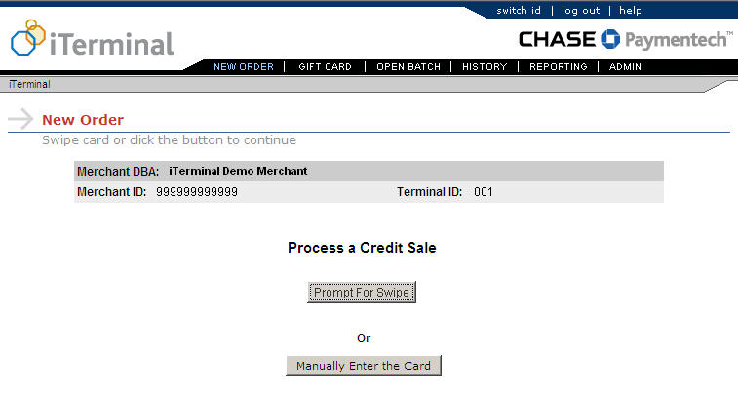
iTerminal ®
Card-Present, hosted solution
An application on Chase Paymentech's web servers
Supports transaction processing for the retail, card-present environment
Offers card processing from your web-enabled personal computer, paired with an external card reader; a receipt printer is also available

Slide 9
iTerminal®
How can I control my account?
Your iTerminal account may have multiple user logons. You have the flexibility to designate each user’s level of access. Control permissions and track users’ transaction history by assigning one of these three access levels:
Manager Full Access: No security restrictions and full rights to all features without having to enter access codes
Administrator Read-Only Access: Read-only rights to iTerminal screens and report generation
Store Regular Access: User must enter correct access codes where enabled

Slide 10
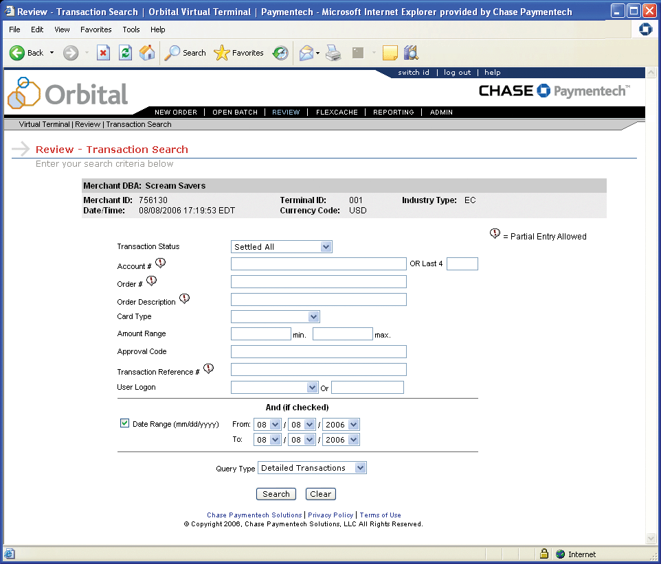
Orbital® Virtual Terminal
Robust Payment Gateway
Orbital Payment Gateway provides an Internet conduit for sending your transactions to Chase Paymentech
Orbital Virtual Terminal provides complete, feature-rich key-entered payment processing through the Orbital Gateway
Web-based application hosted by Chase Paymentech
Eliminates the need for hardware, dedicated phone lines and costly upgrades and maintenance
Customer Profile Management enables storage of customer data
Managed Billing automates your recurring payments

Slide 11
Hosted Pay Page
Your brand presented your way
Orbital Hosted Pay Page clones your payment page so you maintain complete control of the customer checkout experience
No static templates to update
No need to use a Chase Paymentech-branded payment page
You can change your payment page elements at any time and Hosted Pay Page will capture the changes in real time
You’re in control of your brand on the payment page at all times

Slide 12
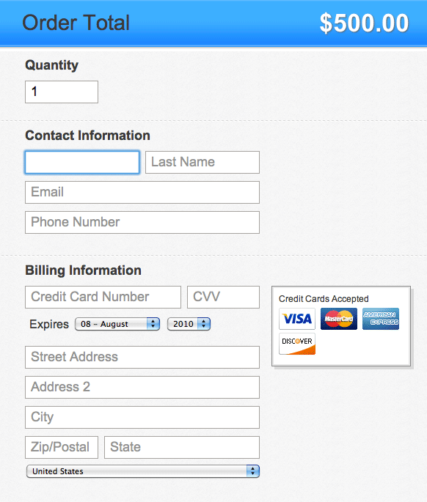
Hosted Pay Page
What is it?
A Chase Paymentech consumer-facing hosted page that captures customer payment data in a PCI compliant manner
Customer payment data never has to enter your company network
You retain brand control on the payment page, decreasing shopping cart abandonment and increasing completed sales

Slide 13
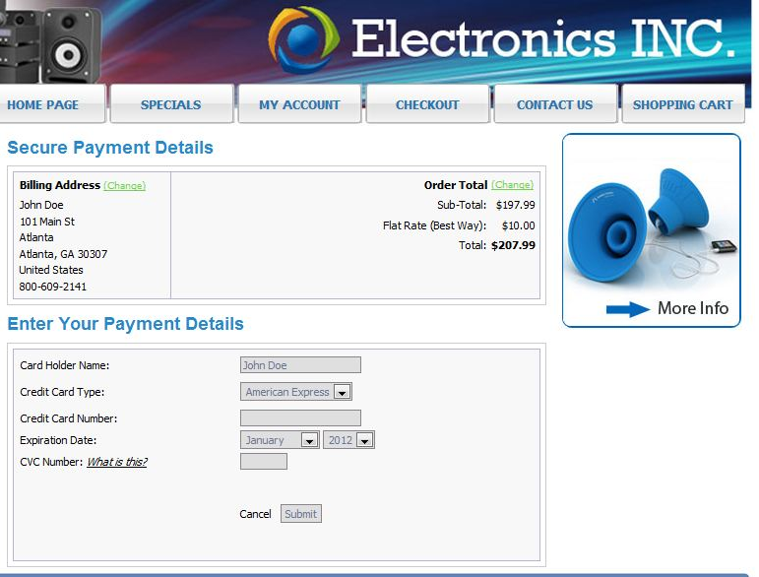
Hosted Pay Page
Brand Impact
Full branding control
Website is “cloned” by HPP
Continues customer conversation

Slide 14
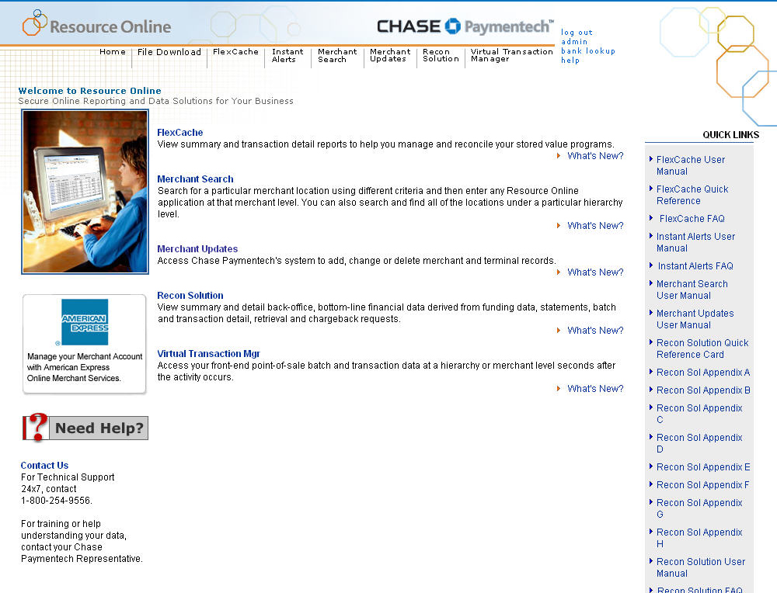
Internet Reporting
Resource Online (ROL) Get your financial data straight from the source
Resource Online (ROL) is Chase Paymentech’s proprietary suite of innovative web-based tools that enables you to quickly and easily access all of your payment processing data. With a few simple clicks of a mouse, you have round-the-clock answers to your payment processing questions.

Slide 15
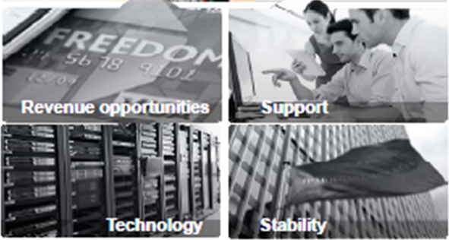
Chase Paymentech Overview
A Global Presence
A Leader in Global Payment Processing
521k
merchant
outlets
Columbus
Toronto
Leader in ecommerce market share
Dublin
Salem
Dallas
New York City
Tampa
1,500
transactions per second
Regional Headquarters Data Centers Offices
Chase Paymentech by the Numbers
$655.2 B
2012 VOLUME
29.5 B
2012 TRANSACTIONS
2,800
NUMBER OF EMPLOYEES
1,500
TRANSACTIONS PER SECOND

Slide 16
Questions?
Wendy Burleson
517-586-0292
wendy.burleson@chasepaymentech.com

