Slide 1


Innovative Staffing Solutions...
Adjunct Employee Staffing

Slide 2

Welcome & Introduction
About EDUStaff & Team
Subject Points:
  Advertising, Recruiting, Screening, & Training
  Management, & Reporting
  Payroll & Accounting
  Financial, Contractual, & Pricing
Open Discussion & Questions throughout Presentation

Slide 3

Recruiting, Publicity, Advertising
Advertising
  General Announcement Emails
  Print
Current Staff
Job Fairs
Collegiate Education Departments
Online Programs
Retirees

Slide 4

Pre-Employment Screening
Proactive Reference Check
Initial Interviewing
State-Required Screening Requirements

Slide 5

Training
Positional Training by Site Management
    Written Materials, Internet, and Group Training
GCN Training Modules
  Allergies Management
  Blood Borne Pathogens
  FERPA
  Hazard Communications
  Sexual Harassment
Employment Orientation
Resources & Tools

Slide 6

Payroll & Accounting
Completely Paperless Process
Quick Turn Payroll Timelines
Stipend / Adjustment Integration
Fully Integrated Cost Accounting

Slide 7
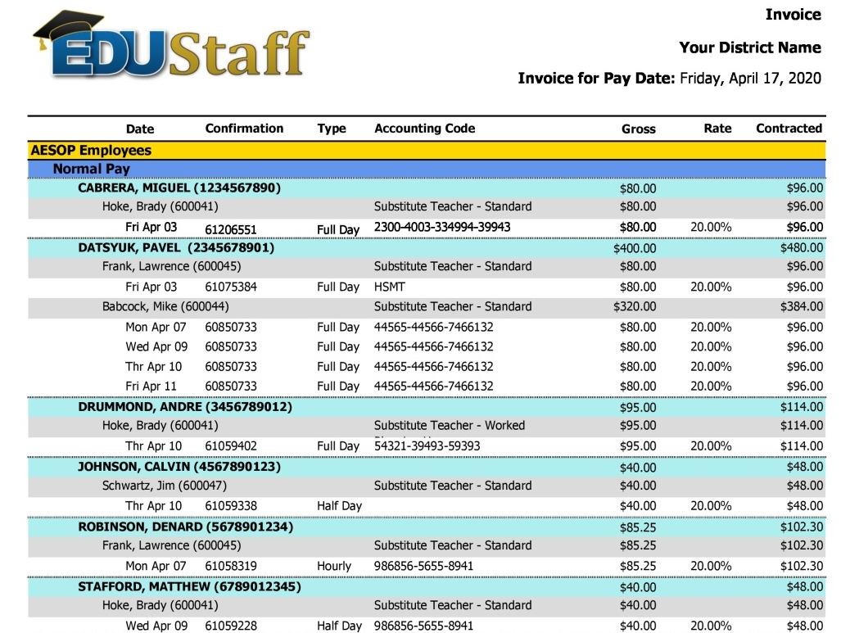

Slide 8

Financial & Contractual
Simple Fee Structure
Complete Cash Flow Separation
No Indirect Escalator Clauses
Transparent Pricing

Slide 9

Benefits to a Third Party
Release of Significant HR Responsibilities
Access to More Recruiting and Advertising
Paperless Payroll Process
Integrated Accounting
Collaborative Effort

Slide 10
Collegiate Pricing & Comparison
Description Community College EDUStaff
Social Security Tax 7.65% 7.65%
SUTA Tax [1.00%] 1.93%
FUTA Tax [0.00%] 0.60%
Employer Pension Funding 25.40% 0.00%
Workers Compensation Premium [0.20%] 0.67%
Employment Practices Insurance Premium [0.20%] 0.20% Payroll Processing Hard Cost [0.30%] 0.30% Hard Cost Replacement 35.22% 11.35%
Services Cost Replacement [Replacement] 4.40%
Recruiting, Screening, Training, Dispatching
Management, Employee Management, Payroll Managing
Total Cost: 35.22% 15.75%
Total Saving: + 19.47%

Slide 11

Summary
Leading Consulting Group
Emphasis on Recruiting, Screening & Training
Competitively Priced Solution
Our Customers are Satisfied

Slide 12

Questions?

Slide 13

THANK YOU!
Clark Galloway - Presenter
EDUStaff, LLC
Clark@EDUStaffOnline.com
616.309.8182
Crista Woods-Presenter
EDUStaff, LLC cwoods@edustaffonline.com
877-974-6338 x 105

