Slide 1
US Economic & Bond Market Outlook
A Presentation to:
Michigan Community College Business Officers Association
March 4, 2016
John N. Dunlevy, CFA
Managing Director of Fixed Income Strategy
513-534-6926
john.dunlevy@53.com

Slide 2
Presentation Outline:
US Economic Backdrop
FOMC Monetary Policy
US Bond Market Overview
Examples of what FT Strategy Group does for clients

Slide 3
I) US Economic Backdrop
What is causing recent Global Market Volatility?

Slide 4
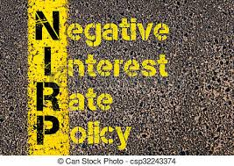
Confusing times in the Financial Markets
Strong US Dollar
Slowing World Economies
Falling Oil Prices
Uncertainty @ FOMC
2016 Presidential Campaign
Negative Interest Rates
The US markets have been impacted by both domestic & global issues.

Slide 5
Financial Market Cycle this year
Weaker Chinese Equity Prices
Risk-Off
Flight to Quality
Lower Oil Prices
Lower Treasury Yields
Lower US Equity Prices

Slide 6
Global Market Uncertainty
Camp # 1
Often results in people moving toward more safe and liquid investments. This is often referred to as the “risk off” or “flight to quality trade”. Since the beginning of 2016 many bond investors have flocked into US Treasuries, Agency MBS, and Municipal Bonds.
vs.
Camp # 2
The contrarians. As Warren Buffet often says…”I want to be greedy when others are fearful and fearful with others are greedy”. Today’s markets may be pricing credit risk at very wide spread levels, which could imply a near-term economic downturn. These abnormalities may be magnified by lack of bank trading capital and the reduction in proprietary trading desks.

Slide 7
“Remember to follow the money”-All The President’s Men

Slide 8
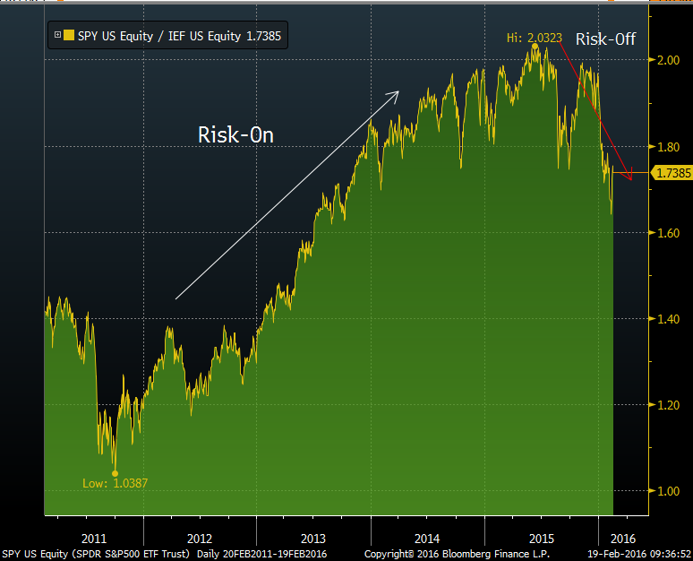
Preference for Equities vs. Treasuries Diminished
Ratio of S&P 500 (SPY) vs. US Treasuries (IEF)
Source: Bloomberg on 2-19-16
The preference for Equities relative to US Treasuries has reversed since Q4 2015 and the “risk-off” trade has become much more common this year..

Slide 9
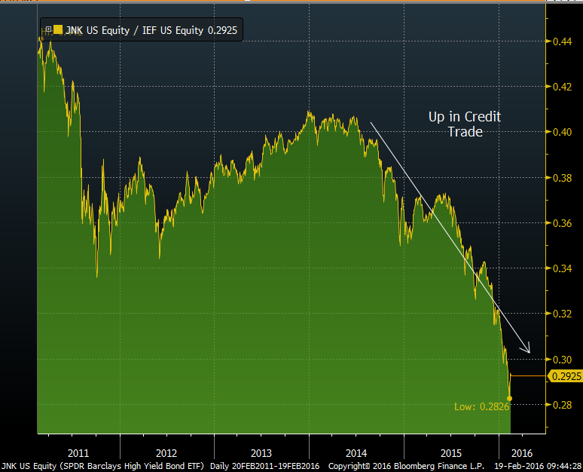
Investor Preference for Risky Assets is fading
Ratio of Junk Bonds (JNK) vs. US Treasuries (IEF)
Source: Bloomberg on 2-19-16
After experiencing a strong preference for High-Yield (Junk) Bonds over US Treasuries during the 2012-Mid 2014 timeframe, that trend has since reversed and investors now seem to prefer safer assets (i.e. US Treasuries).

Slide 10
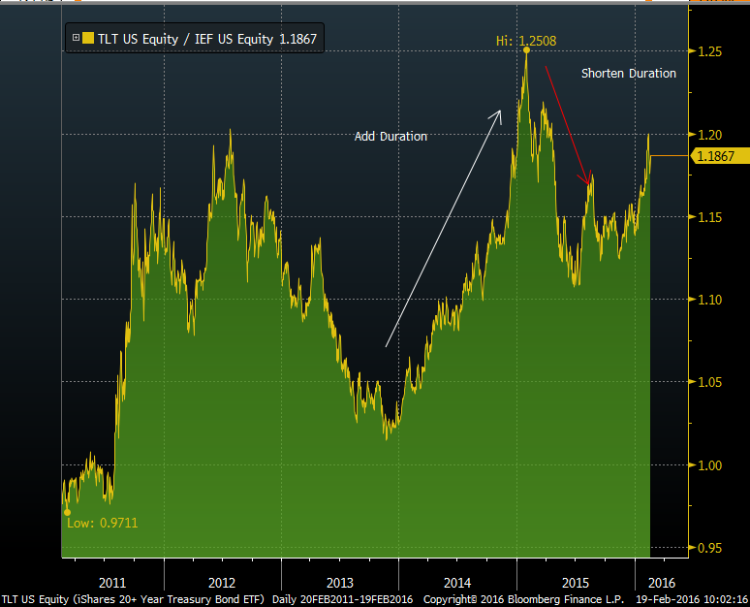
Investors Duration Strategy
Ratio of ETF Prices: Long Treasury Bonds (TLT) vs. Treasury Notes (IEF)
Source: Bloomberg on 2-19-16
During the 2013 “taper-tantrum” the bond market became bearish and investors reduced duration. Since Q1 2014 the market has rallied and investors added duration. The market again became bearish in mid-2015 expecting FOMC rate hikes. However a weakened global outlook has again created a more bullish market tone in recent weeks.

Slide 11
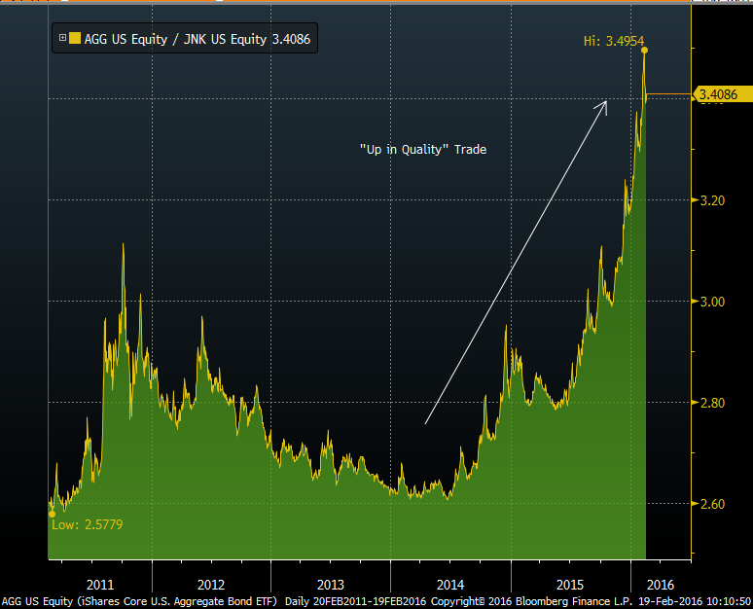
Investors “move-up” Credit Curve
Ratio of ETF Prices: Investment-Grade Bonds (AGG) vs. Junk Bonds
Source: Bloomberg on 2-19-16
Since Mid-2014 investors have reversed the “down-in quality” trade, and are now given the overall market uncertainty “moving up” in credit quality and seeking more liquid investments

Slide 12
4 Improving Sectors of the US Economy

Slide 13
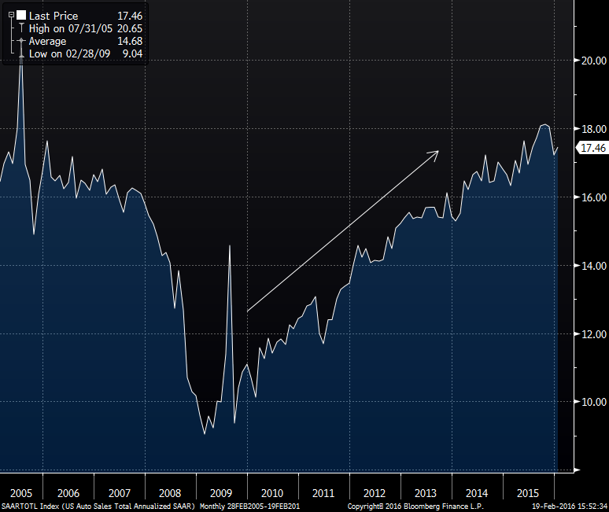
1) Recovery of the US Auto Market
US Auto Sales Annualized
Source: Bloomberg 2-19-16
Domestic Car Sales have nearly doubled from their 2009 recessionary lows.

Slide 14
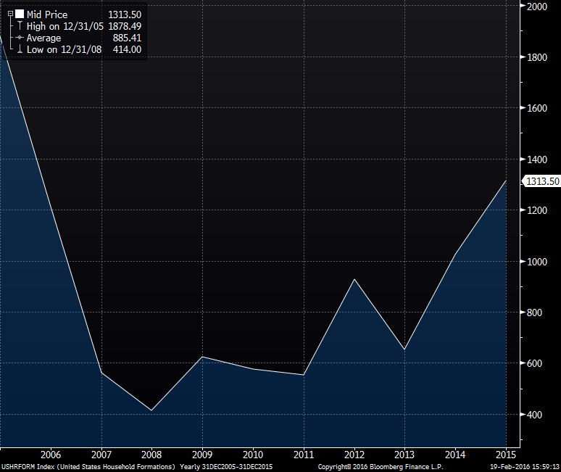
2) Higher levels of Household Formation
Source: Bloomberg 2-19-16
US Household formation has more than tripled since 2008. This has supported rental housing growth and has a positive overall multiplier effect on the economy.

Slide 15
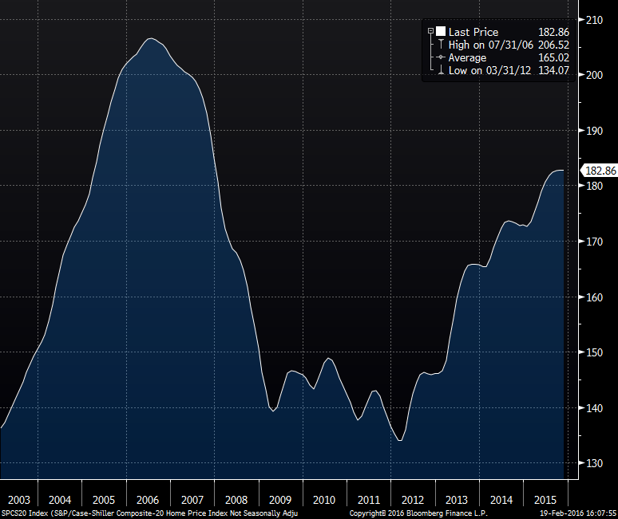
3) Housing Market Recovery
Case-Shiller 20-City Home Price Index
Source: Bloomberg 2-19-16
Based on the recent improvement in the Case Shiller Index homeowners have recovered, on average 67%, of their market value lost during the Housing Crisis.

Slide 16
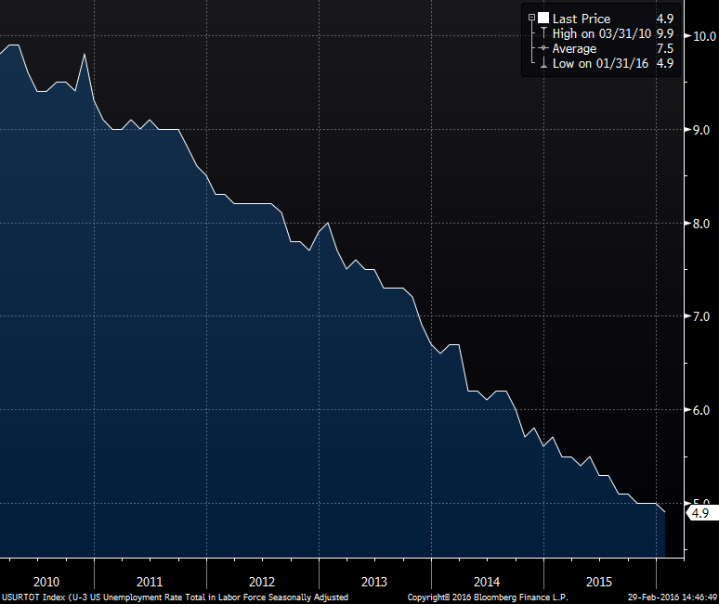
4) Declining Levels of Unemployment
Source: Bloomberg 2-29-16
The unemployment rate is now at its lowest level since 2008.

Slide 17
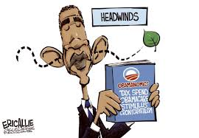
5 Potential Labor Market Headwinds

Slide 18
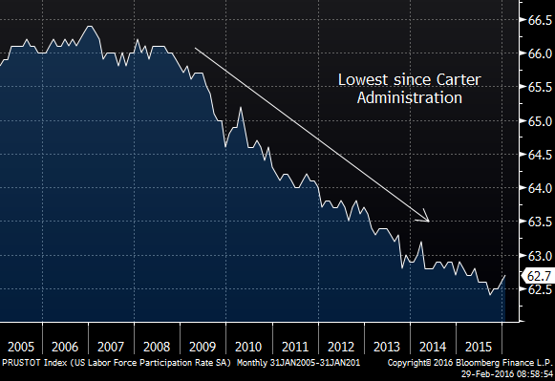
1)Labor Market- Labor Participation Rate
Labor Participation Rate has moved much lower
Source: Bloomberg 2-29-16
Gains in the Unemployment rate can overstate the health of the Labor market.

Slide 19
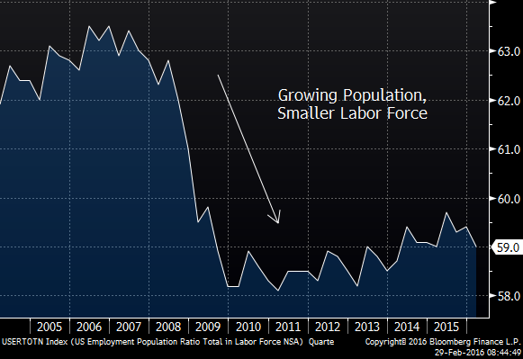
2)Labor Force shrinking vs. US Population
Source: Bloomberg 2-29-16
Is the US Labor Market really improving? Since population growth has vastly outpaced the growth in the labor market.

Slide 20
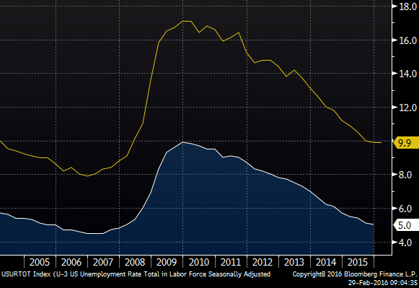
3) Labor Market: Underemployment (U-6)
Broad U-6 US Unemployment Rate %
Source: Bloomberg 2-29-16
Although the overall U-6 unemployment rate has improved sharply since 2010, substantial labor market slack remains relative to pre-recession levels.

Slide 21
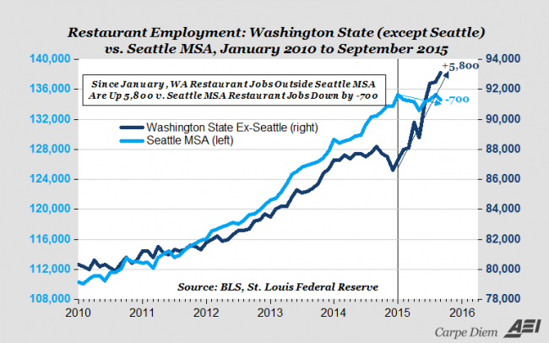
4)Impact of Rising Minimum Wage
Source: Forbes 10-23-15
Higher wages in low-pay/low skill job categories can lead to fewer workers and reduced overall customer service. Additionally Wal-Mart (the world’s largest retailer) attributes rising employee wages as a key reason for their declining profits.

Slide 22
Growing large-scale layoffs growing
US Army-troops 40,000 Hewitt-Packard 30,000
US Army-Civilian 17,000 Schlumberger 20,000
Siemens 13,000 Credit Suisse 2,000
A&P 8,500 Microsoft 7,800
Baker Hughes 13,000 Halliburton 6,400
Procter & Gamble 6,000 Radio Shack 5,400
Caterpillar 5,000 JP Morgan 5,000
Qualcomm 4,500 Amer. Express 4,000
Weatherford 14,000 Wet Seal 3,700
Macys 4,800 AIG 3,500
Shell 2,800 Morgan Stanley 1,800
Forbes, WSJ
Over the last six months large layoffs have been announced in the energy, banking, and retail sectors of the economy.

Slide 23
II) US Economic Forecasts for 2016

Slide 24
Economic Projections for 2016
Consensus 2016 Economic Forecasts
Forecasting Party | Real GDP (YoY %) | Core PCE (YoY %) | Unemployment %
Consensus | 2.20% | 1.50% | 4.8%
FOMC-Dec 2015 | 2.40% | 1.60% | 4.7%
Wells Fargo | 1.80% | 1.50% | 4.7%
JP Morgan | 2.00% | 1.60% | 5.2%
Goldman Sachs | 2.00% | 1.40% | 4.8%
Deutsche Bank | 1.20% | 1.60% | 4.9%
Barclays | 2.20% | 1.40% | 4.5%
Source: Bloomberg 2-29-16
Most forecasters are expecting a modest 2.0%-2.4% Real GDP growth for 2016, with slightly higher inflation and a flat to slightly lower US Unemployment Rate.

Slide 25
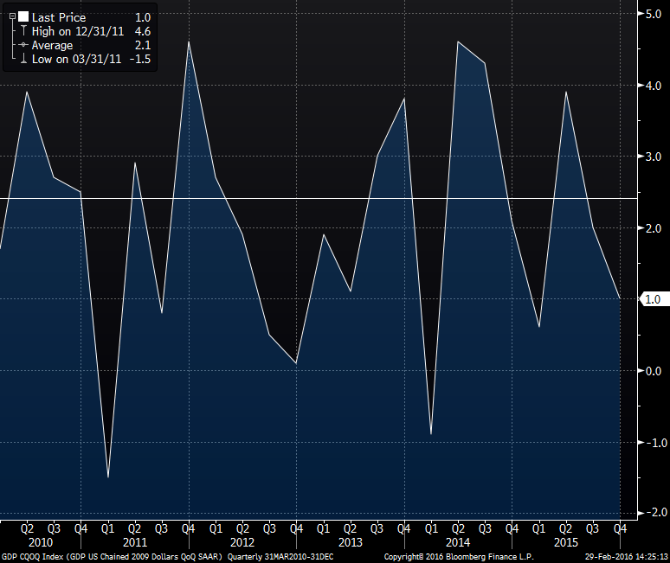
Quarterly Seasonally Adjusted GDP Growth
Source; Bloomberg 2-29-16
Quarterly GDP growth even after adjusting for seasonality, has been very volatile.

Slide 26
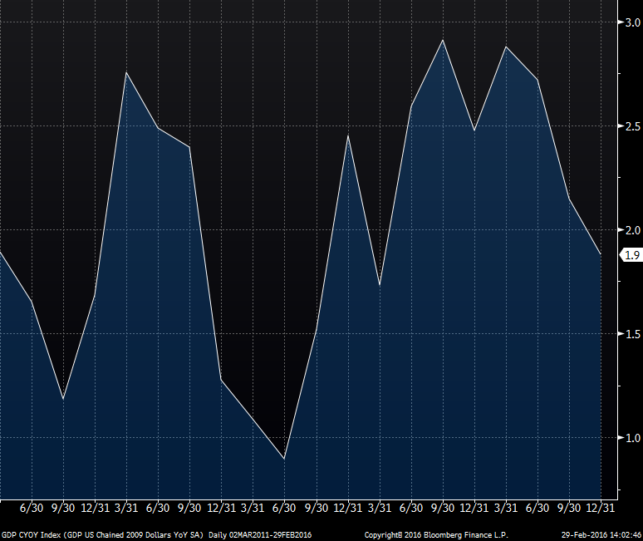
Softer Economic Growth
Real GDP Growth YoY%
Source: Bloomberg 2-29-16
Softer 4th Quarter GDP growth placed Year-End YoY% GDP at +1.9% for 2015, its lowest level since 2012.

Slide 27
II) FOMC Interest Rate Policy
“Its all about the Fed” and “don’t fight the Fed”

Slide 28
Basic Fixed Income Math
Rising rates generally leads to lower market values, unless:
Offset by tighter credit spreads, or
Offset by curve movement-i.e. yield curve roll-down
Offset by bond coupon income

Slide 29
Post December FOMC Meeting Comments
The FOMC decided to move the Fed Funds target rate up in December from 0.00%-0.25% to 0.25%-0.50%.
After reviewing the information presented and watching the Chair Yellen Humphrey-Hawkins press conference three things are clear:
The Fed is still not close to achieving its minimum inflation target of 2% (Core PCE)
The FOMC now has renewed concerned about the financial market instability. These concerns re-emerged in 2016 but were absent from the December FOMC meeting minutes.
Chair Yellen is a consensus builder and it appears the FOMC remains divided on the timing and extent of any future Fed Funds rate hikes.

Slide 30
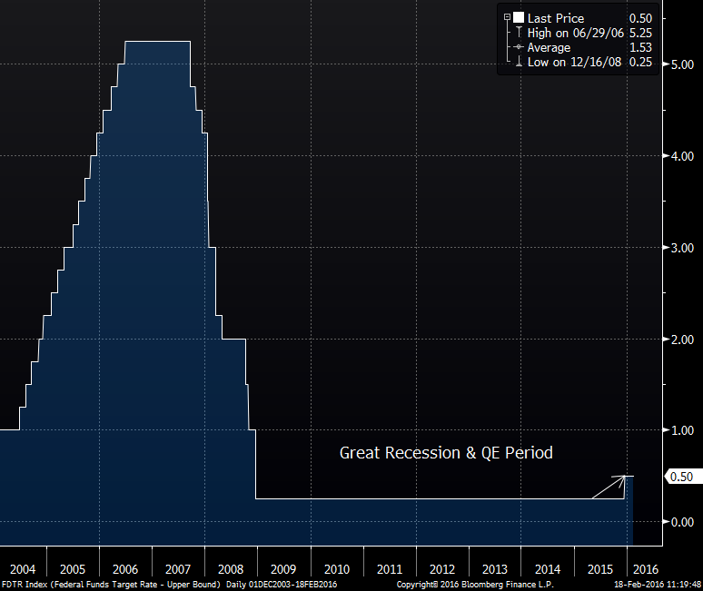
FOMC hikes rates at December 2015 FOMC meeting
Source: Bloomberg 2-18-16
The December 25 bps hike represented the first FOMC rate hike since 2006

Slide 31
Length of time with unchanged Fed Funds rate
Source: Bloomberg 2-19-16
The FOMC kept the Fund Rates unchanged for a record 84 months following the Great Recession and the three QE programs and Operation Twist, before beginning a new tightening cycle by hiking the Fed Funds rate in December 2015.

Slide 32
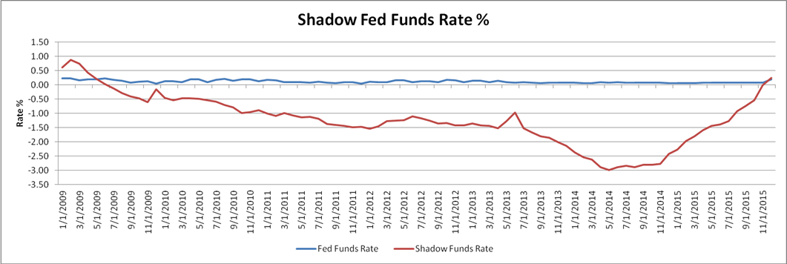
Shadow Fed Funds Rate
Source: Atlanta Federal Reserve Board
The Shadow Fed Funds rate is intended to reflect the true Fed Funds rate after adjusting for monetary policy. Thus during the QE 3 period, the shadow rate reached -3.0% before increasing during tapering and when combined with the December 25 bps rate hike, the shadow rate has risen by 3.25% since mid-2014.

Slide 33
FOMC Fed Funds Rate Projections
Source: Bloomberg 2-17-16
As shown above the Median forecast for the Fed Funds rates at Year-End 2016 and 2017 has been flat or down, however these trends are much more aggressive (higher) than those reflected in the Fed Fund Futures market. For example, the December dot plot median expects four 25 bp hikes to occur during 2016.

Slide 34
Economists & Fed Funds Futures expectations
Source: Bloomberg 2-17-16
Wall Street Economist Consensus forecasts call for nearly three additional 25 bps rate hikes this year, while actual “money at risk” via the Fed Funds Futures market isn’t expecting any new rate hikes in 2016. In fact the futures market is pricing in a 8%, 18%, 23%, and 31% chance of a 25 bps hike (to 0.50%-0.75%) at the March, June, Sept, and Dec. 2016 quarterly FOMC meetings.

Slide 35
Current Curve vs. 2016 Y/E Forward & Economist Curves
Source: Bloomberg 2-19-16
Year-End 2016 Consensus still calls for higher rates across the yield curve, while the forward curve falls between the two curves.

Slide 36
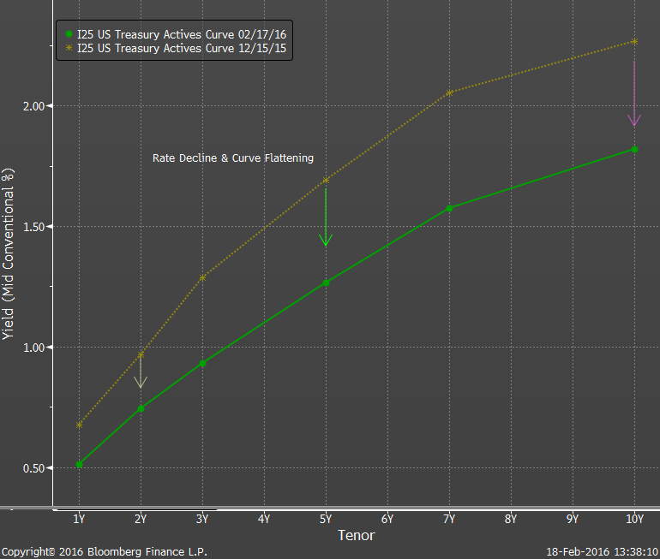
How have the Bond Markets reacted?
Source: Bloomberg 2-17-16
Since before the December 2015 rate hike announcement the 10-Year Treasury yield has fallen by 50 bps and the 2s-10s curve has flattened by 30 bps.

Slide 37
II. US Bond Market Overview

Slide 38
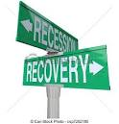
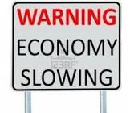
US Economy Thoughts?
There is growing media attention about the risk of a potential recession.

Slide 39
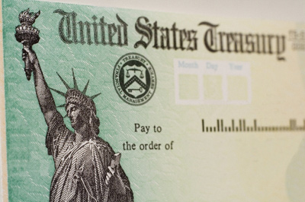
External Factors=> Safe Haven Bid
Treasury demand has also increased due to overseas market instability which may impact both worldwide and US growth.

Slide 40
External Factors-Global Capital Flows
Developed Global Government Bond Yields
Country | 10-Year Govt. Yield | CPI YoY Inflation Rate | Real Rate %
Germany | 0.07% | 0.60% | -0.53%
Japan | -0.07% | 0.50% | -0.57%
Canada | 1.18% | 1.70% | -0.52%
United Kingdom | 1.33% | 0.80% | 0.53%
United States | 1.73% | 1.20% | 0.53%
US Real Interest Rates are among the highest in the Developed world, which has led to demand for US Treasuries via the Global “Carry Trade”.

Slide 41
Probability of March 2016 Rate Hike
Source: Bloomberg 2-19-16
March 2016 rate hike probabilities began the year at greater than 50% and have since fallen into the single-digits.

Slide 42
Why do many expect fewer rate hikes?
3 Reasons to delay:
Inflation goal of 2% has not be met
Higher US Rates and Currency Wars will lead to stronger US Dollar and a weakening domestic economy
Higher rates combined with market volatility could lead to more market instability

Slide 43
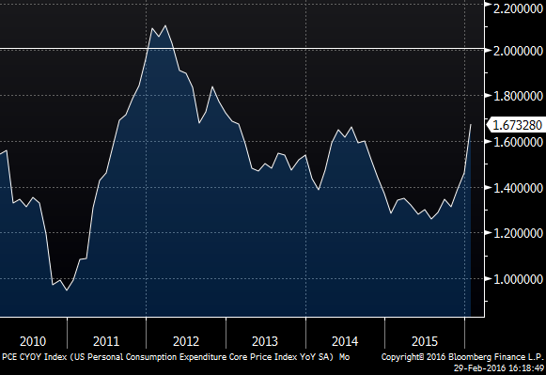
FOMC Minimum Inflation Target
Core PCE YoY%
Source: Bloomberg 9-20-15
Source: Bloomberg 2-29-16
The Fed’s goal of 2% Core PCE inflation has not be met since April 2012 or a period of 46 months. In the last December FOMC projections the 2% goal is not expected to be met until 2018.

Slide 44
Softer Economic Growth
Real GDP Growth YoY%
Source: Bloomberg 2-29-16
Soft 4th Quarter GDP growth placed Year-End YoY% GDP at +1.9% for 2015, its lowest level since 2012.

Slide 45
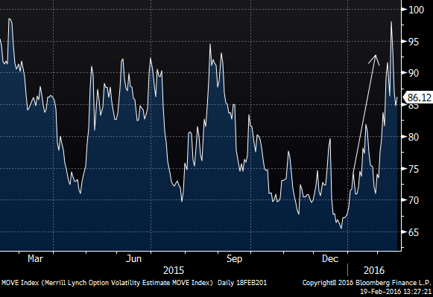
FOMC Rate Hike=> higher levels of volatility
Merrill Option Volatility Estimate (Move Index)
Higher levels of market volatility often results in lower levels of FOMC policy conviction.

Slide 46
Potential Impact of rate hikes in weak economy

Slide 47
Part III- Fixed Income Strategies

Slide 48
Bond Market Strategies-Common Strategies
Bullet Maturities-buy portfolio bonds that match the maturity of desired portfolio duration (and or desired price risk). This is a popular strategy when the curve is flat and/or spreads are wide.
Barbell Strategy- buy bonds that are both longer and shorter than the portfolio’s desired interest rate risk. This is popular when the yield curve is steep and higher degrees of price risk & liquidity are acceptable. Barbell investors generally have a strong market view on interest rates and the yield curve
Laddered Strategy- a conservative investment strategy which combines elements of both strategies mentioned above. It is a favored strategy for investors without a strong interest rate view, especially when the yield curve is positively sloped,

Slide 49
High-Quality Bond Ladder
A bond ladder is built by equally weighting portfolio assets around the investor’s targeted maturity or duration.
Creating a Bond Ladder
In this example, a portfolio with a 3-year target maturity is equally weighted in maturities between 1 and 5 years.
Yr 5
Yr 4
Yr 3
Yr 2
The bond ladder continues to be employed, as after 1-year the proceeds from the 1-year maturity is used to purchase new 5-Year bonds and all remaining holding roll-down the maturity spectrum.
Yr 1
20%
20%
20%
20%
20%

Slide 50
High-Quality Bond Ladder- (Continued)
The following are examples of High-Quality bonds which can be used in the Bond Ladder Strategy:
US Treasuries
US Agency Bonds (Bullet Maturities)
Insured Certificates of Deposits (CDs)
Municipal Bonds (i.e. High-Quality GOs with Bullet Maturities)
An emphasis should also be made to maintain liquidity for each ladder maturity rung, since it will improve mark-to-market returns and make bond swapping (once normalization occurs) much easier.

Slide 51
High-Quality Bond Ladder- (Continued)
Top 3 reasons to consider a Laddered Portfolio
Current uncertainty with regard to the direction of rates
Positive slope to curve allows for roll-down while maintaining limited portfolio price risk.
Laddering strategy gives maximum flexibility to re-enter sectors if credit spreads are tight, spread once market normalization occurs.

Slide 52
IV) 3 Examples of how the FT Strategy Group adds value to our clients

Slide 53
We look for Market Abnormalities
Example #1-Municipal Bond Revenue vs. GO Basis trade

Slide 54
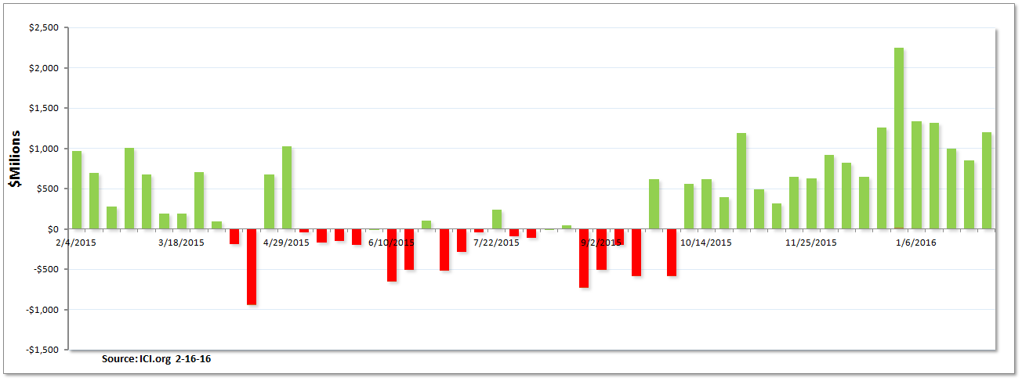
1) Municipal Bond Mutual Fund inflows
We have been watching this strong pattern of sector inflows-21 straight weeks. Many investors prefer Revenue Bonds to GOs because they have higher yields.

Slide 55
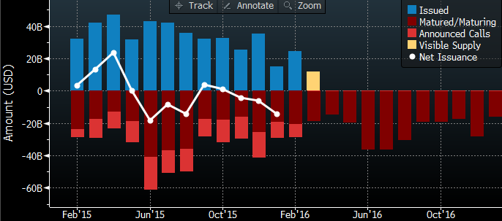
Municipal Market Overview-Net Issuance
Source: Bloomberg 2-19-16
Against a backdrop of declining net issuance has created strong sector performance over the last few months.

Slide 56
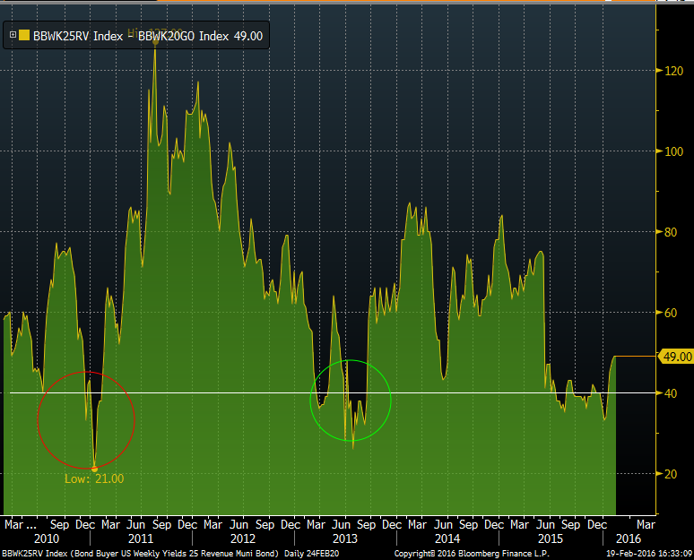
=>GO trade recommendation vs. Revenue Bonds
Source: Bloomberg 2-16-16
Since 2010 the yield difference between this Revenue and GO Bond Indices has only fallen below 40 twice and both times Revenue Bonds subsequently underperformed. When this happened again in December (+33 bps) we recommended our clients swap Revenue Bonds for GOs. The swap level is now at +49 bps.

Slide 57
Build Custom Analytics help to find value in street offerings
Example #2-Using our Proprietary Agency MBS Pool Selection Model

Slide 58
Outline of Pool Selection Scoring Model
MBS traders will often seek pay-ups for any of these loan attributes:
Loan Vintage Originator
FICO Score Gross WAC
Loan Size Pool Size
Geography Loan Purpose
Loan to Value Servicer
We have therefore created a multi- factor pool scoring model
Each attribute is scored on a numeric scale
Pool score is the sum of individual scores of each attribute
Low scores have faster prepay attributes (Green pools), while higher numbers reflect pools with slower prepayment traits (Red pools).
Our model allows the ability to screen multiple MBS pool offerings quickly
It is also easy to modify as market or prepayment trends change
Our model output is visible- that is, it is not a black box

Slide 59
MBS Pool Scoring Model
Specified Pool Offerings
GSE Pool Disclosure
FT Securities scores pools using its 10-factor scoring model
MBS Scoring Model
Pay-Up offerings relative to TBA
Historical Prepay Profile
Pools are scored on a scale of 10-50. Scores > 35 reflect slow-paying or “Red” pools. Fasting-paying pools have scores < 25 “Green” pools.
MBS Pool Scores
Pools ranked in order of attractiveness

Slide 60
Scoring MBS Pools of Same Coupon, Program & Pay-Up
Cusip specific MBS pools (i.e. non-TBA) are often offered in similar price buckets
Wall Street dealers price pools using one or two dominant characteristics (i.e. Vintage, Loan Size)
Dealers moving high volumes tend to ignore second or third level pool attributes .
Our Pool Scoring Model seeks to identify added value from these pricing inefficiencies.
Source: Fifth Third Securities 1-22-16
Our model example above identifies Pool BA6388 as the pool with the most attractive red or slow-pay pool characteristics (score of 43).
To evaluate pools with different MBS Coupons, MBS Maturities (i.e. 30-Year vs. 15-Yr), and pay-ups we use Yield Book to compare option-adjusted spread (OAS) across the various MBS alternatives.

Slide 61
Our Model quantifies risk via calculating breakevens
Pool Pay-Up
CPR speed differential
Breakeven Calculation
# Months to recoup pay-up
Our model requires two of the above three variables to calculate the breakeven on the third factor. This approach quantifies the risk of using our Pool Scoring Selection Model to identify and score pools within the MBS market.

Slide 62
Using breakevens to recommend the merits of the “risk-off” trade.
Example #3-Evaluating the cost of staying in cash

Slide 63
The cost of “cash”- 12-Months ago
Months in Cash | Fed Funds Rate | Accumulated Income | Alternative Inv Yield | Accumulated Income | Foregone Income | Remaining term (Yrs) | Inc ome to "Breakeven" | Yield Needed to BE
3 | 0.06% | $3,000 | 1.20% | $60,000 | ($57,000) | 2.75 | $717,000 | 1.30%
6 | 0.06% | $6,000 | 1.20% | $120,000 | ($114,000) | 2.50 | $714,000 | 1.43%
9 | 0.06% | $9,000 | 1.20% | $180,000 | ($171,000) | 2.25 | $711,000 | 1.58%
12 | 0.06% | $12,000 | 1.20% | $240,000 | ($228,000) | 2.00 | $708,000 | 1.77%
15 | 0.06% | $15,000 | 1.20% | $300,000 | ($285,000) | 1.75 | $705,000 | 2.01%
18 | 0.06% | $18,000 | 1.20% | $360,000 | ($342,000) | 1.50 | $702,000 | 2.34%
21 | 0.06% | $21,000 | 1.20% | $420,000 | ($399,000) | 1.25 | $699,000 | 2.80%
24 | 0.06% | $24,000 | 1.20% | $480,000 | ($456,000) | 1.00 | $696,000 | 3.48%
27 | 0.06% | $27,000 | 1.20% | $540,000 | ($513,000) | 0.75 | $693,000 | 4.62%
30 | 0.06% | $30,000 | 1.20% | $600,000 | ($570,000) | 0.50 | $690,000 | 6.90%
Last year an investor staying on the sideline for 6-Months and earning only 6 bps on idle cash, would have to find an investment yielding 23 bps higher (1.43%) than the 3-Year alternative over the remaining 2.5 years of the investment horizon to breakeven

Slide 64
Current cost of staying in Cash
Months in Cash | Fed Funds Rate | Accumulated Income | Alternative Inv Yield | Accumulated Income | Foregone Income | Remaining term (Yrs) | Inc ome to "Breakeven" | Yield Needed to BE
3 | 0.37% | $18,500 | 1.15% | $57,500 | ($39,000) | 2.75 | $671,500 | 1.22%
6 | 0.37% | $37,000 | 1.15% | $115,000 | ($78,000) | 2.50 | $653,000 | 1.31%
9 | 0.37% | $55,500 | 1.15% | $172,500 | ($117,000) | 2.25 | $634,500 | 1.41%
12 | 0.37% | $74,000 | 1.15% | $230,000 | ($156,000) | 2.00 | $616,000 | 1.54%
15 | 0.37% | $92,500 | 1.15% | $287,500 | ($195,000) | 1.75 | $597,500 | 1.71%
18 | 0.37% | $111,000 | 1.15% | $345,000 | ($234,000) | 1.50 | $579,000 | 1.93%
21 | 0.37% | $129,500 | 1.15% | $402,500 | ($273,000) | 1.25 | $560,500 | 2.24%
24 | 0.37% | $148,000 | 1.15% | $460,000 | ($312,000) | 1.00 | $542,000 | 2.71%
27 | 0.37% | $166,500 | 1.15% | $517,500 | ($351,000) | 0.75 | $523,500 | 3.49%
30 | 0.37% | $185,000 | 1.15% | $575,000 | ($390,000) | 0.50 | $505,000 | 5.05%
After the December FOMC rate hike, it has become less expensive to be in cash during times of “investor uncertainty”.

Slide 65
This information is not intended for use regarding the investment of municipal bond proceeds or municipal escrow investments. (a) Fifth Third Securities is not recommending an action to you as the municipal entity or obligated person; (b) Fifth Third Securities is not acting as an advisor to you and does not owe a fiduciary duty pursuant to Section 15B of the Exchange Act to you with respect to the information and material contained in this communication; (c) Fifth Third Securities is acting for its own interests; and (d) you should discuss any information and material contained in this communication with any and all internal or external advisors and experts that you deem appropriate before acting on this information or material
Investments in fixed income products are subject to liquidity (or market) risk, interest rate risk (bonds ordinarily decline in price when interest rates rise and rise in price when interest rates fall), financial (or credit) risk, inflation (or purchasing power) risk, and special tax liabilities.
This advertisement is neither an offer to sell nor a solicitation of an offer to buy any of these securities. New-issue municipal offerings are made only by official statement. The securities shown as available from the syndicate may no longer be available from the syndicate at the time of pricing.
All bonds are subject to availability and yields are subject to change. Market value will fluctuate. Bond values will decline as interest rates rise. The bond’s income may be subject to certain state and local taxes depending upon your tax status and or the federal alternative minimum tax.
Fifth Third Securities is the trade name used by Fifth Third Securities, Inc., member FINRA/SIPC, a wholly owned subsidiary of Fifth Third Bank, a registered broker-dealer, and a registered investment advisor registered with the U.S. Securities and Exchange Commission (SEC). Registration does not imply a certain level of skill or training. Securities and investments offered through Fifth Third Securities, Inc. and insurance products:
Insurance products made available through Fifth Third Insurance Agency, Inc.
Contents are provided for informational purposes only and do not constitute an offer to sell nor a solicitation of an offer to buy any security
The views expressed here are those of the author and do not necessarily represent or reflect the views of Fifth Third Securities.

Slide 67
John N. Dunlevy,CFA
John Dunlevy, who joined Fifth Third Bank in 2013 as Managing Director of Head of the Fixed Income Research & Strategy team, has more than 30 years industry experience and has worked on both the buy side and sell side of the business.
Most recently John was a Managing Director and Head of Securitized Products for PineBridge Investments (the 2009 spin-off of AIG Asset Management). Prior to PineBridge Investments, he was Chief US Fixed Income Strategist at Nomura Securities in New York.
John’s buy side experience includes working at TIAA-CREF, Hyperion Capital (Lew Ranieri’s firm), and as a member of the Proprietary Desk at Merrill Lynch. Over a six-year period while at Hyperion Capital, Mr. Dunlevy was Lead Portfolio Manager for the Hyperion Total Return Fund (HTR) which received a 5-Star Morningstar rating and was ranked as Lipper’s # 1 fund. He has been an analyst, portfolio manager, Group Head/CIO, and has extensive research, marketing and fundraising experience.
Mr. Dunlevy has published extensively and has contributed chapters to several Fabozzi books including The Handbook of Fixed Income. He was also co-author with Frank Fabozzi of Real-Estate Backed Securities.
John graduated Cum Laude with a BS in Accounting from Boston College, and has a MBA in Finance from Columbia University. He is a CFA and a CPA and has FINRA Series 7, 65, 3, 63, 16 (Research) and 24 (Supervisor) licenses.

