Slide 1
MJNTP Update and Bond Financing
Michigan Community College Business Officers Association
June 29, 2016 ● Grand Traverse Resort
Steven Mann, Principal

Slide 2
Presentation Outline
MNJTP Refresher and Update
Methods of Financing MNJTP
Bond Financing Capital Projects
Cashflow Borrowings
Questions?

Slide 3
MJNTP Refresher
Enacted 2008 to encourage employment
Training paid for through capture of State income tax
College receives 15% administrative fee
New Job requirements
Net increase in employment in the State for the employer
Not a recalled or replacement job
Wage is 175% or more of the State minimum wage

Slide 4
MJNTP Refresher
Eligible Program Costs
Training/Retraining for New Jobs
Adult basic education and job-related instruction
Developmental, readiness, and remedial education
Vocational and skill-assessment services and testing
Training facilities, equipment, materials and supplies
Administrative expenses
Contracted or professional services

Slide 5
MJNTP Update
State minimum wage amendment (2014)
“wage rate in effect as of the date the employer and the college…enter into the agreement”
130 PA 2015, Eff. July 22, 2015
Sunset extended to Dec. 31, 2023
No new agreements after this date
130 PA 2015, Eff. July 22, 2015

Slide 6
Financing MJNTP
Pay as you go method of Training
No indebtedness
Employer pays “new jobs credit from withholding” (tax capture/diversion) to the College monthly
When sufficient funds have accumulated, the College pays for training
No reimbursements

Slide 7
Financing MJNTP
Why no reimbursements?
Dillon’s Rule
A municipality may only exercise those powers expressly granted, necessarily implied, or which are essential — not simply convenient, but indispensable.

Slide 8
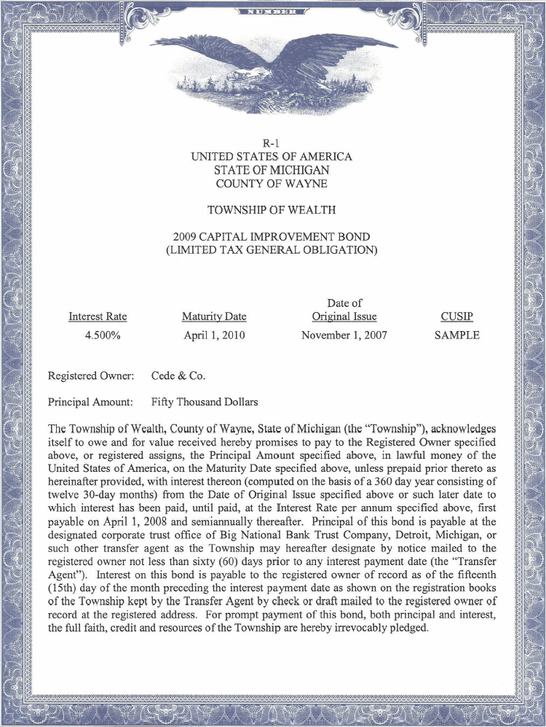
Financing MJNTP
Municipalities have no inherent power to incur debt.
In order to borrow, you must be able to cite specific statutory authority
MJNTP authorizes a financing structure using revenue bonds
No authority for a reimbursement structure

Slide 9
Financing MJNTP
Umbrella Financing Statute
“A municipality shall not issue a municipal security except in accordance with this act.”
34 PA 2001, MCL 141.2301

Slide 10
Financing MJNTP
Financing Training with a Revenue Bond
College issues revenue bond (0% interest)
Employer purchases revenue bond in installments
Bond proceeds used to pay for training
As “new jobs credit from withholding” (tax capture/diversion) are paid to the College, these funds are used to repay principal on the bond

Slide 11
Bond Financing Capital Projects
Building and Site Bonds (Sec. 389.122(b))
Buildings, playgrounds, athletic fields, agricultural farms, and land
30 year term
Limited Tax Bonds (no voter approval)
Debt limit – 1 ½% of the first $250 million in SEV plus 1% of the excess over $250 million
Voter Approved Bonds
No debt limit
Allows levy of unlimited tax debt millage

Slide 12
Bond Financing Capital Projects
Building and Site Bonds (Sec. 389.126)
Residence halls, apartments, dining facilities, student centers, health centers, parking facilities, stadiums, athletic fields, gymnasiums, auditoriums, educational facilities, lands
50 year term
Limited Tax or Unlimited Tax Bonds (same as prior slide)
No debt limit

Slide 13
Bond Financing Capital Projects
Energy Conservation Improvements (Sec. 389.122(c))
Heating systems, windows, doors, roofs, insulation, HVAC
Guaranteed Savings Contract

Slide 14
Bond Financing Capital Projects
Energy Conservation Improvements (Sec. 389.122(c))
Installment Contract or Bond Financing
Limited Tax obligations; 25 year term
Debt is often repaid from resulting energy savings

Slide 15
Cashflow Borrowings
Borrowings for operating expenses (Sec. 389.127)
12 month term
Security Pledged
State appropriations
Student fees and charges
College’s full faith and credit
Flexible Structure
Lines of Credit

Slide 16
Cashflow Borrowings
Borrowings for operating expenses (Sec. 389.127)
Sizing for Tax Exempt Cashflow Borrowing
Maximum projected cash flow deficit in 12-month period; plus
Reasonable working capital reserve (generally 5% of prior fiscal year’s general fund expenditures); plus
Costs of issuance of obligation
QTE designation if issuing less than $10M in FY.

Slide 17
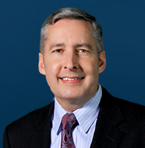
Questions?
Steven Mann is a senior principal with Miller, Canfield, Paddock and Stone, P.L.C. practicing in the area of public finance and municipal law. Steve specializes in the area of municipal finance, representing public agencies as bond counsel. His practice covers all facets of tax increment financing, special assessments, and economic development. Steve also specializes in complex issues related to the Freedom of Information Act (FOIA) and the Open Meetings Act (OMA).
Steve co-authored the Sunshine Laws and Local Government (OMA/FOIA) chapter of the Michigan Municipal Law handbook published by the Institute for Continued Legal Education.
Steve has authored several amicus curiae briefs in both the Michigan Court of Appeals and the Michigan Supreme Court arguing on behalf of the Michigan Municipal League, the Michigan Townships Association, the Public Corporations Section of the State Bar of Michigan, and other municipal associations and their constituents.
Steve served twelve years on the Charter Township of Plymouth Board of Trustees (2000-2012), including one term as Township Supervisor and two terms as Trustee. He received his law degree, cum laude, from Thomas M. Cooley Law School in Lansing, and his B.B.A., summa cum laude, from Cleary University.
17

