Slide 1
More than Just Refunds:
Higher One’s Commitment to Financial Literacy
Jack DeBaar Mary Johnson
VP, Sales Financial Literacy and Consumer Advocacy Manager
Higher One, Inc. Higher One, Inc.

Slide 2
Discussion Outline
About Higher One
Importance of Financial Literacy
What it means for Higher Education
Higher One’s commitment

Slide 3
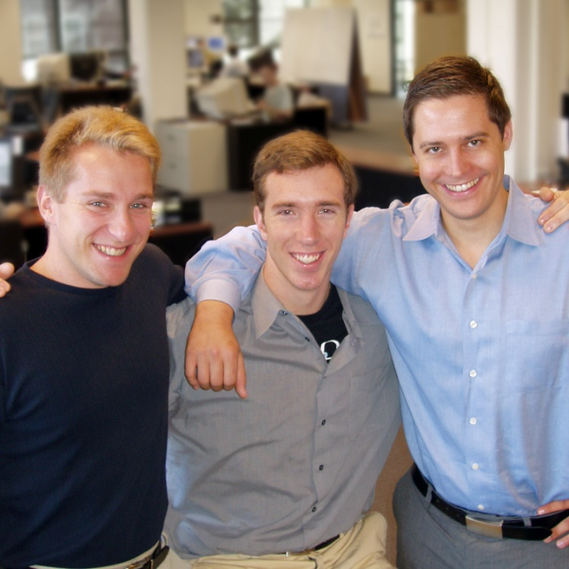
Who We Are
Founded in 2000
  By three college students
  Interested in improving college and university business operations while increasing student services by providing new choices for students

Slide 4
One Focus: Higher Education
Serves more than 820 campuses nationwide
  530+ use OneDisburse® Refund Management®
  390+ use CASHNet® Payment Processing
Approximately 6.2 million students receive refunds faster or make payments more easily
Our best sales people are our current clients

Slide 5

Our Michigan Clients
Aquinas College
Baker College
Davenport University
Eastern Michigan University
Grand Rapids Community College
Hope College
Kalamazoo Valley Community College
Lansing Community College
Macomb Community College
Madonna University
Michigan State University
Muskegon Community College
Olivet College
Saginaw Valley State University
Saint Clair County Community College
Siena Heights University
Spring Arbor University
University of Detroit – Mercy
Wayne State University
Serving over 245,000 students

Slide 6

Active with Student Governments
“Higher One is a trusted member of the American Student Government Association and seeks to educate students on financial responsibility.”—UMBC Retriever Weekly
Notes:
Mary will be presenting, and we are sponsoring, the National ASGA Conference this year in September where 700 ASGA student leaders will be present. We will have many Higher One-branded giveaways.

Slide 7

Financial Literacy Matters

Slide 8
Perspective
“While freshman and their parents are likely thinking more about tests and academics during orientation, the fact is that after graduation a student’s credit rating is arguably far more important to his or her future than grade point averages.”
Robert D. Manning, PhD,, Author – Credit Card Nation
Research Professor and Director of the Center for
Consumer Financial Services
Rochester Institute of Technology

Slide 9
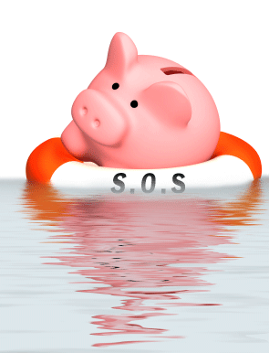
Reality for Students
Inexperienced with money management
Have trouble controlling their spending
Taking on too much debt
Serious post-college consequences

Slide 10
Financially Risky Behaviors
% of students who pay off credit card debt each month
  Less than 20% (Sallie Mae 2009)
Percent of students late on credit card payments
  42% (Higher One Financial Literacy Survey 2011)
Average unpaid balance upon graduation
  $4,100 (Sallie Mae 2009)
Average student loan debt upon graduation
  $25,250 (The Project on Student Debt 2011)
College graduate bankruptcy rate
  Up 20% over last 5 years (Institute for Financial Literacy 2011)

Slide 11
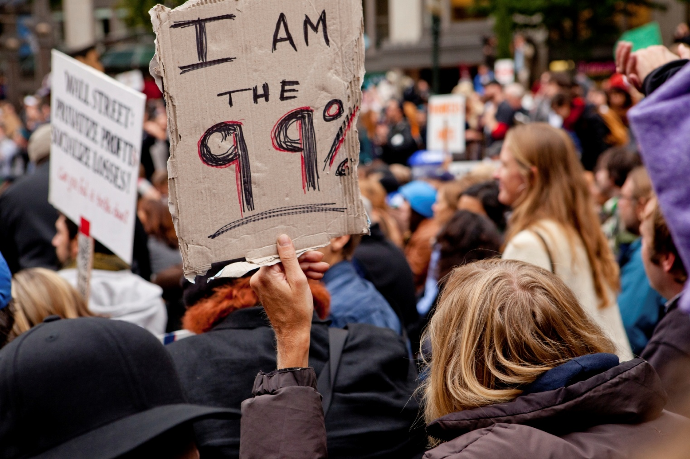
Anxious and Concerned
Time to focus on what they can control

Slide 12

Higher Education’s Role
“State colleges and universities have a unique opportunity to provide leadership on this critical topic by weaving financial education into the fabric of their campus.”
(AASCU – Fall 2010)
Public Service
Financial Incentives
Accountability and Reputation

Slide 13
Cohort Default Rates
FY 2009 Source: U.S. Dept. of Education

Slide 14
What is Financial Literacy?
Knowing
    How much $ you have
    How much $ you will require
    How to grow and protect your $
Understanding
    Financial concepts
    Financial products
Making Informed Decisions

Slide 15
Taking Action
Courses
Dedicated websites
Workshops, seminars, special events
Peer to peer counseling
Social media outlets
Money management centers
Full online programs

Slide 16

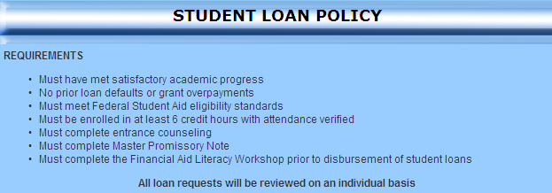

Slide 17

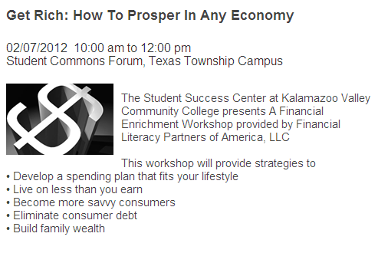

Slide 18
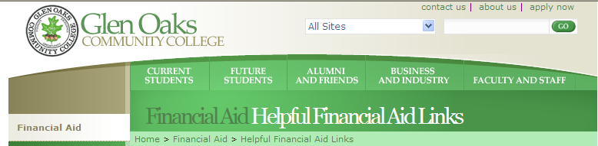
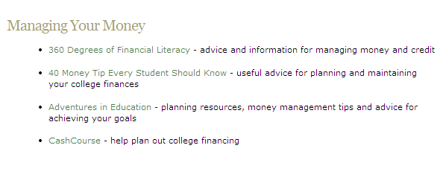

Slide 19

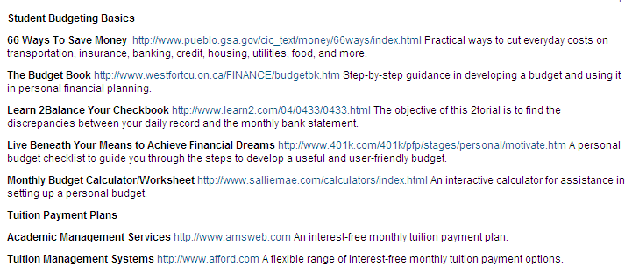

Slide 20
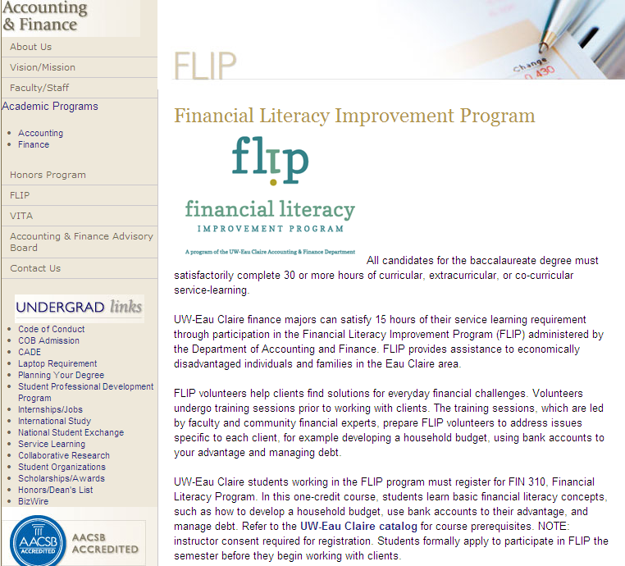


Slide 21
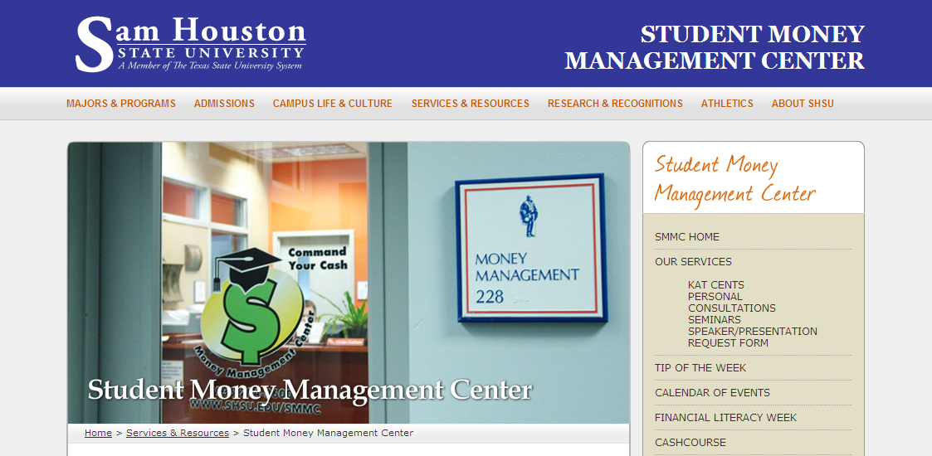
Money Management Centers

Slide 22











Online Programs

Slide 23
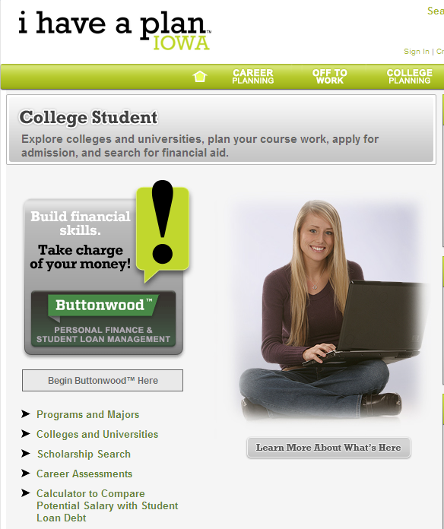

Slide 24

Tips for Getting Started
Identify your advocates
Start small
Know your students
Embrace financial literacy as part of your mission
Choose engaging and high quality content and delivery methods
Assess what you are doing

Slide 25

Higher One’s Commitment
For Students:
  Financial Literacy Manager
  Dedicated website/blog
    Articles and guest bloggers
    Tools
    Contests
  Twitter handle – MoneyTalkMary
  Content Partnerships
    Eric Bell – YoBucko.com
    FDIC Money Smarts
    Scott Gamm - HelpSaveMyDollars

Slide 26




Student Engagement

Slide 27
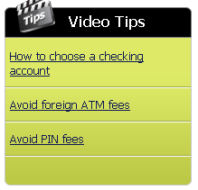
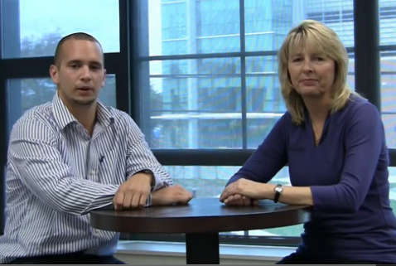

Higher One’s Commitment
For Student Customers:
  Choice of accounts
  Transparent fee schedules
  Money management tips
  Mobile alerts
    Text alerts to phone
  Mobile features
    Text2 Balance
    EasyDepositSM Mobile
    Mobile App

Slide 28

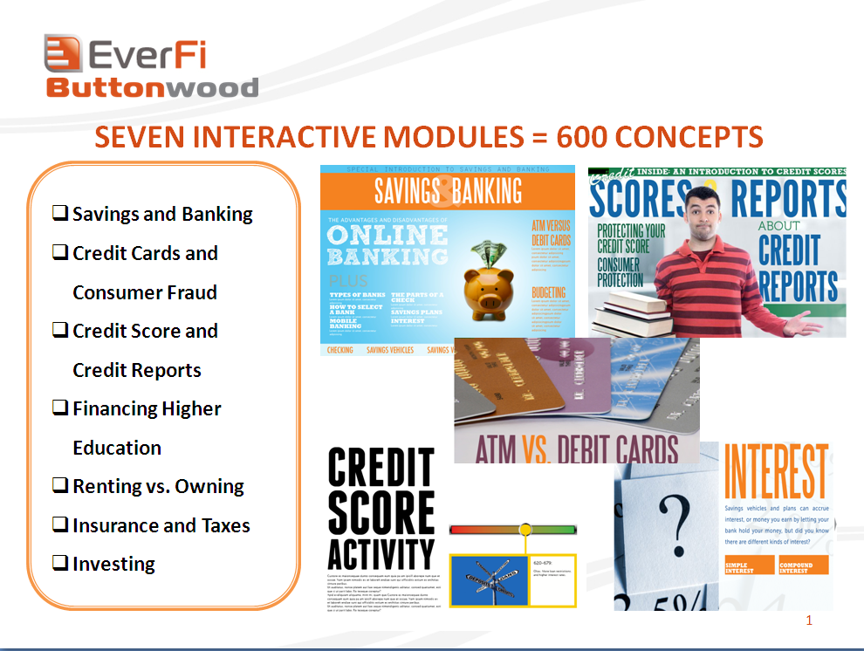
Higher One’s Commitment
For Schools:
  Financial Literacy Counts Grant
  Presentations and Workshops
  Thought leaderships articles and white papers
    Talking to Your Student About Money
    Guest Blogging (e.g. Huffington Post)
  Financial Intelligence - Everfi

Slide 29
Financial Literacy Quiz
Answers
1. D | 11. B
2. B | 12. C
3. C | 13. D
4. D | 14. C
5. B | 15. A
6. C | 16. C
7. B | 17. C
8. B | 18. D
9. D | 19. C
10. B | 20. B

Slide 30
Questions?
Visit: http://www.higherone.com/oneforyourmoney
Follow me on Twitter: MoneyTalkMary

Slide 31



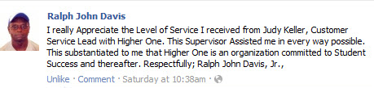

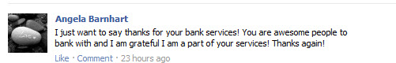

Slide 32
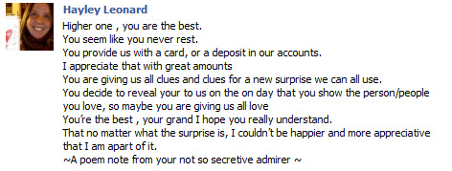


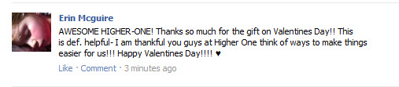
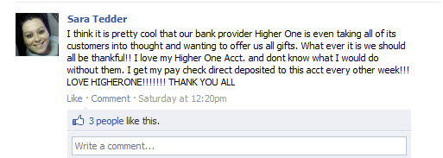

Slide 33
