Slide 1
Office of Retirement Services
Serving more than 530,000 customers
Michigan Public School Employees Retirement System
March 6, 2014

Slide 2
Agenda
GASB 68
Contribution Rates
Future Enhancements
Prep for Enhancements
Legislation Updates

Slide 3
GASB 68
Standard Issued by the Governmental Accounting Standards Board (GASB) in June 2012
Net Pension Liability to be Recorded in Financial Statements
Changes the way Pension Expense is Calculated
Fiscal Year 2015

Slide 4
GASB 68
Net Pension Liability
Market Value of Assets Minus the Actuarial Accrued Liability
Market Value of Assets
Actuarial Accrued Liability
Multi-Employer Cost Sharing Plan

Slide 5
GASB 68
Sharing the Liability amongst Schools
Propionate Share
Retirement Contributions Consist of Four Parts
Pension
Normal Cost
Unfunded Actuarial Accrued Liability
Health Care
Normal Cost
Unfunded Actuarial Accrued Liability

Slide 6
GASB 68
Let’s say MPSERS has only three school districts in it…
Reporting Unit | Unfunded Actuarial Accrued Liability Contributions | Proportionate Share Percentage | Net Pension Liability
School 1 | $1,000,000 | 5% | $1,250,000,000
School 2 | $15,000,000 | 75% | $18,750,000,000
School 3 | $4,000,000 | 20% | $8,000,000,000
Total | $20,000,000 | 100% | $25,000,000,000

Slide 7
GASB 68
Pension Expense
Today is calculated as the Employer Contributions to ORS
Under GASB 68 ORS will determine the Pension Expense and share it with you.

Slide 8
GASB 68
Standard Disclosures and more of them
Additional Required Supplemental Information
ORS will provide data that you and your auditors will use for reporting purposes in fiscal year 2015.

Slide 9
GASB 68 Questions
Does GASB 68 impact the contribution rates?
, GASB 68 is a standard that impacts financial statement preparation. The standard has no impact on calculating contribution rates for reporting units.
No

Slide 10
GASB 68 Questions
Isn’t this the same thing as the Unfunded Actuarial Accrued Liability MPSERS Rate Stabilization Payments?
No
No, GASB changes are related to preparing and reporting financial statements. Rate stabilization is related to funding the pension system.

Slide 11
GASB 68 Questions
How do I lessen my liability?
The liability will be paid off according to the amortization of the unfunded liability over time.

Slide 12
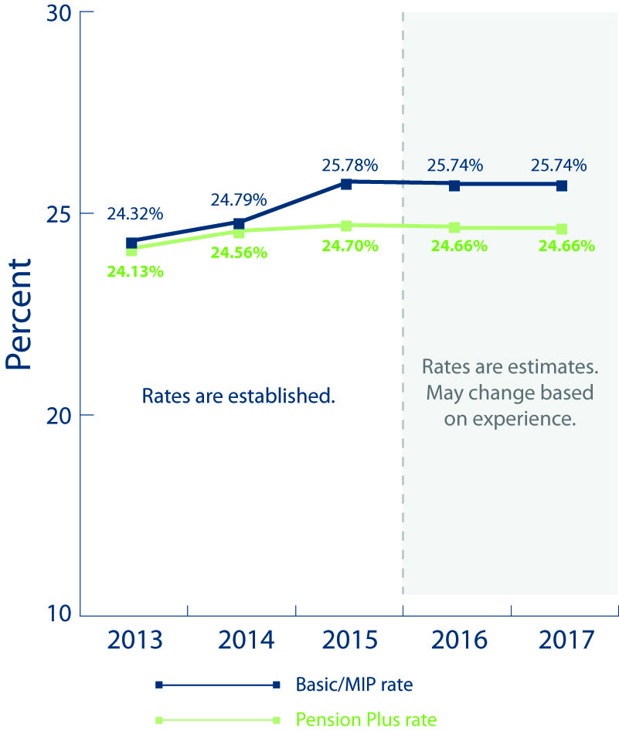
Employer Contribution Rates

Slide 13
Future Enhancements
Defined Contribution/Detail 4 Records
ING Feedback file
Reporting and Payment Standards
Employer Statement New Look
New Hire Elections Online

Slide 14
Detail 4 Records
DC and PHF contributions will be calculated like MIP and the 3% healthcare contributions on the Detail 2 records.
The ING Feedback file will be used in calculating what is due.
The Download Detail will display discrepancies.

Slide 15
ING Feedback File
The ING Feedback File will be available daily.
Personal Healthcare Fund (PHF) and Defined Contribution (DC) deferral amounts will be separated.
The hierarchy or DC and PHF deferrals remains the same.

Slide 16
Transition Ends
Pay Cycle Reports
Reports need to be 100% posted and are due by the 5th business day from the end date of that report.
Pay Cycle Payments
Payments will be due the 7th business day from the end date of your pay cycle.
Plan accordingly, late fees will accumulate more often, resulting in compounded late fees and interest.

Slide 17
Employer Statements
Employer Statements
Statements will be provided by pay cycle.
Available by the 7th business day from the end date of your pay cycle.
Both Defined Benefit (DB) and Defined Contribution (DC) balances will be available in the Reporting Website in one statement.
No DEG to obtain your DC statement.

Slide 18
New Hire Election
Functionality in the Employer Reporting Website to report the election.
Eliminate sending the form to ORS.
Notifications when a member’s election period is ending.

Slide 19
Prepare for Enhancements
Report and post timely
Ensure members with a DC component of their retirement plan have a detail 4 record
Pay timely using ACH online
Reconcile with ORS

Slide 20
Basic Equation to Reconcile
Balance on most current statement
+
Amounts reported after statement
̶
Payments made after statement
+
Assessed fees, if applicable
Balance Owed

Slide 21
Accounts to Reconcile
Defined Benefit (DB)
Pension and 3% healthcare contributions
Defined Contribution (DC)
457 contributions and personal healthcare fund
Two separate types of contributions ̶̶ can’t be commingled
Payments for both should be made via ACH

Slide 22
Current Reconciliation Issues
Adjustments to reports
DTL4 records changes for DC/PHF
MPSERS UAAL Rate Stabilization Amount
Assessed Fees
Payments made to the wrong plan (DB vs DC)

Slide 23
Resources – Specific to DB
DB Online Monthly Statement
Missing/Late Report Invoices
Cash Receipt History
Download Detail on ESS
Upon request:
Cumulative Statement, Alternative Statement

Slide 24
Resources – Specific to DC
DC Monthly Pension Plus Statement
Provides cumulative history
Missing/Late/Incomplete DTL4 Record Invoices
List of Missing DTL4 Records
Cash receipt history
Download Detail

Slide 25
Reconciliation Tools
Available via the Employer Reporting Site:
DB Monthly Statement
View Employer Statement – Current Employer Statement & Employer Statement History
Retirement Detail Reports
Reports: Work on Reports – Download Details
ACH Payment History

Slide 26
Reconciliation Tools
Available via the Data Exchange Gateway (DEG):
DC Monthly Statement
Shortfall Late Fee and Interest Invoices (if applicable)
Missing DTL4 Records
MPSERS UAAL Rate Stabilization Amount invoices

Slide 27
Legislation Update
Working After Retirement rules Public Act 464
House Bill 5181 extends the sunset date through July 1, 2016.
3% Healthcare Contribution
Waiting on a ruling by the Michigan Supreme Court

Slide 28
Questions?

Slide 29
ORS Contact Information
Employer Reporting Questions
Website: www.michigan.gov/psru
Email: ORS_Web_Reporting@michigan.gov
Call Center: 517-636-0166
Member Questions
Website: www.michigan.gov/orsschools
Call Center: 800-381-5111
www.michigan.gov/orsmiaccount

