Slide 1
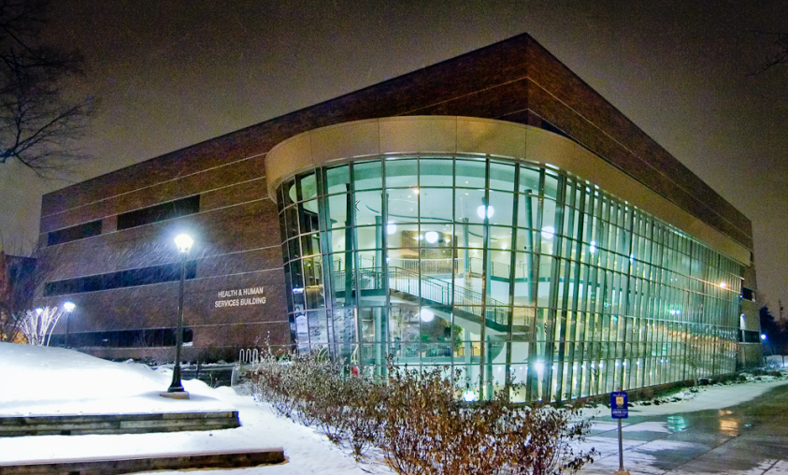
Capturing True Delivery Costs of Accredited Nursing and Allied Health Programs
MCCBOA – March 6, 2014
Health and Human Services Division
Margie Clark, MSN, RN, GNP – Dean

Slide 2
Presentation Description
Several nursing and allied health programs have varying accreditation-directed, regulatory, quality and safety focused requirements. This presentation will address a process and spreadsheet-template tool created to capture the variety of staffing and additional equipment costs associated with high-cost course delivery.
Notes:
Presentation Description – MARGIE
Several nursing and allied health programs have varying accreditation-directed and quality focused requirements. This presentation will address a process and spreadsheet template created to capture the variety of staffing and additional equipment costs associated with course delivery.

Slide 3
Topics
The topics covered in this presentation include:
Financial challenges in high cost programs
Financial implications of program accreditation
Definition of tuition, billable hours, and course fees
Challenges identified when charging student fees
Explanation of a “micro-section”
Process used for identifying program costs
Cost tracking spreadsheet
List of LCC academic programs reviewed
Discussion of the “lessons learned”
Notes:
Topics – SEAN
The topics covered in this presentation include:
Financial challenges in high cost programs
Financial implications of program accreditation
Definition of tuition, billable hours, and course fees
Challenges identified when charging student fees
Explanation of a “micro-section”
Process used for identifying program costs
Cost tracking spreadsheet
List of LCC academic programs reviewed
Discussion of the “lessons learned”

Slide 4
HHS Division Financial Challenges
Programs are expensive and not cost-neutral
LCC supplemented high-cost academic programs
RERs (Revenue-to-Expenses Ratio) were below college expectations
Academic Program | Fiscal Year RER
 | 2010 | 2012
Child Development | .97 | .96
Dental Hygiene | .44 | .66
Diagnostic Medical Sonography | .63 | .84
Nursing | .75 | .74 (+4 FTF)
Radiologic Technology | .60 | .61
Surgical Technology | 1.05 | 1.06
Therapeutic Massage | .93 | .96
Notes:
Financial Challenges in the Division – MARGIE
Programs are expensive and not cost-neutral
LCC supplemented high-cost academic programs
RERs (Revenue-to-Expenses Ratio) were below college expectations
CHDV – study clarified true costs
NURS – loss would have been larger w/o fee increase (was .69 in 2008)
MASG – implemented cohorts

Slide 5
HHS Division Financial Challenges
Programs costly because of small group instruction
Additional faculty members required to meet instructor/student ratios in lab and clinical settings
Necessary to run under enrolled (<12 students) course sections
Some accreditors mandate staffing
Need ability to track program-specific costs
Need to identify opportunities for savings
Notes:
Financial Challenges in the Division – MARGIE
Programs costly because of small group instruction
Additional faculty members required to meet instructor/student ratios in lab and clinical settings
Every section is running under enrolled (<12 students) course sections
Some accreditors mandate staffing others do not
Needed the ability to track program-specific costs
Needed to identify opportunities for savings

Slide 6
Financial Impact of Accreditation
Accredited programs have additional costs
Modest costs to become accredited
Maintaining accreditation requires funding
Requirements of maintaining accreditation:
Administrative positions are required
Additional instructors are required to maintain faculty to student instruction ratios
Ongoing data collection/analysis is needed
Annual review of accreditation requirements
Notes:
Financial Impact of Accreditation – MARGIE
ADDING TO THE FINANCIAL CHALLENGES ARE THE REQUIREMENTS FOR PROGRAM ACCREDIATION
Accredited programs cost money
Modest costs to become accredited
Fees
Internal paperwork, etc.
Maintaining accreditation requires funding
Requirements of maintaining accreditation:
Administrative positions are required
DENT REQUIRES FT DIRECTOR, SUPPORT, AND PT DENTIST
IDMS REQUIRES FT DIRECTOR, CLINICAL COORDINATOR
Additional instructors are required to maintain faculty to student instruction ratios
WE’LL TALK MORE ABOUT THIS IN A FEW MINUTES
Ongoing data collection/analysis is needed
Annual review of accreditation requirements is needed and may include:
SITE VISITS
REPORTS
ANNUAL FEES
WE NEEDED A TOOL TO KEEP TRACK OF ACCREDITATION RELATED COSTS AND REQUIREMENTS

Slide 7
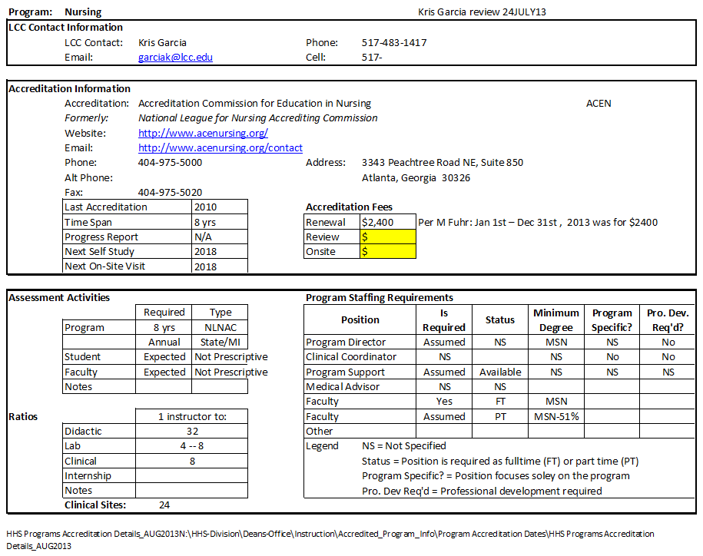
Tracking Accreditation Requirements
Notes:
Tracking Accreditation Requirements – SEAN
THIS IS THE FIRST OF TWO TOOLS USED.
Accreditation information tracking sheet.
THIS SHEET IS ONE TAB IN A SPREADSHEET USED TO TRACK ACCREDITATION INFORMATION FOR PROGRAMS.
HIGHLIGHT:
ACCREDITATION INFO
FEES
RATIOS
STAFFING REQS
ADDITIONAL INFORMATION IS ALSO TRACKED (NEXT SLIDE)

Slide 8
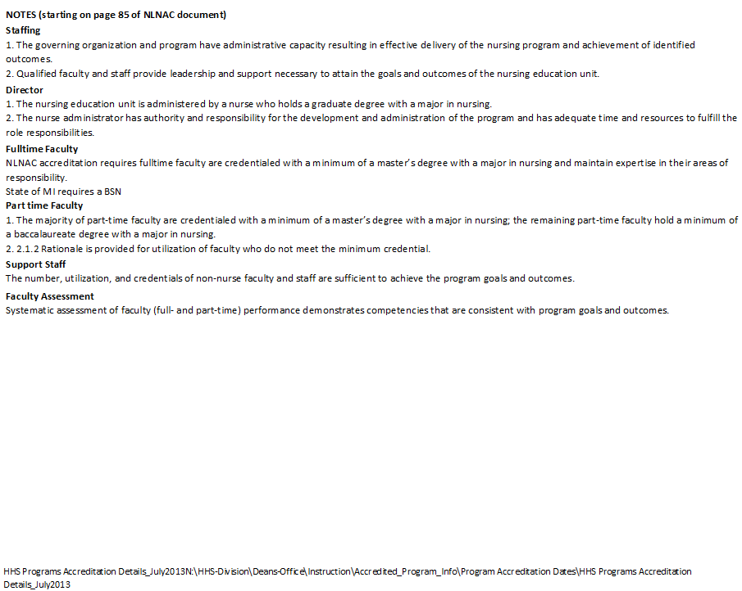
Tracking Accreditation Requirements
2008 accreditation information
Notes:
Tracking Accreditation Requirements – SEAN
Accreditation information tracking sheet.
THE LOWER PART OF THE TAB INCLUDES NOTES THAT EXPLAIN STAFFING REQUIREMENTS, FACULTY EVALUATIONS, PROFESSIONAL DEVELOPMENT, AND FACILITIES
NEXT, WE’LL PRESENT INFORMATION ON STUDENT COSTS

Slide 9
What Students Pay
Student costs fall into three categories.
Billable Hours
Course Fees
Books and Materials
Today’s presentation focuses is on the first two items.
Notes:
What Students Pay – SEAN
Factors impacting program costs for students in HHS programs – Billable Hours and Course Fees
Today’s focus is on Billable Hours and Course Fees

Slide 10
Student Costs – Billable Hours
Represent number of contact hours the student spends with instructor
Tuition is set by the LCC BOT
Tuition equated credits
Tuition based on billable hours
Notes:
Student Costs – Billable Hours – MARGIE
Two factors impacting program costs for students in HHS programs – WE CAN CONTROL Billable Hours and Course Fees
Billable Hours represent the number of contact hours the student spends with the instructor
Not necessarily reflected in credit hours – some courses require more instructor time
Tuition rates are set by the LCC BOT
Billable Hours are paid by student as tuition dollars
Tuition is based on the billable hours
THIS IS AN IMPORTANT DISTINCTION TO MAKE AS WE’LL SEE ON THE NEXT SLIDE

Slide 11
Micro-Sections = More Instructors
Section has average faculty/student ratio of 1:30
Many health-related programs have smaller ratios
A micro-section is a subset of students enrolled in a class that includes additional instructors required to meet clinical and lab faculty to student ratios
Course | Ratio (F:S) | Number of Instructors
 |  | Lecture | Lab | Clinical
WRIT 121 (Composition I) | 1:25 | 1 | 0 | 0
MATH 112 (Intermediate Algebra) | 1:30 | 1 | 0 | 0
BUSN 118 (Intro to Business) | 1:35 | 1 | 0 | 0
NURS 285 (Adv. Acute Nursing Care) | Varies | 1 | 6 | 8
Notes:
Micro-Sections = More Instructors – MARGIE
A section has average faculty / student ratio of 1:30
HIGHLIGHT CHART ON SCREEN
Many health-related programs have smaller ratios PER SECTION
EXPLAIN WHY
A micro-section is a subset of students enrolled in a class that includes additional instructors required to meet clinical and lab faculty to student ratios
EXPLAIN NURS 285 EXAMPLE

Slide 12
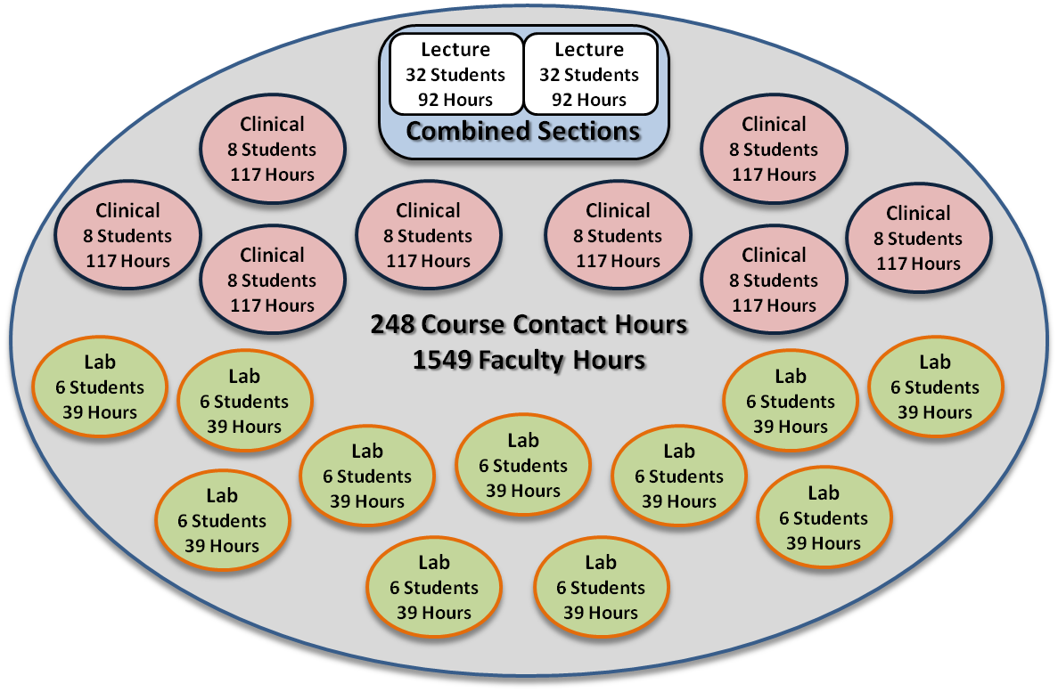
NURS 150: Fundamentals of Nursing
Notes:
NURS 150: Fundamentals of Nursing – MARGIE
Micro sections means increased faculty hours
EXPLAIN THE CIRCLE GRAPHIC
CLICK (brings up the faculty hours box)
EXPLAIN THE BREAKDOWN OF FACULTY HOURS GRAPHIC

Slide 13
NURS 150: Fundamentals of Nursing
9 Credit Hours = 15.5 Billable Hours
Calculate Total Student Contact Hours
92 Contact Hours of Lecture (1:1 ratio)
39 Contact Hours of Lab (1:3 ratio)
117 Contact Hours of Clinical (1:3 ratio)
248 Total Contact Hours
Calculate Billable Hours from Contact Hours
16 Contact Hours = 1 Credit Hour
248/16 = 15.5
15.5 Billable Hours
Notes:
NURS 150: Fundamentals of Nursing – MARGIE
9 Credit Hours = 15.5 Billable Hours
Calculate Total Student Contact Hours
92 Contact Hours of Lecture (1:1 ratio)
39 Contact Hours of Lab (3:1 ratio)
117 Contact Hours of Clinical (3:1 ratio)
248 Total Contact Hours
Calculate Billable Hours from Contact Hours
16 Contact Hours = 1 Credit Hour
248/16 = 15.5
15.5 Billable Hours

Slide 14
CHDV 284: Early Childhood Practicum
2007-2008
5 Credit Hours (48 Lecture, 0 Lab, 128 Other)
5 Billable Hours
2012-2013
6 Credit Hours (48 Lecture, 0 Lab, 192 Other)
6 Billable Hours
Hours at Worksite Per Semester |  | Credits
 | 108 – 159 hours | 2 credit course
 | 160 – 211 hours | 3 credit course
 | 212 – 263 hours | 4 credit course
 | 264+ hours | 5 credit course
Notes:
CHDV 284: Early Childhood Practicum – MARGIE
2007-2008
5 Credit Hours (48 Lecture, 0 Lab, 128 Other)
5 Billable Hours
2012-2013
6 Credit Hours (48 Lecture, 0 Lab, 192 Other)
6 Billable Hours
Hours at Worksite Per Semester
108 – 159 hours = 2 credit course
160 – 211 hours = 3 credit course
212 – 263 hours = 4 credit course
264+ hours = 5 credit course
Example: A program with a worksite component currently has a student working 8 hours per week for 16 weeks totaling 128 hours. This is a 2 credit course because 128 hours is within the identified range of 108 - 159 hours.

Slide 15
Student Costs – Course Fees
Consumables (e.g. supplies)
Equipment maintenance
Cost of additional required instructors/administrators
Mastery learning costs
Simulation education throughout curricula
Increased liability insurance
Notes:
Student Costs – Course Fees – SEAN
Factors impacting program costs for students in HHS programs – Billable Hours and Course Fees
Course Fees:
Consumable items (e.g. supplies)
Equipment maintenance
Pay for additional required instructors (based on ratios), administrators , and professional staff (e.g. dentist, medical director)
Faculty costs to support Mastery learning
Provide simulation education throughout curricula
(Nursing and EMT/PARA courses)
Increase in liability insurance costs

Slide 16
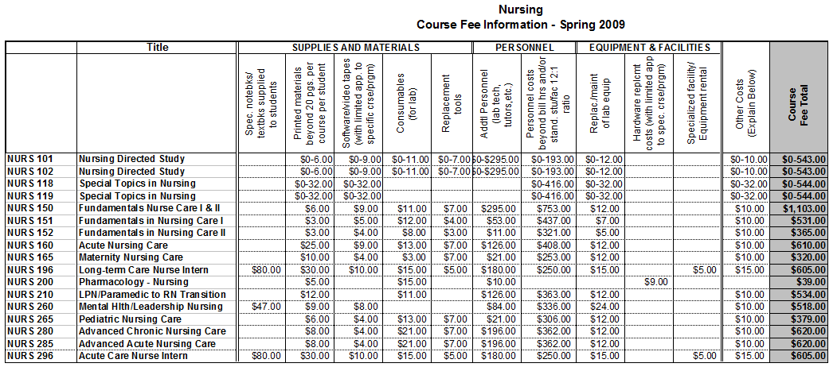
Evolution of Course Fees
Spreadsheets updated yearly by each program
General categories identified
No guidelines for determining some fees
Notes:
Evolution of Course Fees – SEAN
Spreadsheets updated annually by programs
General categories identified
No guidelines for determining some fees
CLICK
Supplies and Materials – consumable items
Personnel – personnel beyond the instructor
Equipment & Facilities – program specific

Slide 17
Limited Ability to Adjust for Costs
Varied approaches used to cover course costs
90s-00s: Tuition/fees increased but only 15%/year
2004: Billable Hours implemented
Three (3) credit hour cap
Billing hours for internships and independent studies continued to be charged same as credit hours
Included college-wide reduction in course fees
2007: Approval to removal of 3 hour cap
Mostly health careers clinical and lab courses
2009: Financial review and update process began to capture course costs in health careers programs
Three year implementation for most programs
Notes:
Limited Ability to Adjust Course Fees – MARGIE
Historically, varied approaches to collect funds to cover course costs.
1990s to 2000s: Tuition and fees charged but Board of Trustees rule that only 15% increase allowed each year
Fall 2004 College implements Bill Hours to help capture costs, especially in small class size situations. – To allow the college to capture the revenue necessary to cover the additional instructor contact hour costs associated with courses.
Upon implementation of the billing hour model. BOT implemented a 3 credit hour cap - Billing hours for internships and independent studies would continue to be charged same as credit hours.
The College lowered course fees by $225,000 along with the billing hour implementation. Because of the higher level of additional instructional hours associated with health career programs, it was originally recommended that health career course fees be allowed to continue to reflect additional costs of instruction. However, some health career course fees were reduced upon implementation of the billing hour model.
Fall 2007 BOT approved Program Areas’ request to removal of cap Mostly health careers clinical and lab courses
2009: Fall 2011 Course fee update process began to capture course costs in health careers programs

Slide 18
HHS Program Review Process
Initiated review process to identify instructional delivery costs for academic programs
Created a tool to document instructional delivery costs for each course within programs
Identified non-course specific program costs
Developed formulas for calculating cost types:
Delivery costs
Accreditation-required costs
Others
Notes:
Course Cost Review Process – SEAN
Created a review process to identify instructional delivery costs for academic programs
Did not focus on course creation or updates, which are covered elsewhere
Created a tool to document instructional delivery costs for academic programs
Formulas for calculating cost types
Delivery costs
Accreditation-required costs
Formulas used to calculate standard costs
Transition: We needed a tool to identify true costs to deliver courses.

Slide 19
Excel Spreadsheet Tool
Excel spreadsheet used to document costs
 | Tracked each course in program areas
Lecture | Totaled methods of instruction/section Enrollment “seats” per course Average instructor rate Used formulas for calculations
Lab
Other
Documented all course-related fees | Supplies and Materials
 | Personnel
 | Equipment & Facilities
 | Other Costs
 | Yielded total costs for each course
Notes:
Excel Spreadsheet Tool – SEAN
Created a spreadsheet to document costs
Tracked courses by program area
Included instruction methods for each section (Lecture, Lab, Other)
Documented all related fees – EXPANDING BEYOND WHAT WAS ALREADY TRACKED
YEILDED UPDATED COURSE FEE SHEET ACROSS CAMPUS
Used multiple tabs to document common info.
Revenue Summary, Projected Revenue, Course Data, Common Costs
USED TO ID COMMON COSTS
CREATE FORMULAS
EVENLY ISTRIBUTE COSTS ACROSS COURSES/STUDENTS

Slide 20
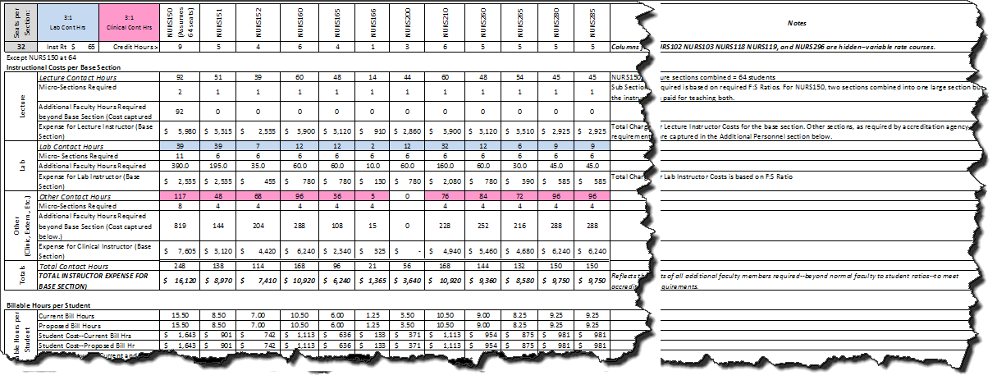
Spreadsheet Tool Tour
Notes:
Spreadsheet Tool Tour – SEAN
TOUR ON SPREADSHEET
USE NOTES FROM WORD DOC

Slide 21
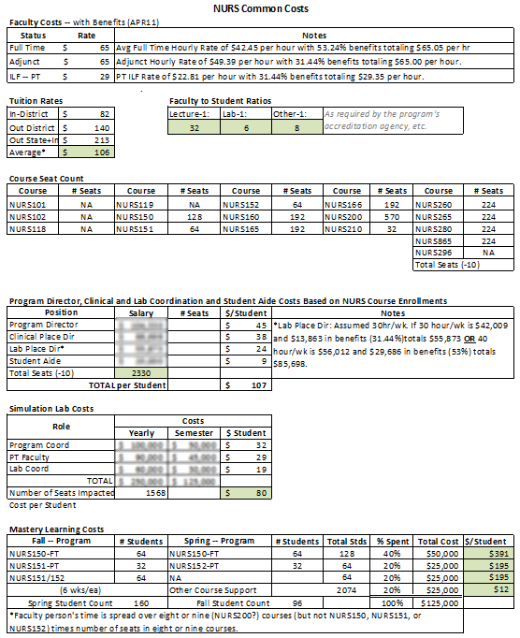
Common Costs Tab
Notes:
Common Costs Tab – SEAN
TOUR ON SPREADSHEET
USE NOTES FROM WORD DOC

Slide 22
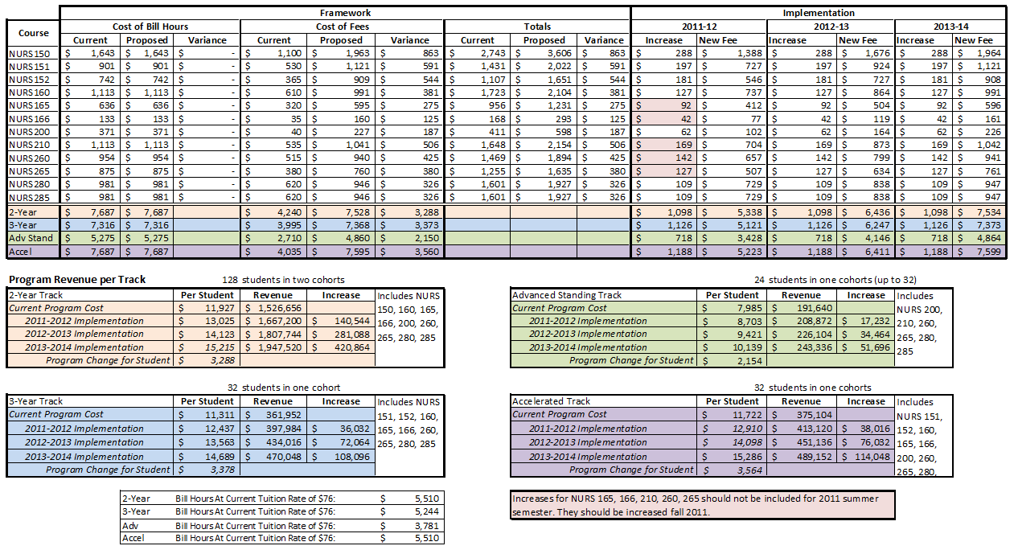
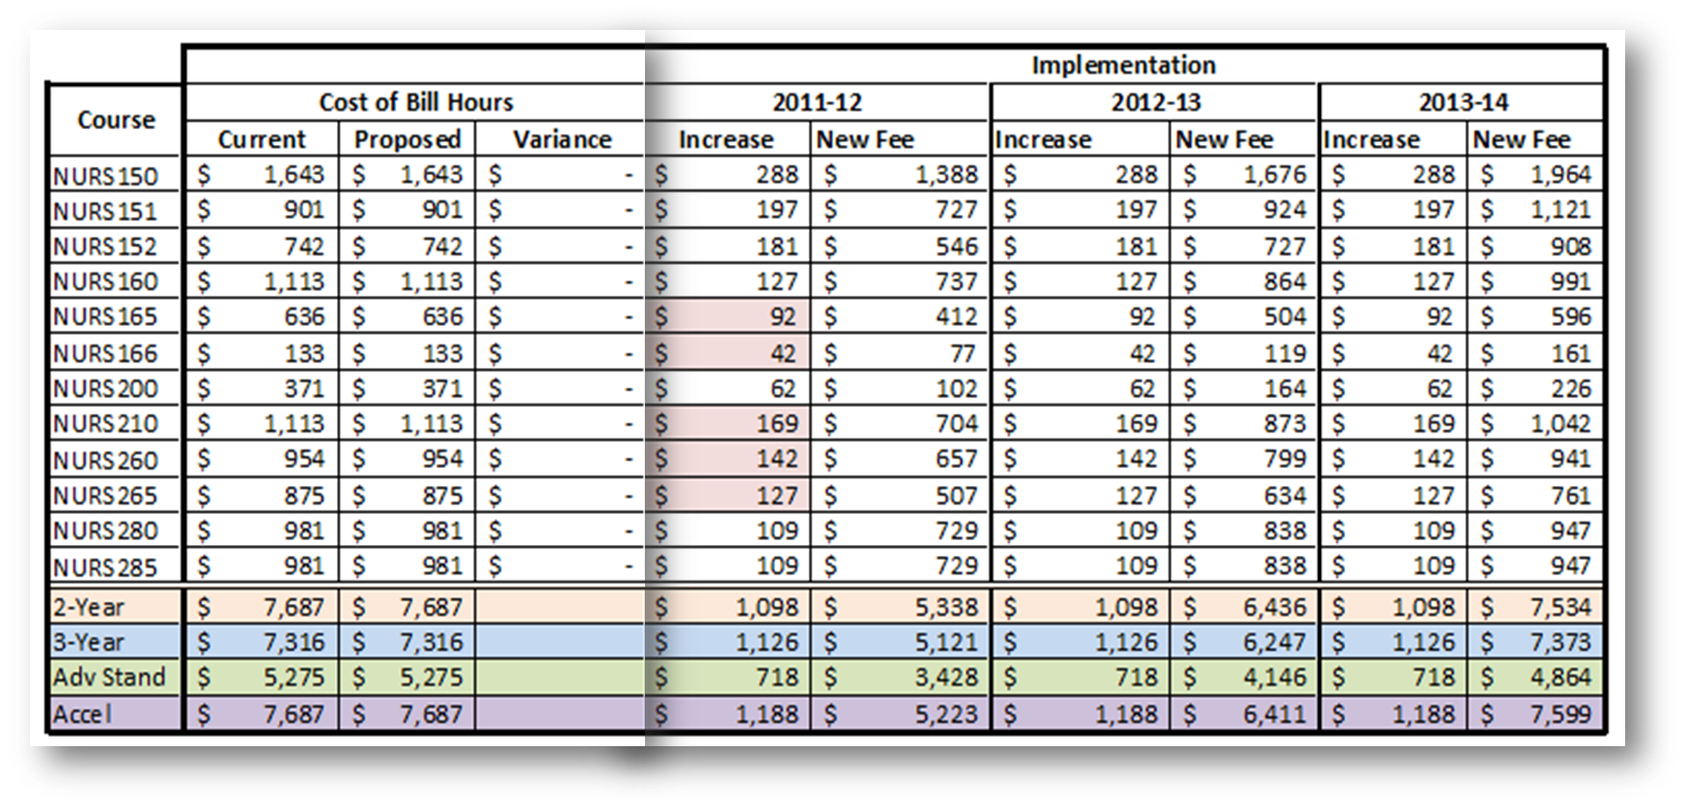
Fee Increase Implementation
Notes:
Fee Increase Implementation – SEAN
Three year implementation plan
CLICK
Spreadsheet page provided to staff for updates in Banner

Slide 23
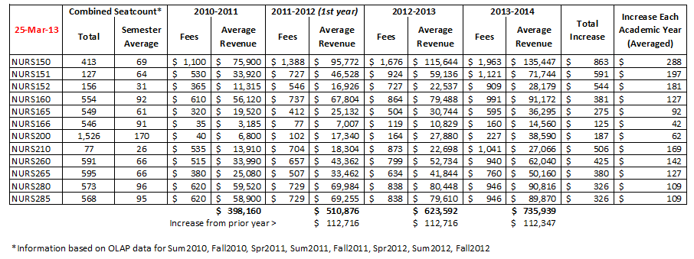
Projected Revenue
Notes:
Projected Revenue – MARGIE
Used for planning purposes
Based on average seatcount
Multiplied seatcount by student fees

Slide 24
Program Cost Review Process
Visioning with Dean
Created spreadsheet
Iterative review process
Honed information
Reviewed with Provost
BOT review and approval
Communicated changes
Implemented
Data (Spreadsheet, Reports, Etc.)
Program Directors
Dean and Provost
Notes:
Program Cost Review Process – SEAN
Visioning discussion with the Dean
Process for Identifying Costs
Elements in course fees
Determine true costs beyond instruction
Created spreadsheet drafts to capture known data
Iterative review process of costs with program administrators and chairs
Honed information on spreadsheets
Reviewed information with Provost
BOT approval after request for comparison with competitor schools
Communicated increases with students and accreditation agencies
Rolled out over three years (4 for DENT)

Slide 25
Health and Human Services Division
Degree/Certificate Programs and Courses in:
Dental Hygiene
Kinesiology
Diagnostic Sonography
Radiologic Technology
Fitness
Registered Nursing
Phlebotomy Technician
Aquatics
Therapeutic Massage
Health Unit Clerk Coordinator
Surgical Technology
Human Services
Paramedic
Medical Insurance Billing
Billing/Coding
Nursing Aide
Pharmacy Technician
Child Development
Sterile Processing Technician
Individual and Team Sports
Health and Wellness
Weight Training
Basic Emergency Medical Technician
25
Notes:
Health and Human Services Division
Animation of programs (in blue) and courses (in green) reviewed

Slide 26
Here’s What Happened
Project Outcomes
HHS academic programs reviewed
Fee changes being implemented
Program RER improving = less LCC subsidies
Lessons Learned
It took time to create spreadsheet
Need for good communication
Have multiple sets of eyes review
Good to focus on similar programs first
Promote ongoing ownership within program areas
Notes:
Here’s What Happened
Project Outcomes – MARGIE
HHS academic programs reviewed
Fee changes being implemented
Program RER improving = less LCC subsidies
CLICK
Lessons Learned – SEAN
Took time to create spreadsheet
CLICK
Need for improved communication with program areas
THERE WERE ISSUES WITH THIS – WHAT WAS THE INTENTION
SOME FACULTY MEMBERS DIDN’T UNDERSTAND WHAT
NEED FOR MORE COLLABORATION
Good to focus on similar programs first
Promote ongoing ownership within program areas

Slide 27
Contact Information
If you have additional questions or for a copy of the spreadsheet file:
Dean of Health and Human Services:
Margie Clark
517-483-1210
chapell@lcc.edu
Director of Instruction
Sean Quinn
517-483-9814
quinns@lcc.edu

