Slide 1
Michigan Public School Employees Retirement System Update
Kevin Kubacki, CPA & John Karagoulis
July 28, 2016

Slide 2
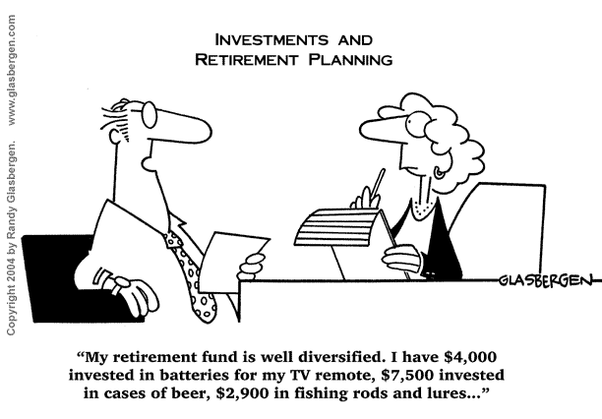

Slide 3
Agenda
Overview of ORS and its Customers
Healthcare Goals
Social Media
Financial Update
Contribution Rates
3% Healthcare Update
GASB Reporting
Recent Legislation
Deferred Compensation Plan

Slide 4
We Have a New Executive Director!
Kerrie
Vanden Bosch
Notes:
The search was national. The choice was local. Please join me in congratulating our colleague Kerrie Vanden Bosch, who has accepted the offer to serve as the new director of ORS.
Since she joined ORS in 2003, Kerrie played key roles in a number of initiatives. She was instrumental in the office’s change-management efforts, process re-engineering, partnership and customer service development, and strategic planning, among others. Her strategic and tactical efforts contributed to ORS’s success. As part of the DTMB team for the design and implementation of more than five major retirement reforms, she helped the department trim long-term liabilities by more than $20 billion.

Slide 5
Office of Retirement Services
Serving Michigan customers
1 of every 14 adults.
1 of every 9 households.
Market value of Defined Benefit assets is approx. $64 billion.
48th Largest pension fund in the world.
18th Largest public pension fund in the U.S.
Defined Contribution and Deferred Compensation assets of approx. $6 billion.
Sources: Census.gov; FY15 CAFR and Financial Statement; and 2014 Towers Watson P&I / TW 300 Analysis
Notes:
MPSERS
SERS
SPRS
JRS
MRS

Slide 6
Michigan Public School Employees’ Retirement System
Membership includes:
234,700 current employees
207,600 retirees and beneficiaries
Membership comes from:
Public school districts, ISDs and libraries
Some public school academies
Community colleges
Central, Eastern, Western, and Northern Michigan Universities, Ferris State, Lake Superior State and Michigan Technological Universities*
*Closed to new members on or after January 1, 1996
Source: FY15 CAFR
Notes:
Numbers include DB/Pension Plus and DC (rounded down to nearest hundred).
MPSERS
Active: 228,419
Retired: 207,651
DC
Active: 6,337
Retired: 0

Slide 7
Other Customers of ORS
State Employees’ Retirement System
121,000 customers
State Police Retirement System
4,800 customers
Judges Retirement System
1,200 customers
Military Retirement System
10,900 customers
Source: FY15 CAFRs
Notes:
Numbers include DB/Pension Plus and DC (rounded down to nearest hundred).
SERS
Active: 18,010
Retired: 58,453
DC:
Active: 36,012
Retired: 8,579
SPRS
Active: 1,852
Retired: 2,987
DC: 0
JRS
Active: 134
Retired: 560
DC
Active: 449
Retired: 62
MRS
Active: 10,504 (unofficial and unaudited)
Retirees: 457 (unofficial and unaudited)
DC: 0

Slide 8
Healthcare Goals
Healthcare Mission
To maintain a quality healthcare plan that is affordable to both the member and the schools.
Quality Goal
Measurably improve the quality of care enjoyed by members.
Cost Goal
Limit the rate of cost growth to the compound rate of inflation (CPI) and real economic growth.
Notes:
ORS has also been working hard to on its Healthcare Service. Our mission is to maintain a quality healthcare plan that is affordable to both the member and the school districts that employ them. We want to make sure that the product we provide helps employers attract the best talent and provide the ability to retain that talent… all while keeping it affordable.
In order to meet this mission we have a quality goal and a cost goal.

Slide 9
Recent Actions
The Strategic Planning Process began in the mid-’90s – Each year’s initiative has sought to maintain or increase the quality of the health plan and manage the cost.
Year | Initiative
2015 | Benefit Additions and Coverage Updates Leading to Cost Reductions and Avoidance.
2014 | Expanded Dental PPO Network
2013 | Implemented Public Act 300 of 2012
2012 | Implemented Employer Group Waiver Plan + Wrap for Medicare Prescription Drugs
2011 | Early Retiree Reinsurance Program
2010 | Adjusted Cost-sharing Amounts
2008/2009 | Expanded PPO Network; Therapeutic Interchange Program, Step Therapy and Prior Authorization; Care Management; Rx Copay Maximum
2007 | Medicare Advantage
Notes:
With keeping our qualitity and cost goal in mind here is a quick summary of some of the actions we have taken over some of the previous years.
Last year we had benefit additions and coverage updates that lead to reductions and avoidance of costs.
In 2014, we expanded the Dental PPO Network
In 2013 we implemented Public Act 300
In 2012, we implemented the Employer Group Waiver Plan which resulted in savings in the millions.
And so on and so on…
So every year we are looking to make major impacts to improve quality and cost.

Slide 10
Defying the Trends
Notes:
This is one of my favorite slides. I have often heard that the Affordable Care Act has resulted in dramatic increases to health costs. Through the hard work our that our healthcare folks have done, we have seen large increases in our covered retirees but our overall health spend has remained relatively the same.

Slide 11
Social Media
Definition: forms of electronic communication used to share information, ideas, personal messages, and other content.
Build relationships with customers.
Promote other products and services.
Relatively inexpensive communication channel.
Integrate retirement content with “fun” stuff.
Notes:
One item that ORS has been working hard at steadily improving is our social media.
Social Media is forms of electronic communication used to share information, ideas, personal messages, and other content.
The goals of our social media outreach was to:
Build relationships with customers
Promote other products and services
Keep it cost effective!
And have some fun. Retirement is an exciting part of peoples lives. We wanted to keep that excitement going with our social media goals.

Slide 12
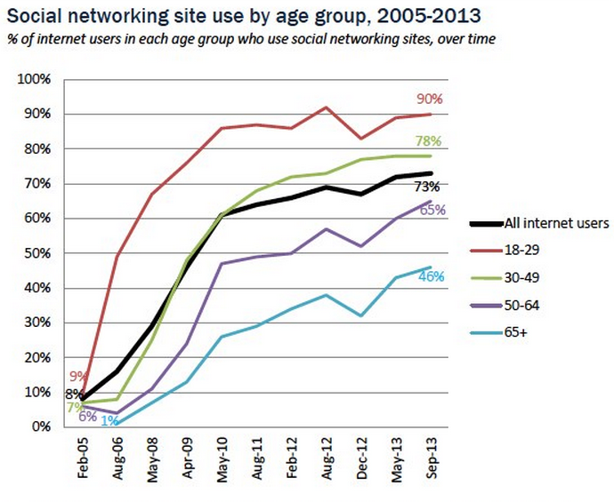
Social Media
Source: Pew Research Institute
Notes:
We pulled some social media information from the Pew Research Institute. In February of 2005, around 8% of internet users were regularly using social media. Over the course of 8 years you can see in the chart that social media usage is skyrocketing. What is most interesting about this chart is that, yes, all age groups are now using social media!
65% of people nearing the retirement age are using social media. 46% of our retired member is using social media. We looked at this data and said to ourselves, this looks like a very cost effective communications channel that we are under utilizing. We may have an opportunity here…
- Over 2/3 of our fans are over age 55.

Slide 13
Facebook
www.facebook.com/MichiganORS
Notes:
So work started on developing the Office of Retirement Service’s facebook page. At ORS, we maintain email addresses for our membership. An email blast went out to the membership in August of 2013 and within the first week we saw over 10,000 likes. So within the first week, we had already become the most liked public pension system in the U.S.
What Facebook has allowed us to do is to start steering the membership to other products and services we offer. We also post other retirement related articles.
An email blast
Over 25,000 fans since inception!
Most liked public pension system in the U.S.!
Discuss initial email that got everything started.

Slide 14
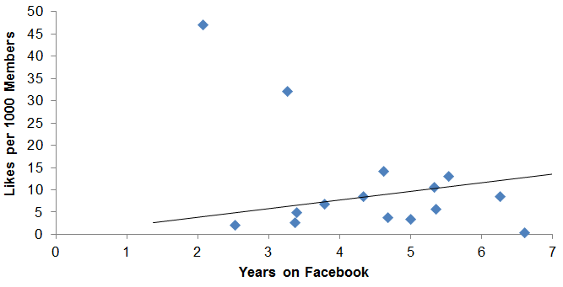
Likes VS Time
Source: Facebook
Notes:
Graph from September 2015
After the first week, you can see how word is continuing to get out. Our likes per 1,000 continues to grow.

Slide 15
Facebook
Target a different objective each day
Additional posts as needed
Customers can comment, like, share
Notes:
There is a lot of great content on our Facebook page. New and interesting articles are posted routinely and our Facebook account is actively reviewed daily. Remember how I mentioned earlier that one of our objectives was to keep it interesting and fun… well just the other day, I saw a quick video on, “inside a dog retirement home”. So yes, you can even find a place for the dog to retire.
As you can see on the screen here on the bottom left of the slide, a member had a question about purchasing some credit years and one of our Facebook technitions was able to direct her to a link on our website that provides all the details. Also, on the right side of the screen you can see some membership discussion after we posted an article about the 7 Reasons not to pay off your mortgage before you retire.

Slide 16
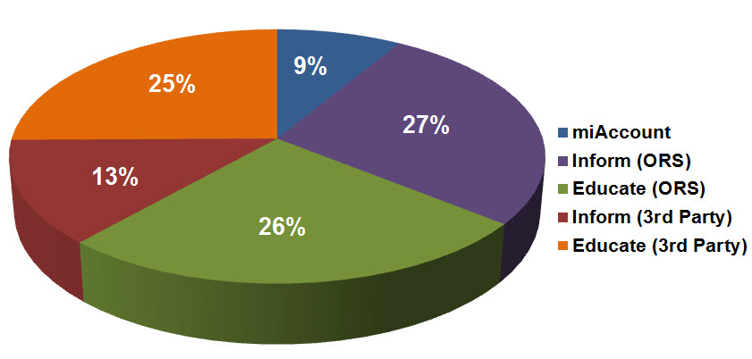
ORS Facebook Content Mix
Notes:
So here are some statistics about the mix of content we have on our Facebook page.
Over 50% of the content on Facebook contains education materials about retirement.
40% of the content is to inform the membership and 3rd parties about other products and services we provide.

Slide 17
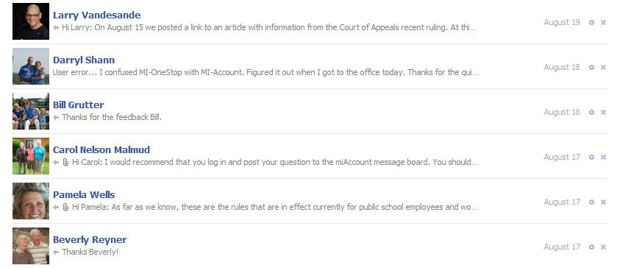
Facebook Private Messaging
Between ORS and the individual
Notes:
Our Facebook technicians also reply to private messages that are received. For general questions about retirement, this is another method of communication that members can utilize to get general questions answered.

Slide 18
ORS Social Demographics
The ladies dig us!
76% of fans
And so do retirees!
67% over age 55
Notes:
Some more interesting statisics:
76% of our likes are from Women
67% of our likes are from people over the age of 55!
Overall, we view our Facebook page as a very large success and I want to encourage everyone here to come check it out!

Slide 19
@MichiganORS
Launched ORS Twitter account in October 2014
Different messaging and target audience
Key into existing conversations
@MichiganORS
Notes:
So what else has ORS done with social media…?
After seeing so much success with Facebook, we extended our social media communication to Twitter.
A twitter account was launched in late 2014.

Slide 20
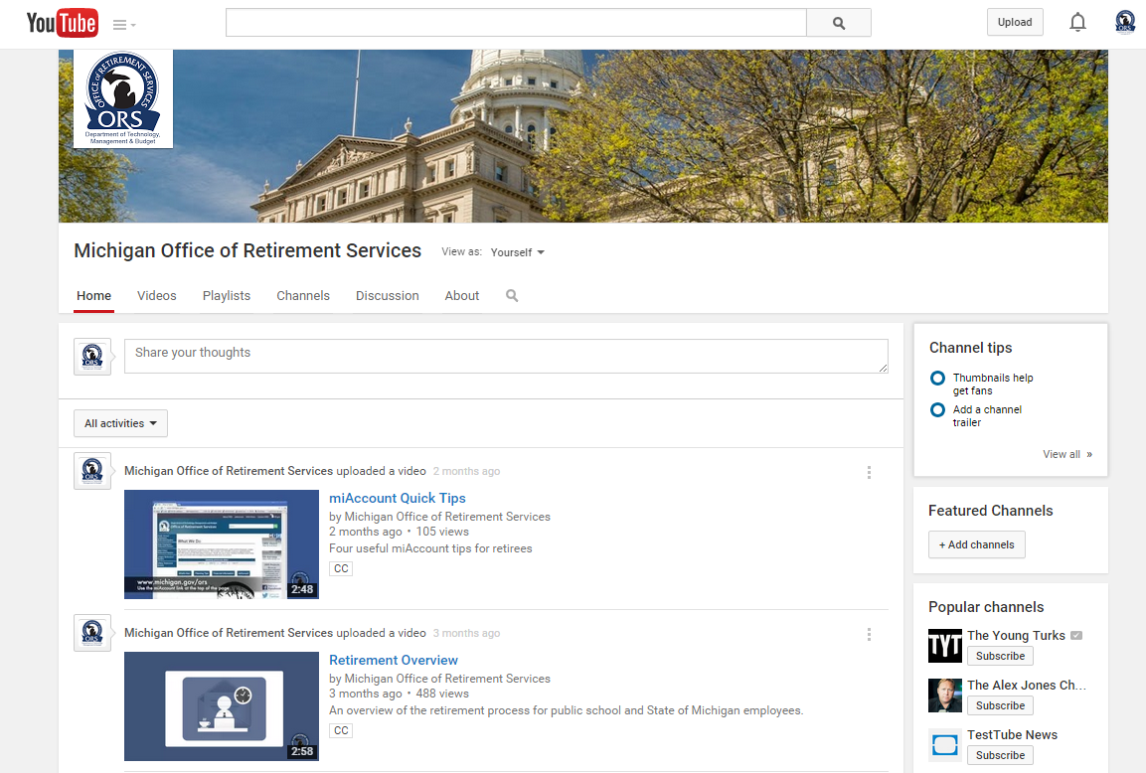
ORS YouTube Channel
Launched YouTube channel in March 2015
Supportive of other communication channels
Notes:
Oh yes, the social media outreach continues.
Recently in March of 2015, ORS developed its own YouTube channel. Recently videos have been released on the financial status of the plans and there are other videos on miAccount and a video that walks you through the retirement process.

Slide 21
MPSERS Financial Status Update
MPSERS Pension Funding Ratio
Notes:
Switching topics to the financial status of the plan.
MPSERS has two separate trusts associated with it.
- 1 for the Pension Benefits
- and another for Health Insurance benefits.
The chart on the screen shows the funding ratio for the Pension plan on the Market Basis and Actuarial Basis.
The Market Basis Funding ratio takes the amount of money that we currently have in the bank and is applied by the liability amount determined by System’s actuary.
The actuarial basis funding ratio smooths investment gains and losses and is applied against the same liability the actuary determines for the system.
Both of these funding ratios serve important purposes:
The Market Basis Funding ratio is what determine the amount of liability that is reported on a set of financial statements for GASB 67 & 68 purposes.
The actuarial basis funding ratio is utilized to determine the funding of the system.

Slide 22
MPSERS Financial Status Update
MPSERS Healthcare Funding Ratio
Notes:
So as noted on the previous slide there is a second trust for OPEB.
Historically we did not show the funding status of the healthcare trust because it was funded on what actuaries’ call, “a Pay-go” basis. In other words, the system was funded just enough to pay the current bills. Therefore, prior to 2012, the funded status of the plan hovered around 3 – 4%.
Starting in 2012, the System began prefunding the healthcare trust. In 3 years, the funded status of the plan has jumped from 4 – 5% to 21 – 25%.

Slide 23
MPSERS Financial Status Update
Pension trust assets total: $45 Billion¹
Healthcare trust assets total: $4.5 Billion¹
The system is scheduled to be fully funded by 2038
¹Source: MPSERS 2015 Comprehensive Annual Financial Report
Notes:
So the system is not 100% funded. Should you panic? No!
Pensions are very long term in nature. The systems are being funded based on a closed amortization schedule. So by the year 2038 the system is currently scheduled to be fully funded. Bringing the system to 100% funding is like paying off a mortgage. You keep chipping away at the balance until it is fully paid off.
According to the 2015 MPSERS CAFR, the Pension had over $45 billion in trust assets, with the Healthcare trust also caring over 4 and a half billion.

Slide 24
FY 17 Contribution Rates
MPSERS ESTIMATED PENSION CONTRIBUTION RATE
Includes reconciliation
October 1, 2016 - September 30, 2017
 | Basic/MIP with Premium Subsidy |  | Pension Plus with Premium Subsidy |  | Pension Plus PHF |  | Pension Plus to DC with PHF |  | Basic/MIP to DC with Premium Subsidy |  | Basic/MIP to DC with PHF |  | Basic/MIP with PHF |  | Retirees Returned to Work *
Pension Normal Cost | 3.76% |  | 3.13% |  | 3.13% |  | 0.00% |  | 0.00% |  | 0.00% |  | 3.76% |  | 0.00%
Pension UAL | 13.91% |  | 13.91% |  | 13.91% |  | 13.91% |  | 13.91% |  | 13.91% |  | 13.91% |  | 13.91%
Pension UAL - Early Retirement Incentive | 1.36% |  | 1.36% |  | 1.36% |  | 1.36% |  | 1.36% |  | 1.36% |  | 1.36% |  | 1.36%
Total Pension | 19.03% |  | 18.40% |  | 18.40% |  | 15.27% |  | 15.27% |  | 15.27% |  | 19.03% |  | 15.27%
Health Normal Cost | 0.22% |  | 0.22% |  | 0.00% |  | 0.00% |  | 0.22% |  | 0.00% |  | 0.00% |  | 0.00%
Health UAL | 5.69% |  | 5.69% |  | 5.69% |  | 5.69% |  | 5.69% |  | 5.69% |  | 5.69% |  | 5.69%
Total Health | 5.91% |  | 5.91% |  | 5.69% |  | 5.69% |  | 5.91% |  | 5.69% |  | 5.69% |  | 5.69%
Total Contributed by Schools for DB | 24.94% |  | 24.31% |  | 24.09% |  | 20.96% |  | 21.18% |  | 20.96% |  | 24.72% |  | 20.96%
DC employer match | 0.00% |  | 1.00% |  | 1.00% |  | 3.00% |  | 4.00% |  | 4.00% |  | 0.00% |  | 0.00%
PHF employer match | 0.00% |  | 0.00% |  | 2.00% |  | 2.00% |  | 0.00% |  | 2.00% |  | 2.00% |  | 0.00%
Total DC | 0.00% |  | 1.00% |  | 3.00% |  | 5.00% |  | 4.00% |  | 6.00% |  | 2.00% |  | 0.00%
Total Contributed by Schools for DB & DC | 24.94% |  | 25.31% |  | 27.09% |  | 25.96% |  | 25.18% |  | 26.96% |  | 26.72% |  | 20.96%
(percentages match the rate communication)
Notes:
Contribution Rates for Districts remain capped at 20.96%
Rates increased in total slightly from FY2016.
Pension portion of rate is up because the retirement system moved to more conservative assumptions
Healthcare potion of rate is slightly down
Total contributions projected for FY17 are: $3.3 Billion ($3,286,023,535)
Contributions from School Aid Fund: $1 Billion (1,056,766,737)
Normal Cost did go down however, the UAAL portion of the pension part increased at a greater rate. For the basic plan, normal cost decreased .63%; however, the pension UAAL component increased .71%.

Slide 25
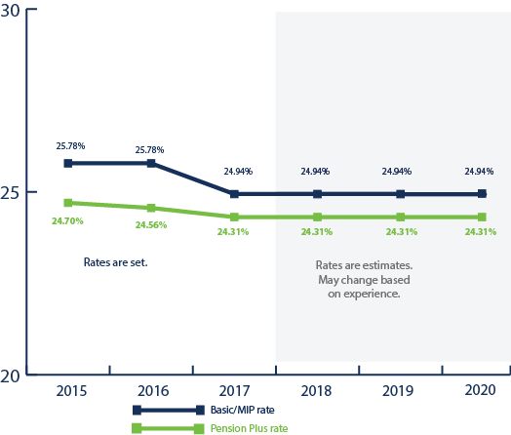
Employer Contribution Rates
Rates remain relatively constant
Notes:
Contribution rates are determined actuarially based on the economic conditions and an assumed investment return each year. Contribution rates for fiscal years 2016 and 2017 have been calculated, provided to employers, and published on the employer website.
Rates for fiscal years 2018, 2019, and 2020 are estimated using the most recent data available.

Slide 26
Funding Notes
The effects of the 2008/2009 recession have now fully phased in.
Good investment returns will start to positively impact the system.
$3.2B actuarial gain per 2014 valuation.
Investments yielded 15.9% return in FY14.
Retiree healthcare pre-funding and asset levels continue to improve.
Stranded costs have an impact.
Notes:
Good investment returns (notes)
$3.2 B actuarial gain per 2014 valuation—investments yielded a 15.9% return in FY14.
This gets phased in over 5 years which lowers annual required contributions.
This benefits schools indirectly in that there would be less money needed to come out of the school aid fund over the next 5 years for the UAAL rate stabilization allocation, which in theory could be made available to them in the per-pupil allowance.
Even though we had the investment gains, stranded costs hide those successes, and we had an additional $54M in stranded costs last year which comes out of the school aid fund.

Slide 27
Membership Status
Notes:
As you can see in this slide membership has declined by almost 100,000 members from 2004. The drop in membership has resulted in stranded costs. Stranded costs are created when the payroll base is not as high as the actuary anticipates. This can result in increased contribution rates to ensure the system is fully funded by 2038.

Slide 28
Future of the Pension System
If population drops by a third, we need to ask two important questions:
Are we providing the right retirement benefit?
Do we have a change in employee wants and needs?
Do we need to shift focus from primarily long-term employees to also be more concerned with those who are more mobile?
Do we have the right funding model?
The model in place worked very well for decades and does work well in most of the U.S.
Michigan has a very organic model that provides parents a great deal of choice: charter schools, schools of choice.
Are the actuarial payroll assumptions correct?
Notes:
Ask questions as open ended questions to the audience.
These are items that we are continuing to work with the budget office and legislators to ensure the system provides a great benefit at a great price.

Slide 29
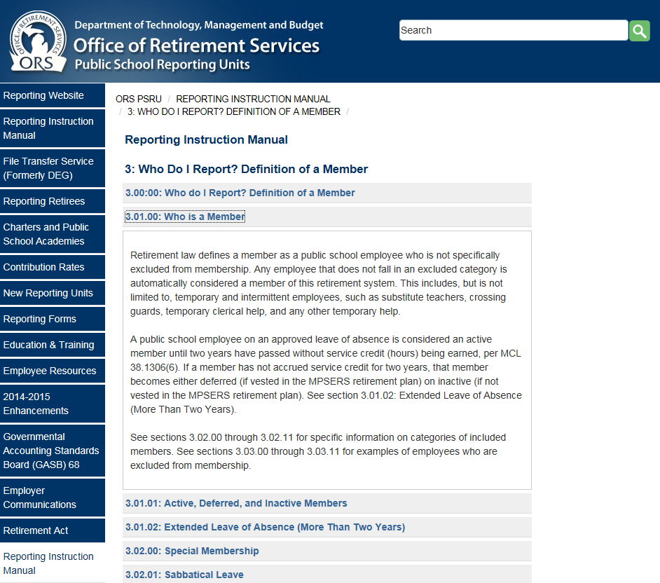
Reporting Instruction Manual
RIM is moving to the same content management tool that houses the PSRU website.
Improvements:
Look and feel
Navigation and search
ADA compliance
Technical support
Notes:
The RIM is going to be moved to the PSRU website. The RIM should maintain the same look and feel that everyone is familiar with; however, they are going to make some improvements that will allow for easier navigation, ADA compliance, and technical support.
Targeting late April/early May for transition.

Slide 30
3% Healthcare Contribution Update
On June 7, 2016, the Michigan Court of Appeals ruled on Public Act 75 of 2010 and the 3% healthcare contributions that are being held in escrow for public school retirees. The court remanded the ruling back to the trial court.
On July 19th the Governor’s office has filed to appeal this decision to the Michigan Supreme Court.

Slide 31
3% Healthcare Contribution FICA Tax
ORS has been made aware of recent determinations, which ruled in part that the contributions are subject to FICA taxes.
ORS has not changed the previous guidance made to school districts on the federal tax treatment of the retiree healthcare contributions.
ORS has created an Overview and Analysis document.
Sets forth some of the best arguments for favorable tax treatment.
Reporting units will each have to make their own determination with regard to their federal tax analysis.
ORS has submitted for a private letter ruling request.
ORS encourages employers to consult with your tax advisor.
Notes:
ORS has created an Overview and Analysis document that sets forth some of the best arguments for favorable tax treatment.
In the meantime, ORS has submitted a private letter ruling request to the IRS.
Reporting units will each have to make their own determination with regard to their federal tax analysis.
For those reporting units that are advocating for favorable tax treatment on an individual basis, it is anticipated that parts of the Overview and Analysis can be used as they advocate for that position.

Slide 32
GASB 68
Year two of GASB 68 is upon us.
Audited GASB 68 information was released on July 18th.
Public School Reporting Units website: www.michigan.gov/prsu
On the left hand navigation tab, find the GASB 68 tab.
New this year: 147(c) and 147(d) payments.
00.00% of your 2015 147(c) payments is for pension.
69.45% of your 2016 147(c) payments is for pension.
Notes:
The second year of GASB 68 implementation is coming. I think it is safe to say that we all learned a lot about the new GASB standards. ORS will again provide audited data by the Office of Auditor General; however, this year we are targeting to release the information in July.
The Information will be located again on the PSRU website and we will update the tables with new information. You can expect a few changes as a result of recently released AICPA guidance on “employer pickup contributions” and the release of detailed deferred inflows and outflow information.
We have also been getting a lot of questions on how to handle 147c and 147d payments in regards for GASB 68. For 2015, 147c payments were applied to the Health Care Trust; however, all of the 147 D payments were applied to the pension trust. ORS will be including the 147d amount as part of the calculation for proprionate share and pension expense. Again, all of this data will be audited.
Now here is where things are start getting tricky, in 2015, 147c payments don’t impact GASB 68 because GASB 68 only affects pensions and all of the 147c money was applied as a healthcare trust payment; however, in 2016, 147c payments will impact both, pensions and healthcare. School disctricts will need to keep this in mind when preparing the yearend financial statements because some of the 147c payment will need to be included as part of the deferred outflows for payments made subsequent to the system’s measurement date.

Slide 33
GASB 67 Testing
2015 census testing has started.
Routine audits performed annually
The Office of Auditor General is scheduling visits with 55 schools
Notes:
The OAG has recently arrived onsite at ORS to begin planning the GASB 67 phase of MPSERS’s yearend audit. This will require our auditors to visit onsite with reporting units to verify census information that is submitted to us. Districts are selected for testing based on a risk based approach that the OAG determines. ORS will send an email/letter to those who have been selected for testing.
These are routine audits that have already been occurring and will continue to occur for the forseeable future.

Slide 34
GASB OPEB
Government Accounting Standards Board (GASB) Statements No. 74 & 75.
No. 74 sets reporting guidance for the plan.
No. 75 sets guidance for the reporting units.
No. 75 goes into effect on 06/30/2018 financial statements.
Similar to pensions, liability now reporting on balance sheet.
Reporting units can expect similar service to what is provided for GASB 68 reporting from ORS.
Notes:
GASB OPEB is also coming in the future; however, we still have a few years left before the standard needs to be implemented.
The standard will have a very similar impact that GASB 67 & 68 had.

Slide 35
Recent Legislation
Public Act 219
In effect until 7/1/2018.
Re-enacts critical shortage list (no earnings limit).
Substitute teacher, instructional coach/school improvement facilitator (1/3 FAC earnings limit).
Employers still pay Unfunded Accrued Actuarial Liability (UAAL).

Slide 36
Deferred Compensation Option
Option to extend the 457 to all your employees.
Benefits to member:
Provides another deferred compensation vehicle
Target date funds
Standard line-up
Self-managed account
Very low transparent rates
Online Advisor Service at no cost

Slide 37
Deferred Compensation Option
Benefits to you, the employer:
Robust plan to offer employees
One-stop shopping for your employees
Easy to manage - only report to ORS; same reporting process currently used
For more information or to sign-up, go to www.michigan.gov/psru

Slide 38
Contacts
John Karagoulis, Senior Data Analyst
Employer Reporting
Office of Retirement Services, DTMB
phone. 517-636-4018 email. karagoulisj1@michigan.gov
Kevin Kubacki, CPA, Plan Administration Specialist
Benefit Plan Design
Office of Retirement Services, DTMB
phone. 517-284-4567 email. kubackik@michigan.gov

